Slide 1
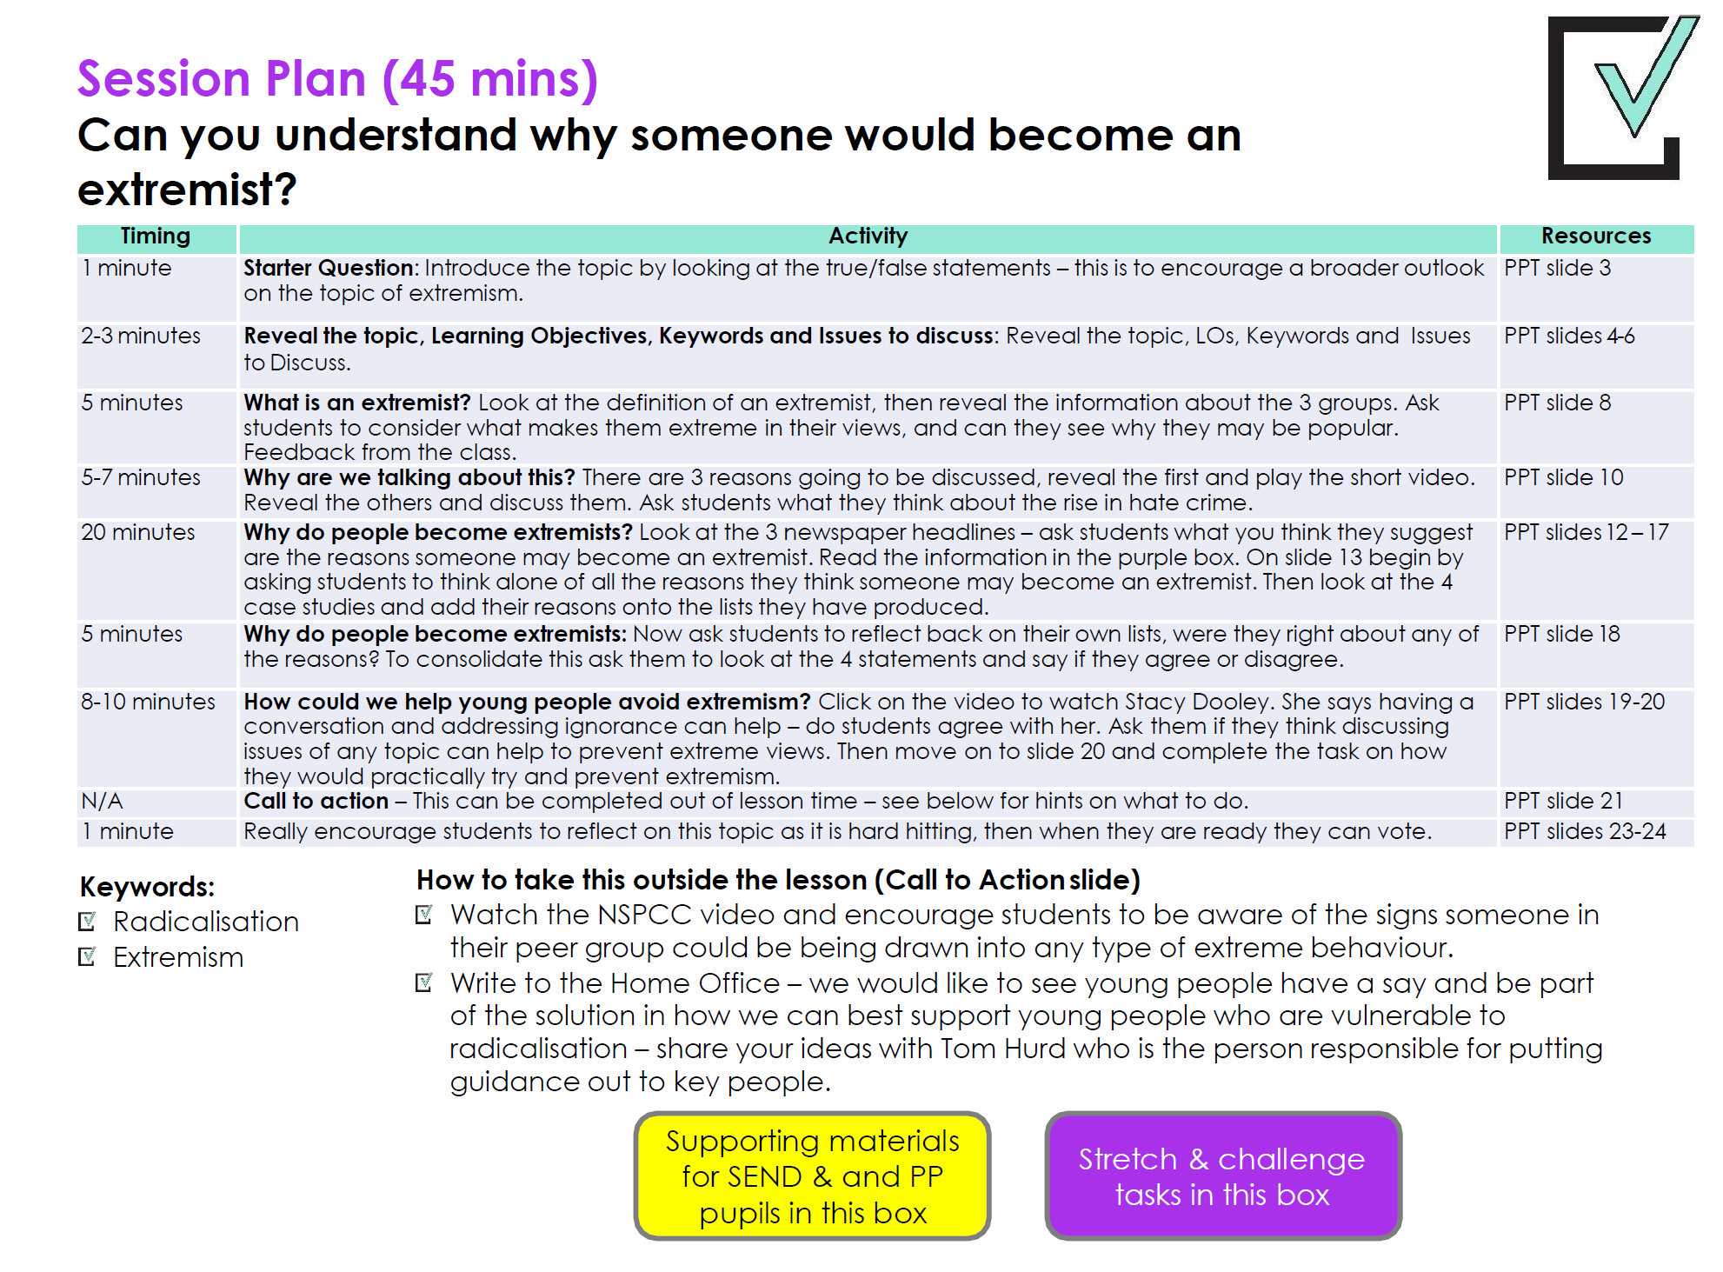
©VotesForSchools2017

Slide 2


Slide 3


Starter:
Individual Activity (3 mins)
Choose true or false for these 5 statements.
Read the stats to help you.
Click to reveal answers.
1. All extremists are Muslims.
2. All extremists are terrorists.
3. Young people are most at risk from extremism.
FALSE
FALSE
TRUE
4. Extremism exists all over the world.
5. Extremist groups use social media to target children.
TRUE
TRUE
1/3 of people reported for extremism in 2016 were white racist extremists¹
Daesh (ISIS) is on Twitter, Facebook, Tumblr, Instagram, YouTube and other social media sites³
91 of 260 people held on suspicion of terrorism in 2016 were white⁴
Most people reported for concerns about extremism are between 15 and 20 years old⁵
©VotesForSchools2017
Notes:
Images:
1-https://blog.lawinfo.com/wp-content/uploads/2013/01/True-or-False-300x300.jpg
References:
1- http://www.independent.co.uk/news/uk/home-news/finsbury-park-attack-far-right-extremist-rise-year-statistics-prevent-terrorism-scheme-referrals-a7798231.html
2- http://www.independent.co.uk/news/uk/home-news/one-three-terror-suspects-white-amid-rise-far-right-extremism-nazi-a7623931.html
3- http://familiesmatter.org.uk/take-action/staying-safe-online/
4- http://www.theweek.co.uk/85826/how-big-a-threat-is-white-extremism
5- https://www.theguardian.com/uk-news/2017/nov/09/only-5-of-people-referred-to-prevent-extremism-scheme-get-specialist-help

Slide 4
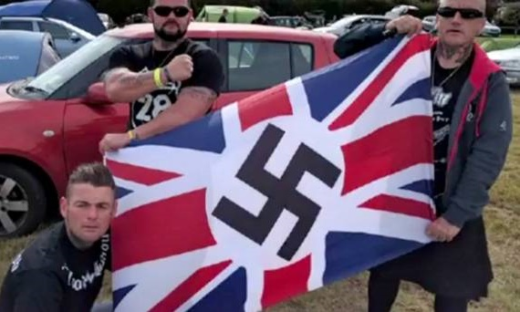
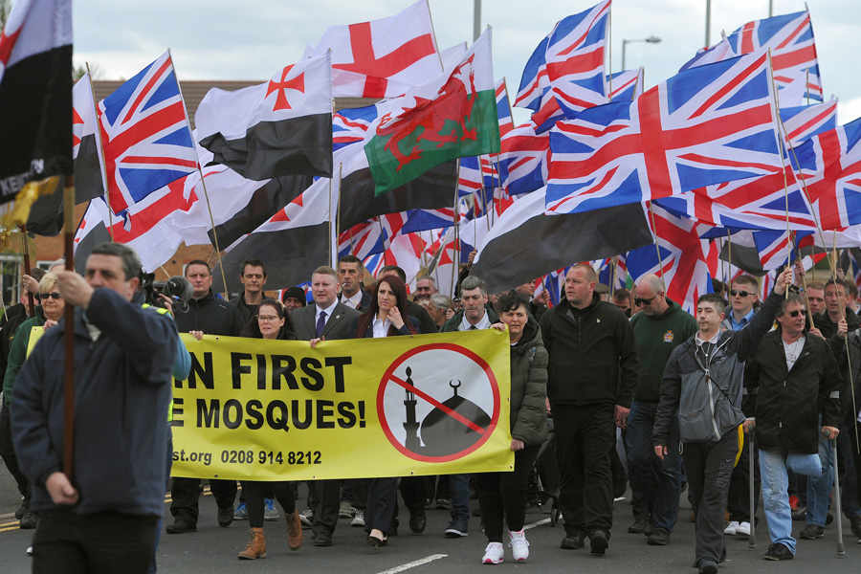
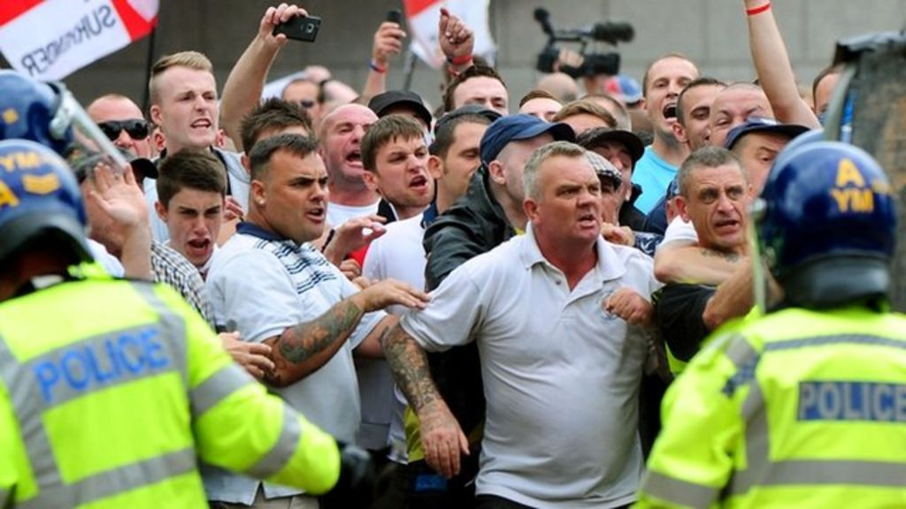
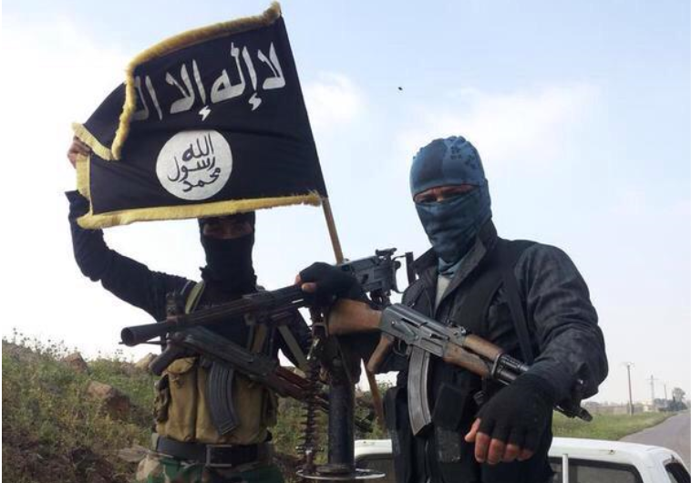
Can you understand why someone would become an extremist?
©VotesForSchools2017
Notes:
Images:
1-https://ichef-1.bbci.co.uk/news/1024/media/images/68860000/jpg/_68860907_68860905.jpg
2- http://cdn.gospelherald.com/data/images/full/17304/isis.png
3 -https://arc-anglerfish-arc2-prod-shropshirestar-mna.s3.amazonaws.com/public/LAVCPVC72RBI3NLWQA6Y7ZXUB4

Slide 5
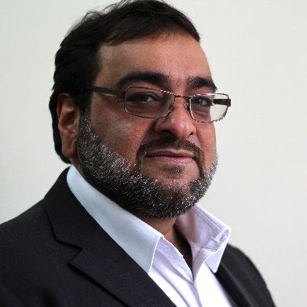

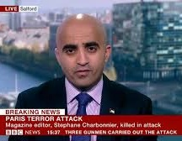
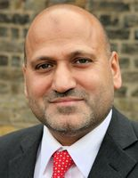
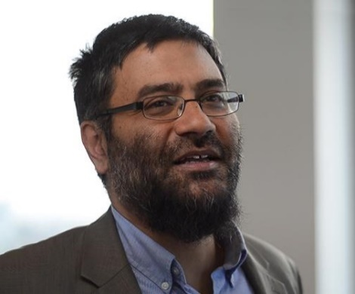

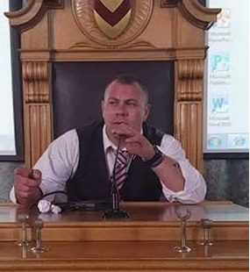
A special VoteTopic
For this week’s VoteTopic we have worked with some fantastic specialists and experts in the field of extremism. We will be holding a live debate with them on Thursday 30th November on this very same question. Check our twitter for updates and tweet your questions live from 2.30pm using the twitter handle @votesforschools.
Hanif Qadir
Co-founder of Active Change Foundation
Mohammed Khaliel
Founder and Director of Islamix
Mohammed Shafiq CEO, Ramadhan Foundation
Nick Daines
Director at Omega Communications
Usama Hasan
Academic and researcher in Islamic studies, Quilliam Foundation
Fiyaz Mughal OBE
Founder of Tell MAMA and Faith Matters
©VotesForSchools2017
Notes:
Images:
1- http://www.theglobepost.com/wp-content/uploads/2017/11/Fiyazmughal.jpg
2- http://islamix.co.uk/wp-content/themes/islamix/images/mohammed.jpg
3- http://www.tonyblairfaithfoundationus.org/sites/default/files/styles/profile_picture/public/Usama_Teaser_0.jpg?itok=l14cQTeB

Slide 6
Learning objectives for today
To understand what extremism is.
To investigate the reasons why someone might become an extremist.
Keywords
Radicalised: the process by which a person becomes increasingly extreme in their views, e.g. someone who is an Islamic extremist has been radicalised.
Extremism: Extremism is the opposition (either through speaking or action) of British values which include democracy, the rule of law, individual liberty, and respect and tolerance for different faiths and beliefs. e.g. an extremist might be someone who wants only white people to live in the UK, standing in opposition to democracy and individual liberty.
For more keywords please see the glossary on slide 26
©VotesForSchools2017
Notes:
Images:
1-
References:
1- Counter Extremism Strategy, October 2015
2- Terrorism Act, 2000

Slide 7
Issues to consider
What is an extremist?
Why are we talking about this?
Why do people become extremists?
How could we help young people avoid extremism?
Call to Action
Vote!
This VoteTopic might be sensitive for some students to discuss, as it covers extremism and terrorism. There are some very helpful websites on the final slide to refer to if you need more information or advice.
©VotesForSchools2017
Notes:
Images:
1-
References:
1-

Slide 8


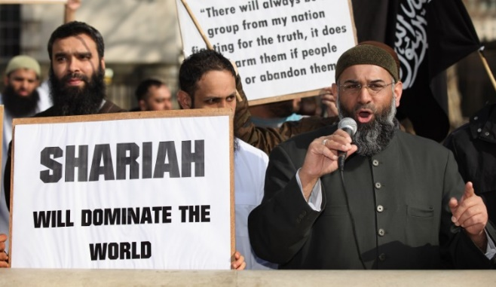
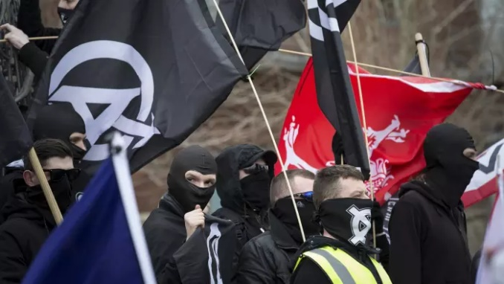
According to the UK government*, extremism is:
“Someone who vocally or actively opposes British values, which include democracy, the rule of law, individual liberty, and respect and tolerance for different faiths and beliefs.”
What is an extremist?
Group activity (3 mins)
Look at these images of different extremist groups in the UK. Have you heard of them before? What do you think makes them extremists? Write on a post-It:
What makes them extreme
Why might some people join these groups?
National Front:
4000 likes on Facebook. Holds marches which target Muslim communities, destroy their property and call for white people to be put first. Members do not recognise non-white people as British.
Islam4UK:
Now banned, the organisation wanted to make Britain an Islamic state and introduce its own version of law, which would go against democracy. Had 500 members.
The National Action:
Calls for Muslims and non-white people to leave the UK. Wants a war between races. Banned in the UK after it asked its members to commit violence against members of the public.
©VotesForSchools2017
Notes:
Images:
http://www.patdollard.com/wp-content/uploads/2016/08/SPLC-Intelligence-Files-Groups-Brotherhood-of-Klans-1280x720_0.jpg
References:
1- https://www.channel4.com/news/edl-far-right-extremism-woolwich-lee-rigby
2- https://www.facebook.com/NFMAINPAGE/
3- https://en.wikipedia.org/wiki/National_Front_(UK)

Slide 9




Issues to consider
What is an extremist?
Why are we talking about this?
Why do people become extremists?
How could we help young people avoid extremism?
Call to Action
Vote!
©VotesForSchools2017
Notes:
Images:
1-
References:
1-

Slide 10
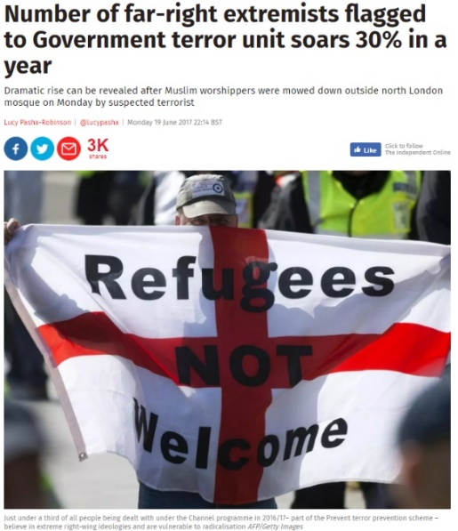
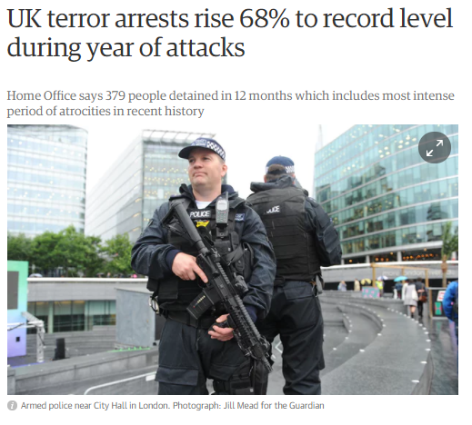

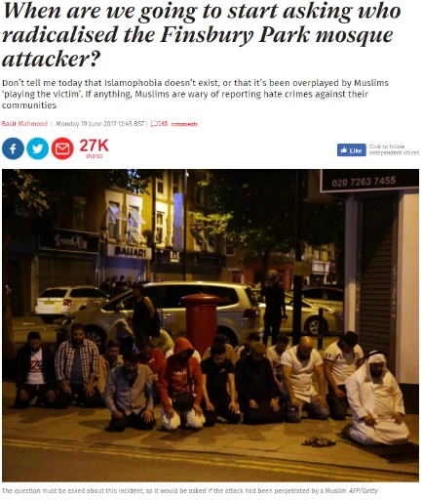
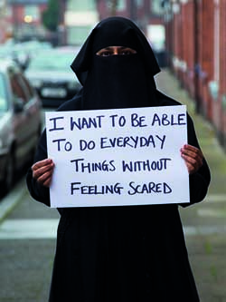
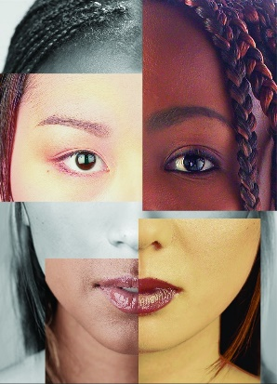
2
Why are we talking about this?
There has been a record number of extremist led terror attacks this year in the UK.
1
Extremism and extremist groups are on the rise in the UK and around the world…
0:00-
0:36
Most committed by Islamic extremists,
Class Activity (1 min)
Click to the image to hear a short clip.
Others by far right extremists…
3
Hate crime over religion and race has also risen dramatically in the UK.
Far right extremists:
People with far right views believe in hierarchy (one group is better than the other) and freedom over equality. A far right extremist takes this to the extreme and often oppresses a group for their race, religion or nationality.
Class Question (2 mins)
Have you noticed a rise in extremism?
Hate crime over religion rose by 35% this year.
78% of hate crimes in 2016/7 were over race.
https://www.pbs.org/newshour/show/u-s-sees-300-violent-attacks-inspired-far-right-every-year
©VotesForSchools2017
Notes:
Images:
1- http://www.museumofman.org/wp-content/uploads/Race-OpeningPostcard-v3-Front.jpg
2- https://www2.le.ac.uk/offices/red/funding/case%20studies
References:
1- https://www.theguardian.com/uk-news/2017/sep/14/uk-terror-arrests-rise-68-record-level-during-year-attacks

Slide 11
Issues to consider
What is an extremist?
Why are we talking about this?
Why do people become extremists?
How could we help young people avoid extremism?
Call to Action
Vote!
©VotesForSchools2017
Notes:
Images:
1-
References:
1-

Slide 12
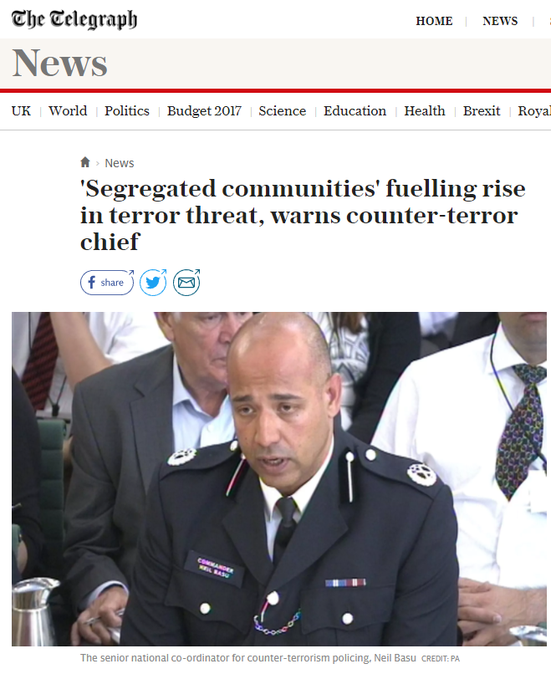
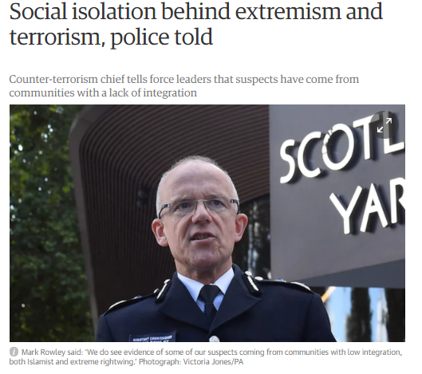
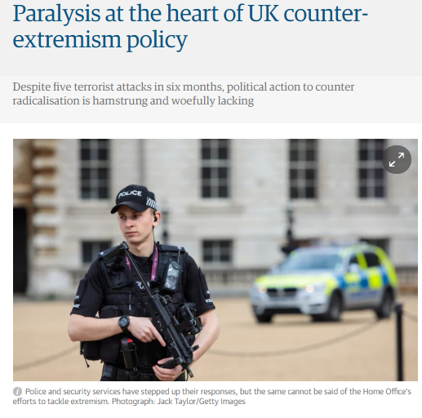
Why do people become extremists?
Pair Question (1 min)
What do these headlines suggest is the reason for people becoming extremists or terrorists?
If something is in paralysis, it means it doesn’t do its job properly.
In 2016, a poll showed that 96% of Britons¹ didn’t think the strategy for tackling extremism was working. What do you think?
There are many different ideas behind why people become extremists, including that they come from communities where there are problems between religious or racial groups, or that extremists were lonely and sad as children. These ideas do not seem to explain every case of extremism. On the next slide, you will explore why people are radicalised and become extremists…
©VotesForSchools2017
Notes:
References:
1- https://www.theguardian.com/uk-news/2017/sep/14/uk-terror-arrests-rise-68-record-level-during-year-attacks
2- http://www.theweek.co.uk/general-election-2017/85311/the-truth-about-the-prevent-counter-terrorism-strategy

Slide 13


Why do people become extremists?
Individual Activity (3 mins)
Before you go to next slides, take a post-It and write down as many reasons as you can think of for why someone might become an extremist e.g. because they are friends with extremists. Put these up somewhere where the whole class can see.
Pair Activity (10 mins)
On the next four slides you will hear different views from extremist experts and extremists themselves, on why people become extremists. For each person, note down the reasons that they give.
©VotesForSchools2017
Notes:
Images:
1- https://cdn.pixabay.com/photo/2015/02/03/15/52/think-622689_960_720.png

Slide 14

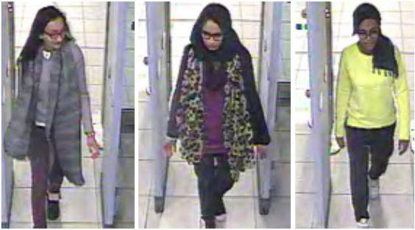
1. Why do people become extremists?
This is Adam Dean. Adam joined the British Islamist extremist group al-Muhajiroun at university but later found that his values and sense of what was right, both for himself and in the eyes of the Islamic faith, conflicted with those around him.
0:42-
3:23
Class Activity (2 mins)
Click the image to watch a video of Adam Dean. Does anything surprise you about him?
850 British people¹ are known to have left the UK to join extremist groups in Syria and Iraq. 100 are women and 50 are under the age of 18, like these three girls who left their school in London to join Islamic State in 2015.
https://youtu.be/LnmBa_lDNAw?t=42
©VotesForSchools2017
Notes:
References:
1- http://www.independent.co.uk/news/uk/home-news/isis-british-jihadis-return-uk-iraq-syria-report-islamic-state-fighters-europe-threat-debate-terror-a8017811.html

Slide 15
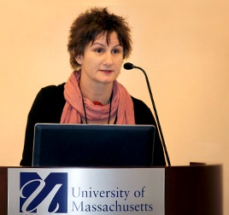
2. Why do people become extremists?
S&C: Do you agree with the reasons Kate Barrelle gives?
“People are often wrong about the reasons why people turn to extremism. People assume that all extremists are poor, badly educated or have mental health problems, when in fact some are very well educated, rich and come across as totally ‘normal’. In fact, there is no pattern of reasons why it happens, but my research shows that people join extremist groups because it offers them a chance to be part of a new social group. It offers an explanation of what is wrong with the world and gives them a clear way of fixing it, which can be very appealing.”
Dr Kate Barrelle studies violent extremism and why people become radicalised.
http://www.bbc.co.uk/programmes/p053w8gs
©VotesForSchools2017
Notes:
*Blake’s name has been changed to protect his identity
Images:
1- http://www.tedxdanubia.com/uploads/Eladok/Hanif_Qadir.jpg
2- http://www.societyforterrorismresearch.org/wp-content/uploads/2015/01/Kate_Barelle.jpg
3 -https://www.elearning.prevent.homeoffice.gov.uk/images/callum-big.png
4- https://www.theguardian.com/uk-news/2017/nov/02/social-isolation-behind-extremism-and-terrorism-police-told
References:
1-

Slide 16

3. Why do people become extremists?
Blake grew up in a divided town where people from different races and religions didn’t mix much. He played football every weekend with older men from the town. They started suggesting Blake meet them in evenings at the pub for secret meetings, which he shouldn’t tell his parents about. This made him feel cool. He had always wanted to go to the pub and hang out with the older guys. At the pub, everyone would talk about what the problems were in the town, which they saw as being the fault of non-White and non-British people. Blake wasn’t sure about what he was hearing at first, but soon it made sense to him that these people were the problem in his town and he could help sort out the issues. He had new friends, a purpose and was keen to join the marches and parties.
Blake*, a 17 year old student, became a far right extremist when he was 16.
©VotesForSchools2017
Notes:
*Blake’s name has been changed to protect his identity
Images:
1- http://www.tedxdanubia.com/uploads/Eladok/Hanif_Qadir.jpg
2- http://www.societyforterrorismresearch.org/wp-content/uploads/2015/01/Kate_Barelle.jpg
3 -https://www.elearning.prevent.homeoffice.gov.uk/images/callum-big.png
4-
References:
1-

Slide 17

4. Why do people become extremists?
Class Activity (2 mins)
Click the image to hear what Hanif thinks are the reasons for extremism.
0:00-
2:08
http://viewpure.com/p_45u3JH-nE?start=0&end=0
©VotesForSchools2017

Slide 18



Why do people become extremists?
Class Reflection (3 mins)
Look back at your post-Its. Were you right about why people become extremists?
1. Extremists are certain types of people with specific problems.
2. People become extremists because older people offer them answers to problems they have with themselves and the world.
3. Vulnerable young people don’t always know what they are getting in to.
Pair Activity (5 mins)
Read the statements. Decide if you agree or not. Give a reason why.
4. Extremism happens when someone is angry or thinks something is unjust/unfair.
Vulnerable:
If someone is vulnerable it means they are more likely to be harmed either physically or emotionally.
Shabazz
Dr Kate Barrelle
Blake
Hanif Qadir
©VotesForSchools2017

Slide 19
Issues to consider
What is an extremist?
Why are we talking about this?
Why do people become extremists?
How could we help young people avoid extremism?
Call to Action
Vote!
©VotesForSchools2017
Notes:
Images:
1-
References:
1-

Slide 20

How could we help young people avoid extremism?
0:00-
1:26
Class Activity (2 mins)
Click the image to watch a short video.
Stacey says that it is ignorance which causes extremism in her town. If people would only take the time to listen to each other's views and opinions about why they have the problems they have, then less people would have extremist views. Do you agree with her?
Ignorance:
Lack of knowledge or information about a person or situation.
Class Question (1 min)
Do you think discussing topics such as gender, race, news and politics in the class can help prevent extremism?
http://viewpure.com/ooMVxiBm61g?start=0&end=86
©VotesForSchools2017

Slide 21
How could we help young people avoid extremism?
Group Activity (5 mins)
Pick one of the causes of extremism below (or your own). Decide how it could be changed to help prevent extremism. Look a the clues to help! Present your ideas to the class.
S&C: Whose job is it to prevent extremism? Parents? Communities? Government? Teachers?
The cause of extremism we have focused on is……….....................................
We propose……………………………….. ……………………………………………… because……………………………..
No friends at school/bullied.
Divided communities along racial or religious lines.
Looking at extreme online content via social media.
Having parents with extreme views.
Why might this make someone more vulnerable to extremism?
What could be done about it?
How will you know if this person has extreme views if no-one spends time with them?
What can be done for a young person who is surrounded by people with extreme views?
What subjects would help this young person at school to become more tolerant?
Why might this make someone more vulnerable to extremism?
Could you organise an event that encourages people from different backgrounds to spend time together?
Should someone check what you are looking at online?
Does everyone in your school know how to stay safe online?
Should your parents know what you look at on social media?
©VotesForSchools2017

Slide 22

Call to action
SCHOOL
Think about:
How would you know if your friend at school was being radicalised or had extremist views? Watch the video from the NSPCC which might help you think of some ideas. Do you think discussing the news in class would help you see if someone had extreme views?
0:00-
1:26
Click to watch a video about possible warning signs.
http://viewpure.com/VOis5CFU8vs?ref=search
©VotesForSchools2017
Notes:
Image Sources
1-https://02varvara.files.wordpress.com/2011/06/01-writing-a-letter.jpg
2- https://www.nspcc.org.uk/what-you-can-do/report-abuse/dedicated-helplines/protecting-children-from-radicalisation/
3- http://moziru.com/images/pen-clipart-cartoon-14.png
4- https://assets.publishing.service.gov.uk/government/uploads/system/uploads/person/image/2709/s216_tom_hurd.jpg

Slide 23

Can you understand why someone would become an extremist?
No
NO
I cannot understand why someone would want to hurt or discriminate against someone else under any circumstances.
Everyone is capable of having an “extreme” thought but most people can deal with them responsibly without hurting others.
I think individuals need to take responsibility for their own actions and thoughts and they should know how to be tolerant, accepting and respectful towards all others.
Everyone is capable of living a life without extremist views and I think people are strong enough to say no to extremist views and people.
Not everyone who is exposed to extremist views becomes an extremist, proving that becoming extreme is a conscious choice.
©VotesForSchools2017

Slide 24
Can you understand why someone would become an extremist?
Yes
YES
Young people can become radicalised online and in person by people who are taking advantage of the fact that they are vulnerable.
People who belong to extremist groups try to recruit young people by giving them a social life and secrets to keep which entices them to join groups that they might not really know the meaning of until it’s too late.
Extremist groups offer many people who are upset with something about the world, a chance to “fix” it and stop bad things happening to them.
Extremist groups exploit young people by finding their weaknesses and offering them solutions to their problems so I can see why it would appeal to some people.
Extremism encourages people to blame their problems on others, which can be tempting when things aren’t going well for you.
©VotesForSchools2017

Slide 25



Vote Now on… www.votesforschools.com
If you need further advice or information on the sensitive issues covered in this week’s VoteTopic, you can look at these websites:
Families Against Stress and Trauma (FAST), provide support to vulnerable families and individuals whose lives have been affected by the trauma of losing loved ones to hateful ideologies and groups.
NSPCC gives advice for adults worried about a child becoming radicalised.
Q&A on radicalisation from DfE website Educate Against Hate.
What is Prevent?
Government policy on counter-extremism
©VotesForSchools2017
Notes:
Families Against Stress and Trauma (FAST)
https://www.nspcc.org.uk/what-you-can-do/report-abuse/dedicated-helplines/protecting-children-from-radicalisation/
https://educateagainsthate.com/parents/what-are-the-warning-signs/

Slide 26
Glossary of Key Terms:
British values: These are the standards of behaviour that all British people are expected to respect and follow, including democracy, the rule of law, individual liberty, mutual respect, tolerance of those of different faiths and beliefs.
Extremism: Extremism is the opposition (either through speaking or action) of British values which include democracy, the rule of law, individual liberty, and respect and tolerance for different faiths and beliefs. e.g. an extremist might be someone who wants only white people to live in the UK, standing in opposition to democracy and individual liberty.
Extremist: Someone with views that oppose British values.
Far right extremist: People with far right views believe in hierarchy (one group is better than the other) and freedom over equality. A far right extremist takes this to the extreme and often oppresses a group for their race, religion or nationality, opposing British values.
Islamic Extremism: Any form of Islam that opposes democracy, the rule of law, individual liberty and mutual respect and tolerance of different faiths and beliefs.
Radicalised: The process by which a person becomes increasingly extreme in their views, e.g. someone who is an Islamic extremist has been radicalised.
Terrorism: The unlawful use of violence and intimidation, especially against civilians, in the pursuit of political aims.
©VotesForSchools2017

