Slide 1


Slide 2
Pause II
And Think!

Slide 3
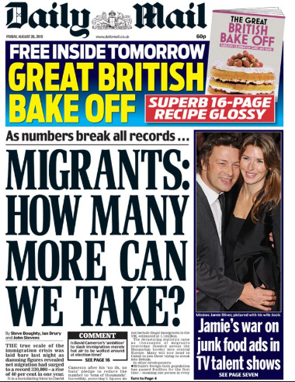
Notes:
Show yours students the next 5 slides. Ask them to make a note of their key impressions from the newspaper headlines. Ask them not to discuss with other people at this point.

Slide 4


Slide 5
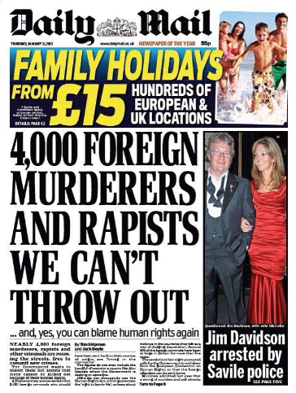

Slide 6
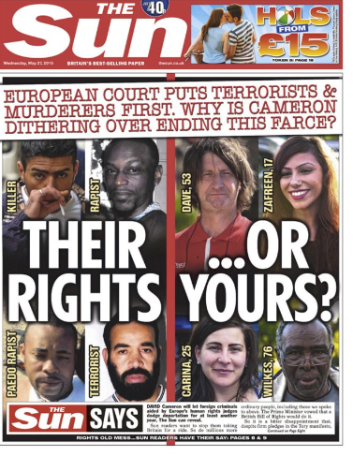

Slide 7
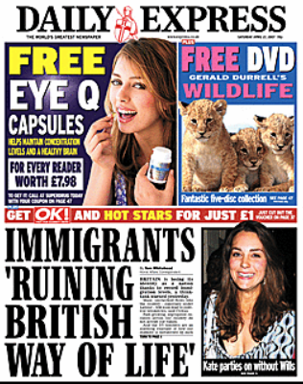

Slide 8
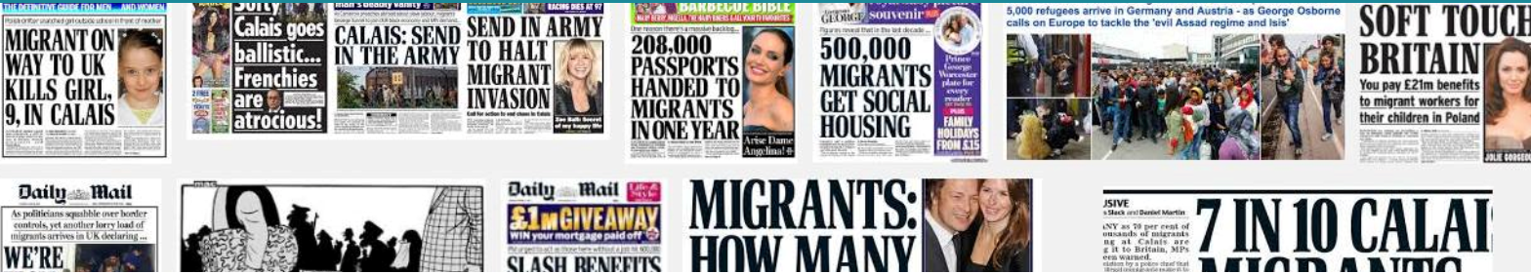
History has shown us time and again the dangers of demonising migrants and minorities
UN High Commissioner for Human Rights, 2015
After what it called “decades of sustained and unrestrained anti-foreigner abuse, misinformation and distortion”, in 2015 the United Nations accused some British newspapers of “hate speech”. UK experts are now warning that hate crime is being “fuelled and legitimised” by the media.
Notes:
Show the students the slide with the statement from the UN High Commissioner.

Slide 9
Watch the short video
Pause II And Think

Slide 10
Working in pairs discuss
Discuss the issues behind the headlines
Are the headlines accurate?
Do you usually believe what you read in a newspaper on online?
Would you now question what is presented to you?

Slide 11
Think! Before you Click

Slide 12

If you saw this story online would you ‘like’ it?
Notes:
Work through the following slides with your students – ask them to indicate which slides they would ‘like’ and which they wouldn’t. You could use post-its or a tally chart to collect the information or make an interactive quiz.

Slide 13
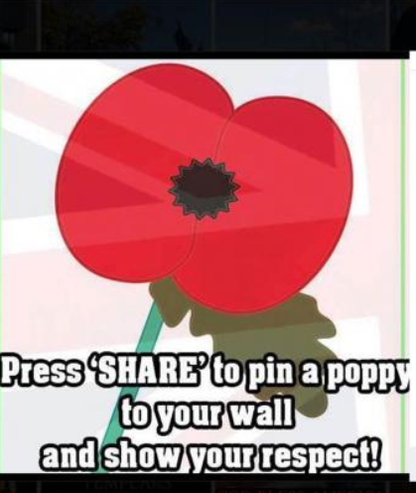

Slide 14
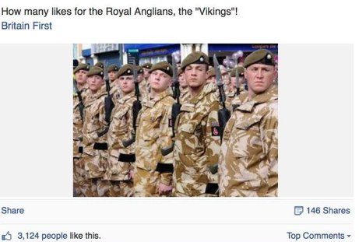

Slide 15


Slide 16
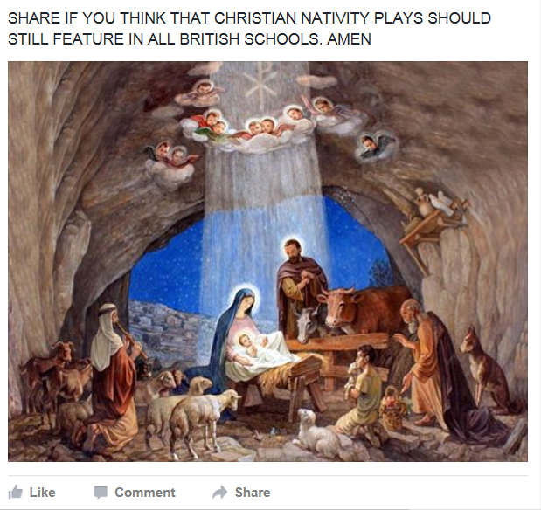

Slide 17
Pause II
And Think!
Notes:
Now stop, pause and think – look at the following slides carefully. Take a moment to note key observations and re-visit the ‘like’ activity.

Slide 18
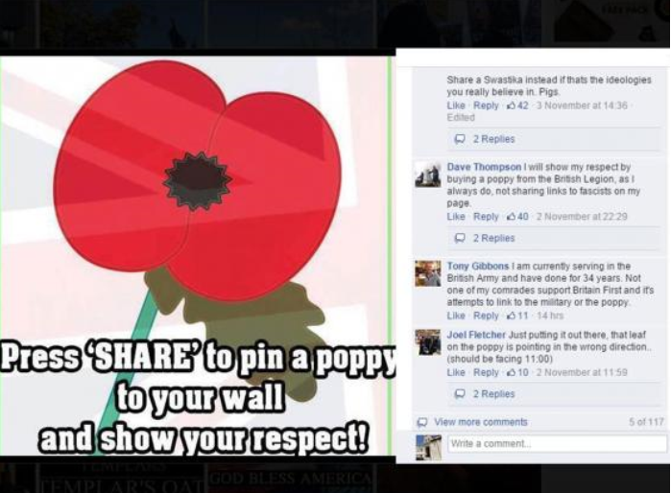

Slide 19
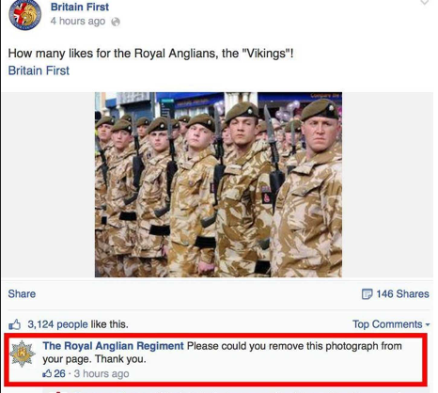

Slide 20
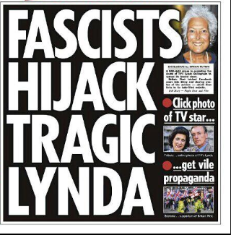

Slide 21
Would you re-think your likes?
II

Slide 22
Who are Britain First?
Britain First is a far-right and British nationalist political party and movement formed in 2011 by former members of the British National Party (BNP). The party was founded by Jim Dowson, an anti-abortion campaigner linked to Ulster loyalist groups in Northern Ireland. Its leader is former BNP councillor Paul Golding.

Slide 23
Re-watch the video
Pause before you click

Slide 24
Activity
What have you learnt about Social Media?
Have you ever ‘liked’ something without checking its origin?
How is social media used by right-wing extremist groups to target people?
How would you behave differently given the information you’ve seen in both activities?
Notes:
As a group discuss the following questions.

