Slide 1
Thank you for downloading this resource pack which contains slides to facilitate 17 sessions covering the following themes:
London Identity
E-Safety
Bullying
Discrimination
Exploitation
Hate crime
Cults and extremism
Sex and the media
Abuse and relationships
Teachers are encouraged to review the slides, notes and videos in advance of each session to ensure they are comfortable with the themes and potential questions that might arise.

Slide 2
Week 1 Session 1: London Identity

Slide 3
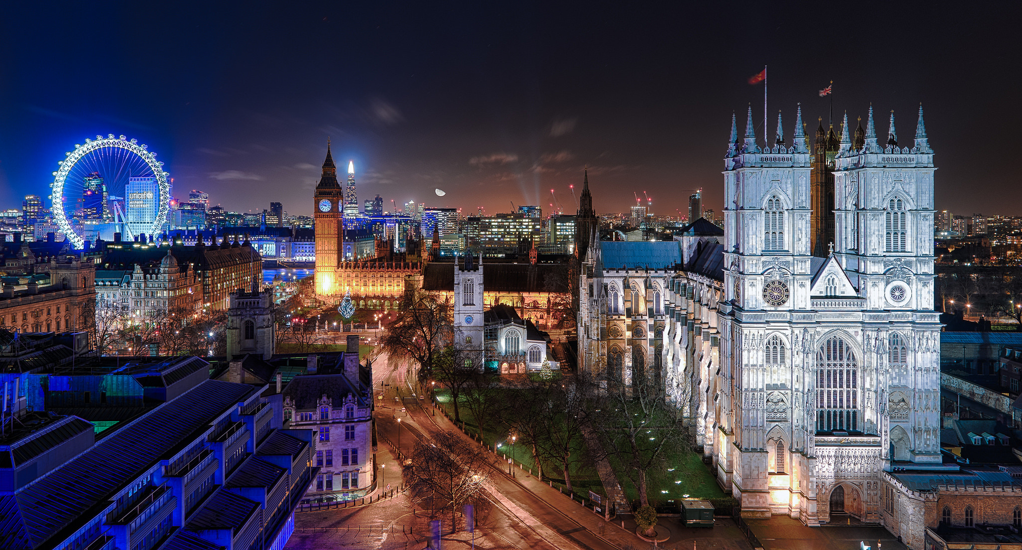
What do you think of London?
List 5 words you think of when you think of London and stick them on the board.
Are these mainly positive or negative?
Notes:
Session 1

Slide 4
How might living in London shape young people’s identity?
Activity: Rank the factors in terms of how much they might affect your identity. You must be able to justify each choice!
5 – Most important
4
3
2
1 – Least Important
Notes:
Students discuss statements on factors using continuum of opinion most important / least important. It is recommended that teachers provide children with A3 version continuum for children to place cards on. Children should be reminded that they can place multiple cards in each position.

Slide 5
Is ‘Londoner’ a positive identity for young people?
Activity: Sort the statements into positive / negative / both
Positive
Negative
Both
Challenge: Look at any negatives. What, if anything, could be done to reduce the negatives or turn them into positives? Who would be responsible for this?
Notes:
Optional activity to use with card sort: In order to encourage a critical, questioning stance when considering identity, children may also be invited to explore whether a young London identity is a positive one to hold. Arguments on cards (or children’s own arguments) can be sorted onto Venn diagram to support judgements about the extent to which London identity might be a positive one to hold.

Slide 6
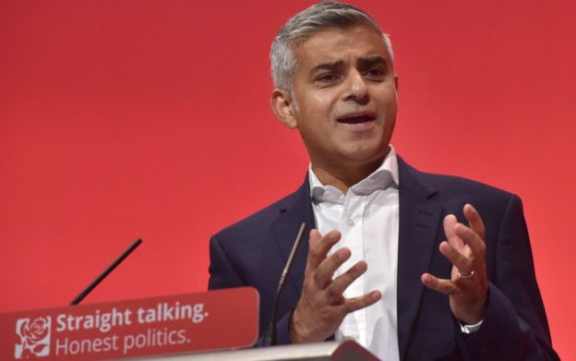
How might living in London shape young people’s identity?
As a class were we negative or positive about living in London?
Imagine you were the mayor of London. What would you like to do to make London a better place to live in?
I would…

