Slide 1
Thank you for downloading this resource pack which contains slides to facilitate 17 sessions covering the following themes:
London Identity
E-Safety
Bullying
Discrimination
Exploitation
Hate crime
Cults and extremism
Sex and the media
Abuse and relationships
Teachers are encouraged to review the slides, notes and videos in advance of each session to ensure they are comfortable with the themes and potential questions that might arise.

Slide 2
Week 1 Session 2: Staying safe in society

Slide 3
What things are concerning about living in London?
Notes:
Session 2

Slide 4
How safe is it being a teenager in London?
How do these headlines make you feel?
Notes:
If students are worried about acid attacks it might be worth mentioning that life sentences can now be given for these. See article below
https://www.theguardian.com/world/2017/aug/04/people-who-carry-out-life-changing-acid-attacks-face-life-sentences

Slide 5
Mark on the sheets how you would judge yourself to feel about each of the following issues.
Gang violence
Robbery
Acid attacks
Terrorism
Hate crimes
Not at all concerned
Very concerned

Slide 6
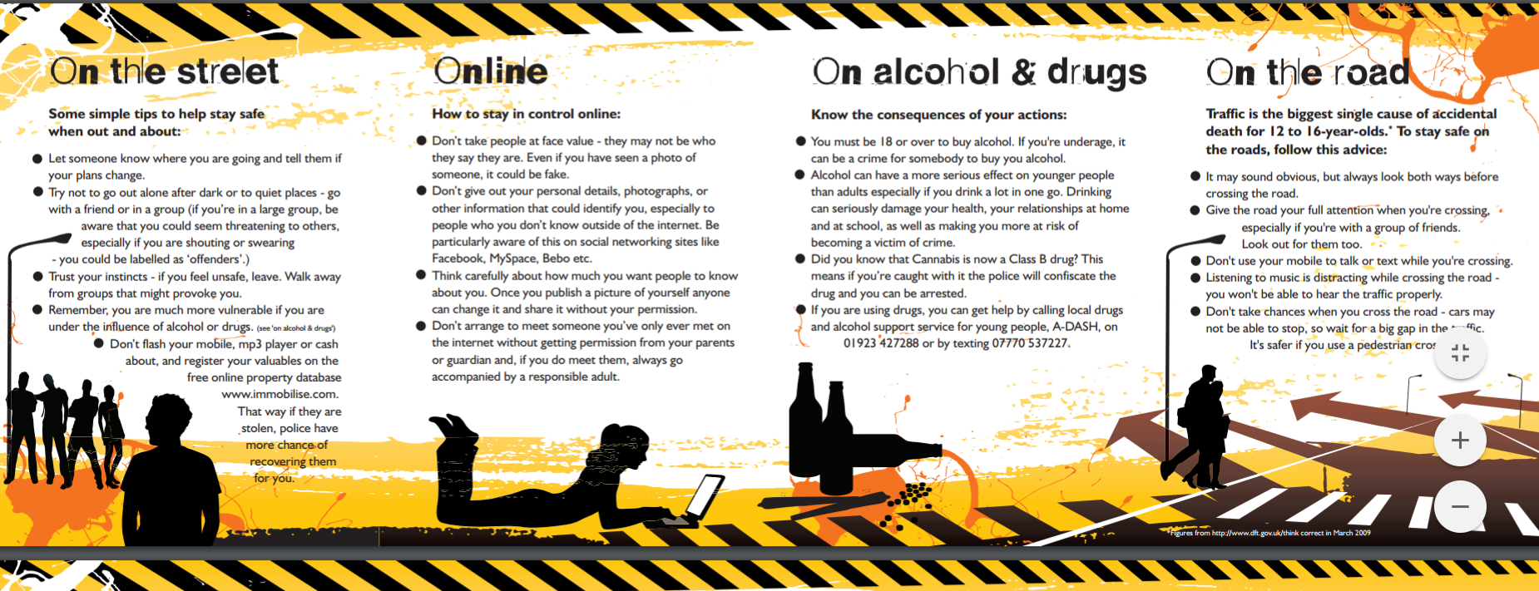
What can you do to stay safe?
Read the police leaflet.
Think of 3 pieces of advice you would give to someone in year 7
Is this good advice?
What else could you add?
Notes:
https://www.herts.police.uk/pdf/young_people_staying_safe.pdf
https://www.herts.police.uk/pdf/young_people_think_b4_u_act.pdf

Slide 7
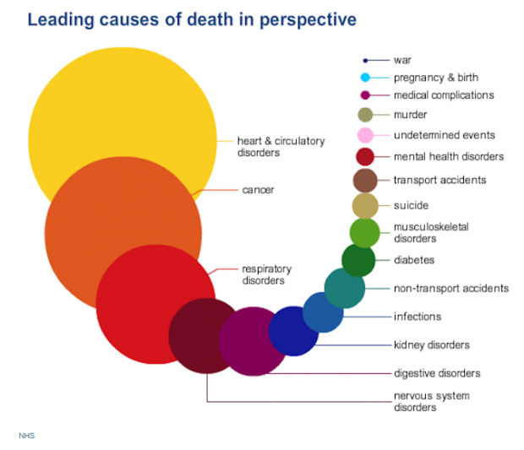
Whilst we need to be aware of potential dangers, we should keep them in perspective. There’s a difference between being aware and alarmed
Click on the infographic for the article
This shows the leading causes of death in the UK.
We live in one of the safest countries in the world
Notes:
If students want to see numbers of people killed by terrorism in perspective then follow this link: http://www.telegraph.co.uk/news/0/many-people-killed-terrorist-attacks-uk/

