Slide 1
Thank you for downloading this resource pack which contains slides to facilitate 17 sessions covering the following themes:
London Identity
E-Safety
Bullying
Discrimination
Exploitation
Hate crime
Cults and extremism
Sex and the media
Abuse and relationships
Teachers are encouraged to review the slides, notes and videos in advance of each session to ensure they are comfortable with the themes and potential questions that might arise.

Slide 2
Week 2 Session 1: Staying safe in school

Slide 3
A schools most important duty is to keep its students safe.
You can find out about some of the things we do at GSAS on our website

Slide 4
In pairs write a definition of bullying
How does it compare to the Tower Hamlets definition?
Bullying can be defined as a physical, psychological or verbal attack against an individual or group of individuals by a person or group of persons, causing physical or psychological harm to the victim.
It is usually conscious and wilful and commonly consists of repeated acts of aggression and/or manipulation. It can take a number of forms - both physical and non-physical, either in combination or in isolation.

Slide 5
What issues, if any, do you think some students might be concerned about in school?
Physical bullying
Psychological
Cyber-bullying
Exclusion
Other
Not at all concerned
Very concerned
Notes:
For discussion. Add more if you like or ask for other (give details)

Slide 6
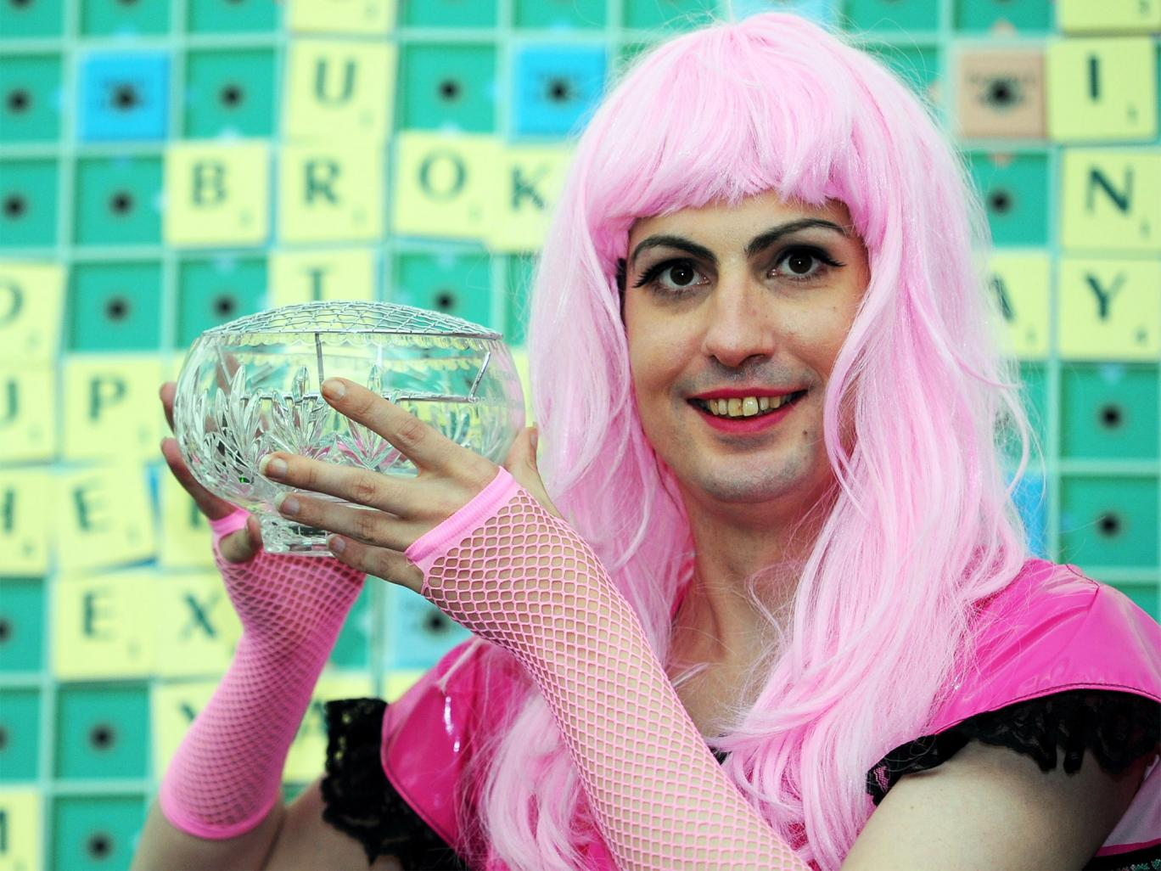
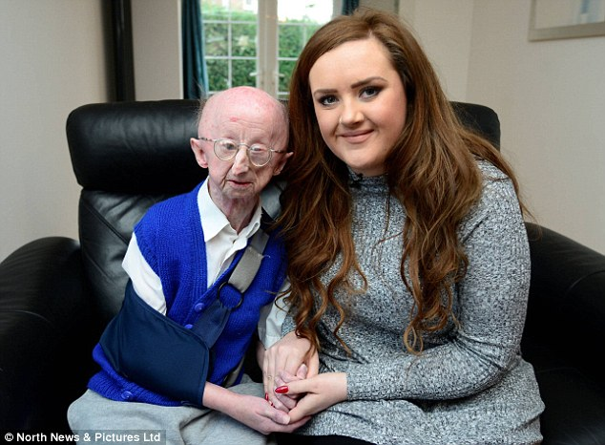
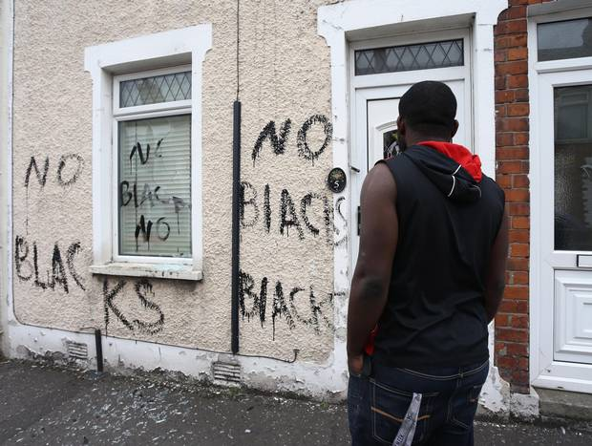
Why do you think each of the following people were discriminated against?
Notes:
All were victims of hate crime
http://www.independent.co.uk/news/uk/home-news/transgender-woman-killed-herself-after-being-taunted-in-street-for-being-different-court-hears-10193390.html
http://www.independent.co.uk/news/uk/home-news/teenager-wearing-hijab-knocked-unconscious-demonstrates-rise-in-hate-crime-in-london-10489930.html
http://www.dailymail.co.uk/news/article-2991352/Alan-Barnes-attacker-told-assault-classed-disability-hate-crime.html
http://www.belfasttelegraph.co.uk/news/northern-ireland/race-hate-unit-arrests-84-suspects-in-northern-ireland-30968281.html

Slide 7
If you witnessed hate in the school what would you do?
Why might some people keep things they witness to themselves?
What could we as a school do to encourage people to speak out against bullying/hate?
Think of 2-3 things and stick them on the board

