Slide 1
Thank you for downloading this resource pack which contains slides to facilitate 17 sessions covering the following themes:
London Identity
E-Safety
Bullying
Discrimination
Exploitation
Hate crime
Cults and extremism
Sex and the media
Abuse and relationships
Teachers are encouraged to review the slides, notes and videos in advance of each session to ensure they are comfortable with the themes and potential questions that might arise.

Slide 2
Week 2 Session 2: Staying safe online

Slide 3
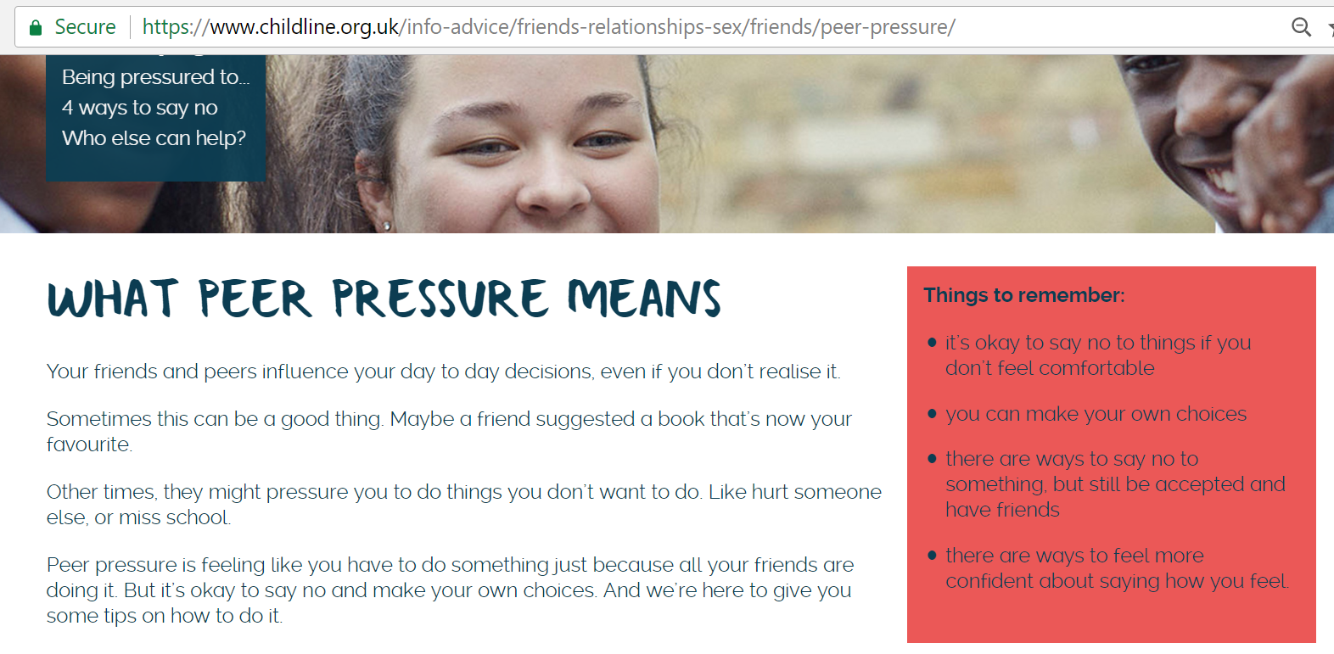
In pairs: what does the term peer pressure mean?
Now think of a time you felt you were pressured into doing something you didn’t want to
Notes:
https://www.childline.org.uk/info-advice/friends-relationships-sex/friends/peer-pressure/

Slide 4
The following video shows dangers of peer pressure. In this instance it’s from someone online.
https://www.youtube.com/watch?v=47ficaYb2wk

Slide 5
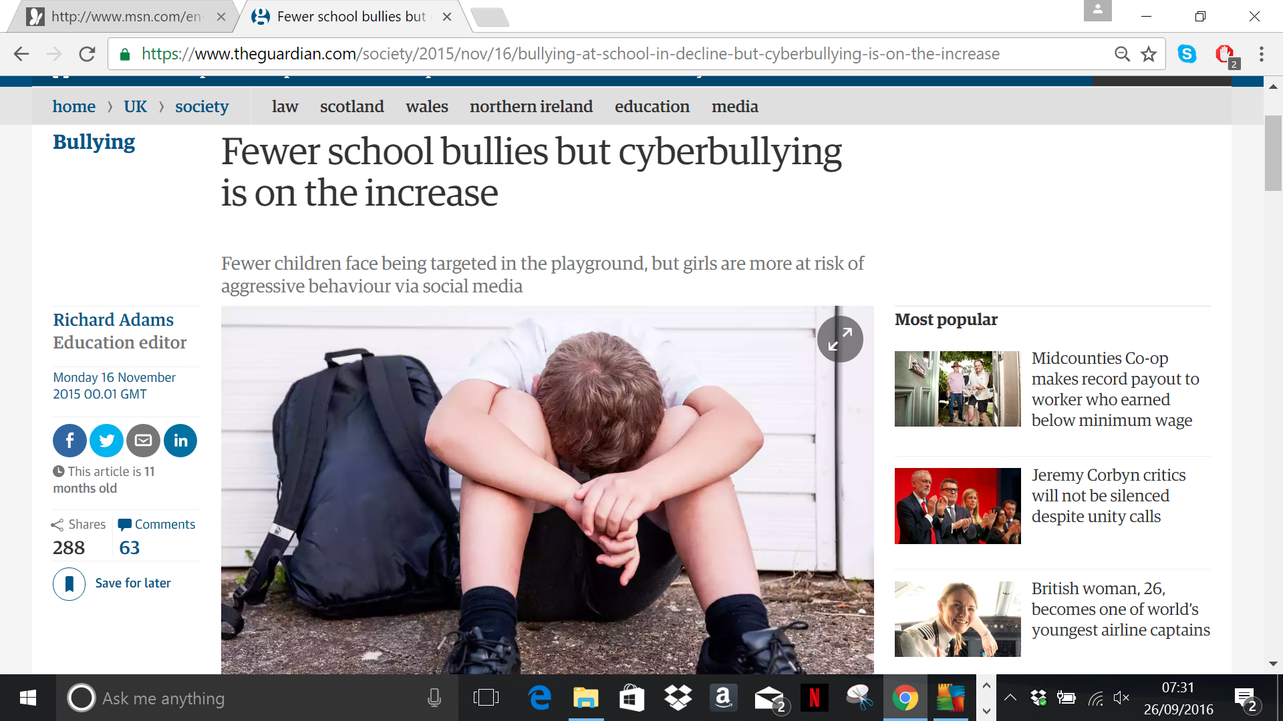

Slide 6
What was the most important piece of information?
Who could you turn to in school if you felt pressured

