Slide 1
Thank you for downloading this resource pack which contains slides to facilitate 17 sessions covering the following themes:
London Identity
E-Safety
Bullying
Discrimination
Exploitation
Hate crime
Cults and extremism
Sex and the media
Abuse and relationships
Teachers are encouraged to review the slides, notes and videos in advance of each session to ensure they are comfortable with the themes and potential questions that might arise.

Slide 2
Week 2 Session 3: Prejudice and Discrimination

Slide 3

If you had to describe yourself in 5 words what would they be?

Slide 4
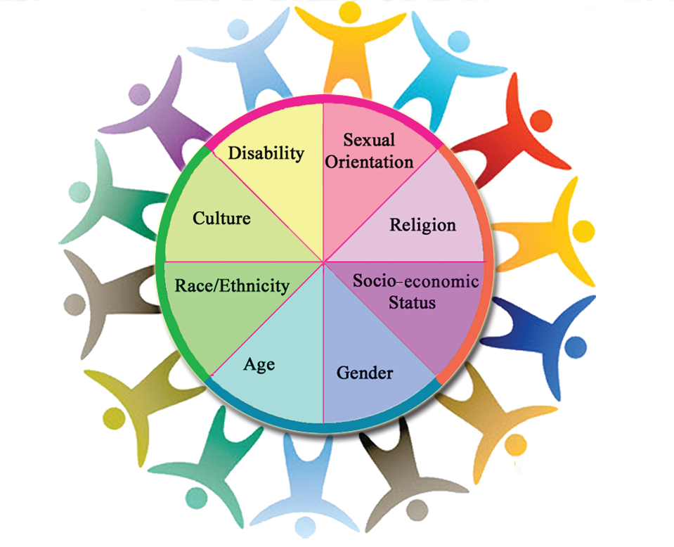
We are all unique.
Could any of the things you wrote to describe yourself be a reason for you to be treated differently?

Slide 5
What do the following words mean?
Prejudice
Prejudice is when you pre-judge someone or a group of people.
Stereotype
Stereotypes are a commonly held public belief about specific social groups or types of individuals. This can be done through the simplified representation of character, appearances and beliefs.
Discrimination
Discrimination is when you act on a prejudice. It’s treating someone or a group of people in a different way because of who they are.
In pairs: Can you think of an example for each?

Slide 6

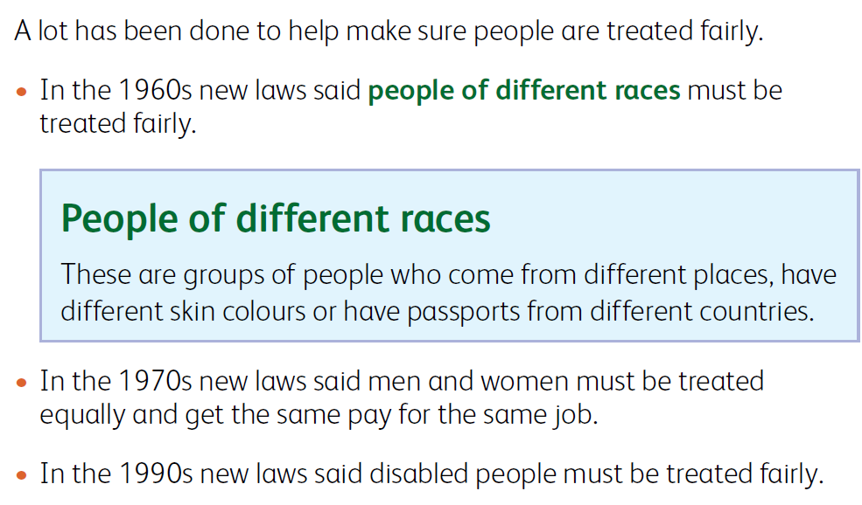
By law you can be any religion you like, you can change faith, or you can be agnostic or atheist. It’s against the law to treat people differently because of their beliefs.

Slide 7
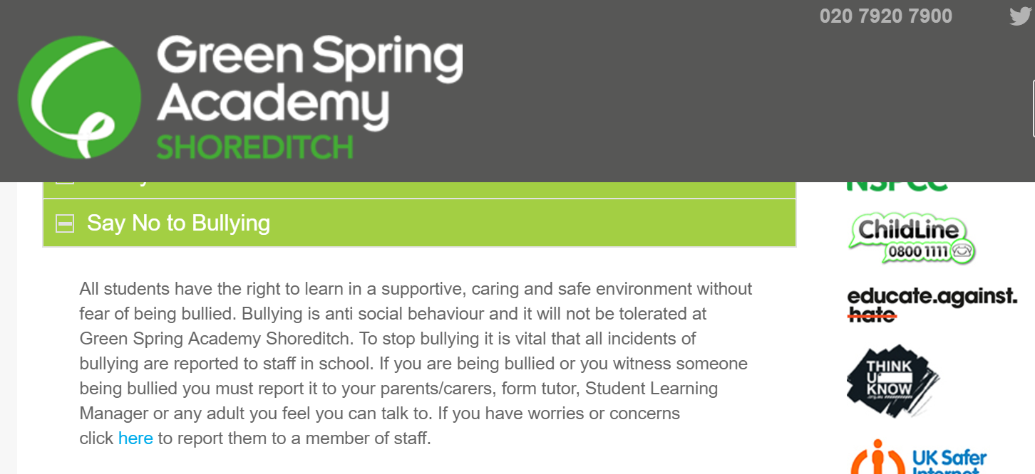
At GSAS we recognise that we are all different and that diversity is something to be celebrated.

