Slide 1
Thank you for downloading this resource pack which contains slides to facilitate 17 sessions covering the following themes:
London Identity
E-Safety
Bullying
Discrimination
Exploitation
Hate crime
Cults and extremism
Sex and the media
Abuse and relationships
Teachers are encouraged to review the slides, notes and videos in advance of each session to ensure they are comfortable with the themes and potential questions that might arise.

Slide 2
Week 3 Session 1: Hate crime

Slide 3
What is hate crime?
Hate crime is defined as ‘any criminal offence which is perceived, by the victim or any other person, to be motivated by hostility or prejudice towards someone based on a personal characteristic.’
Which do you think is the biggest cause of hate crime?

Slide 4
Can you see anything wrong with this?
Notes:
The problem is that the numbers add up to more than 100%. This is because many hate crimes are not just commited for one reason alone. E.g. someone might commit a crime for racist and Islamophobic motivation

Slide 5
Is this offensive?
Why do you think a Jewish comedian created this?
Notes:
Choose either this video or the next.
Obviously Sacha Baron Cohen, who plays Borat, is taking using this to ridicule those who have anti-Semitic views. However when the film came out I do remember students being offended as they didn’t realise this.

Slide 6
Is this offensive?
Why do you think Muslim comedians created this?

Slide 7
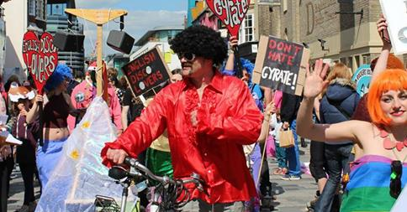
For discussion:
Is humour a good way to respond to bigotry?
The English Disco Lovers mock the EDL and now have more ‘likes’ on Facebook.
Whenever the EDL turned up to march. The English Disco Lovers would also turn up start dancing to disco music
Notes:
No obvious answer. You might want to bring up some other famous humorous protests too.

Slide 8
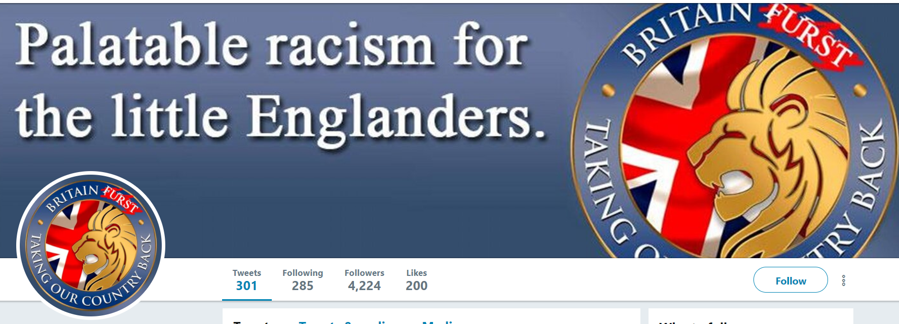
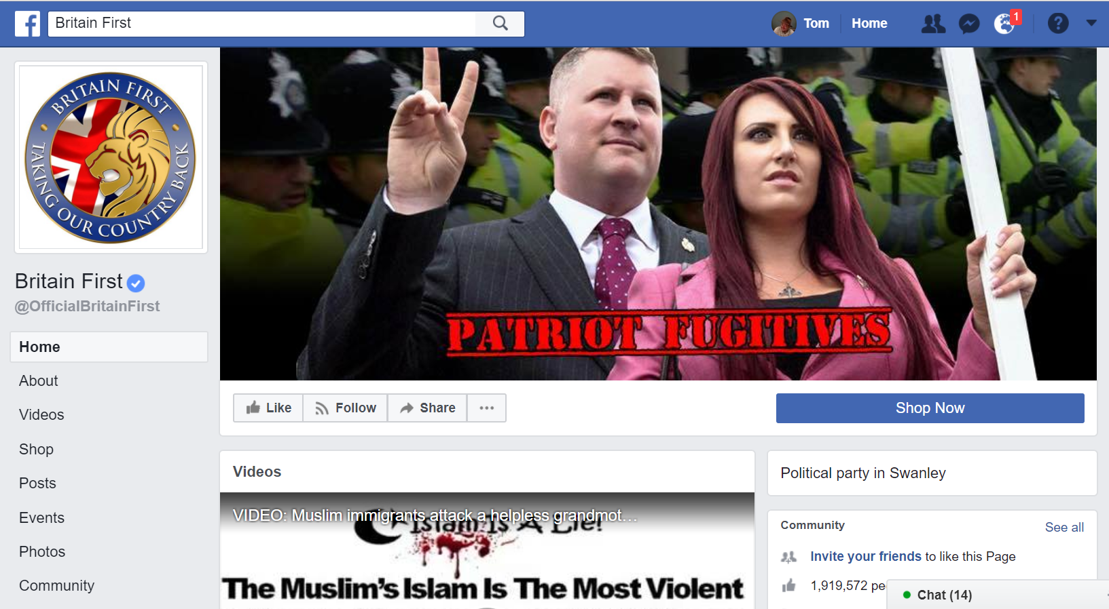
Because of this groups like Britain Furst were created. They have deliberately spelt their name wrong to highlight the fact that a lot of Britain First posts contain spelling mistakes.
They put up fake articles that are similar in tone to those of BF.
Britain First are known for their far-right views and Islamophobia. They post a lot on social media.

