Slide 1
Thank you for downloading this resource pack which contains slides to facilitate 17 sessions covering the following themes:
London Identity
E-Safety
Bullying
Discrimination
Exploitation
Hate crime
Cults and extremism
Sex and the media
Abuse and relationships
Teachers are encouraged to review the slides, notes and videos in advance of each session to ensure they are comfortable with the themes and potential questions that might arise.

Slide 2
Week 3 Session 2: What to do if others are being exploited

Slide 3
This half-term we have looked at issues to do with safety.
Discuss in pairs:
What do you think being an upstander means?

Slide 4
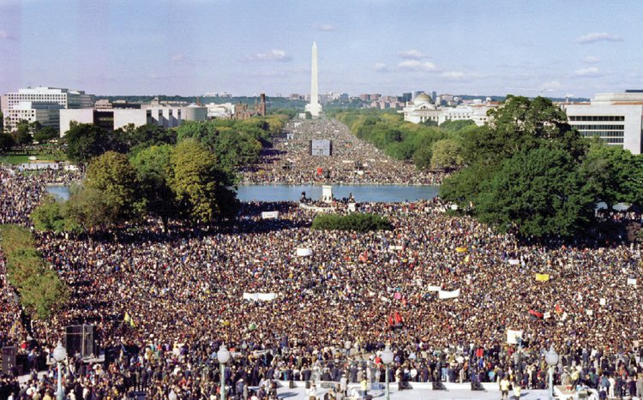
This photo shows the ‘Million Man March.’ This is where Martin Luther King gave his ‘I Have a Dream Speech’ in Washington.
Who is this person?
How much of the speech do you think they could hear?

Slide 5
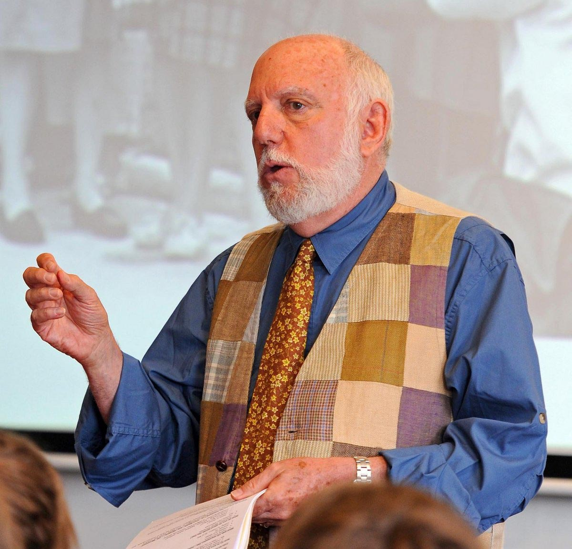
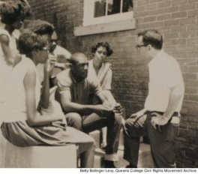
One man who was there was a teacher called Mark Levy.
He couldn’t hear the speech from Martin Luther King where he was standing.
He didn’t mind he that he couldn’t hear all the words. He still agreed with the message.
Mark Levy (far right) talking with high school students outside the Meridian Freedom School in the summer of 1964

Slide 6
Mark Levy volunteered and worked at the first Freedom School in America in 1964.
Freedom Schools were temporary, free schools for African Americans. They were part of a nationwide effort during the Civil Rights Movement to achieve equality in the United States.
Volunteers like Mark went and taught in these schools for free and taught black children things they’ hadn’t been allowed to be taught before.
They did this because they wanted to make the world a better and fairer place.

Slide 7
Mark was a huge fan of Martin Luther King Jr but he has an important message for us all.
The message is that there is still injustice in the world.
We all have a responsibility to stand up and fight for justice.
People like Martin Luther King were inspiring and hugely important.
BUT
So are ordinary people like Mark and the millions of others who supported equal rights.
On his own Martin Luther King would not have achieved equal rights for black people. The millions who supported him were also hugely important.

Slide 8
As a school what can we do to encourage people to be upstanders?

Slide 9
We must all stand up for equal rights and each other. Its up to all of us to be upstanders.
Be like these people!

