Slide 1
Thank you for downloading this resource pack which contains slides to facilitate 17 sessions covering the following themes:
London Identity
E-Safety
Bullying
Discrimination
Exploitation
Hate crime
Cults and extremism
Sex and the media
Abuse and relationships
Teachers are encouraged to review the slides, notes and videos in advance of each session to ensure they are comfortable with the themes and potential questions that might arise.

Slide 2
Week 4 Session 1: How cults recruit

Slide 3
Discuss: How do you boil a frog?
Ps. Apparently it doesn’t work and please don’t try it!
Notes:
Ask students to think of an answer.
The old story goes that if you put a frog in hot water it will jump out.
If you slowly increase the heat it won’t realise and will stay there until it dies.
Link to grooming. It’s a gradual process to push someone into doing something harmful to themselves and others

Slide 4
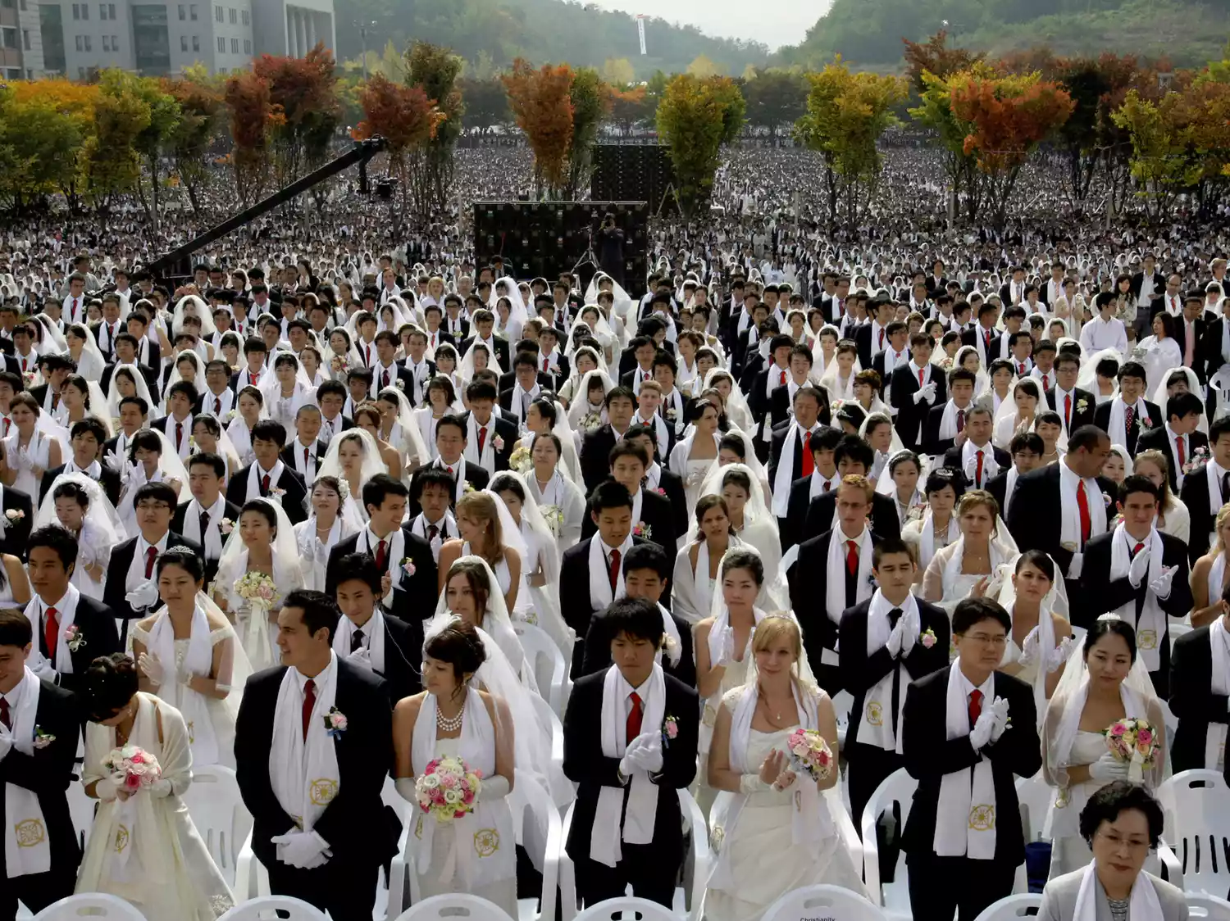
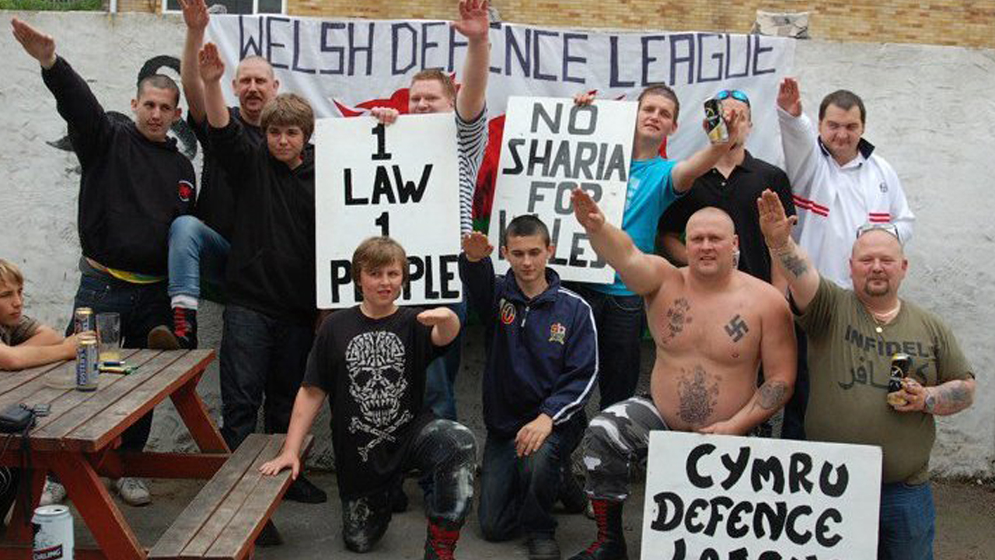
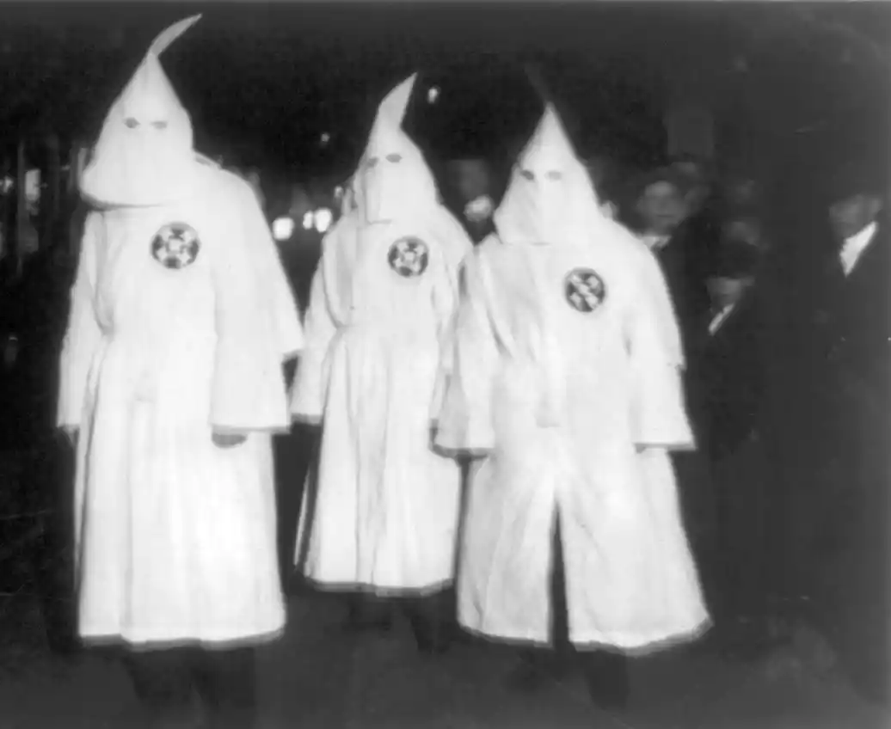
Discuss: What do cults promise their members?
Notes:
For discussion
Expect thigs like – it gives answers, friendship, sense of belonging, power, strength
For info. If you are going to show this link to students please check the images on the sidebar are appropriate.
http://www.therichest.com/rich-list/most-shocking/10-of-the-most-dangerous-religious-cults/

Slide 5
Make two lists.
What qualities do you look for in a friend?
What qualities would a cult leader look for in a follower?
Discuss the similarities and differences

Slide 6
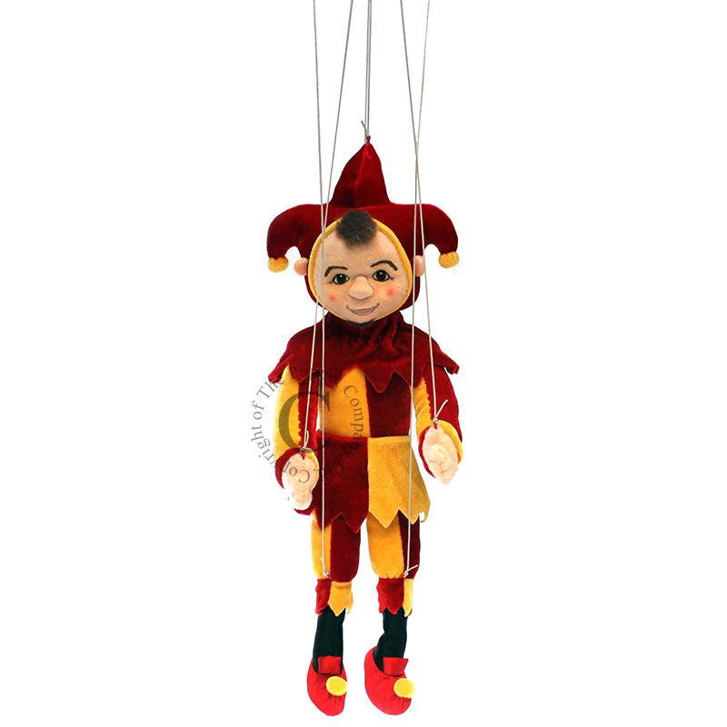
How could this image symbolise a follower of a cult or a gang member?
What would you do if you found out a friend was getting interested in a group you considered to be dangerous?
Notes:
A gang, cult member, or member of an extremist organisation is a puppet. They do what they are told and not what is in their best interest.

Slide 7
What these groups have in common
Them and Us mentality
In sociology and social psychology, an ingroup is a social group to which a person psychologically identifies as being a member. By contrast, an outgroup is a social group with which an individual does not identify. For example, people may find it psychologically meaningful to view themselves according to their race, culture, gender, age or religion
Who are ‘them’ or the outgroup for these groups?
Daesh
National Action (info in comments)
Notes:
National Action - Proscribed December 2016 National Action is a racist neo-Nazi group that was established in 2013. It has a number of branches across the UK, which conduct provocative street demonstrations and stunts aimed at intimidating local communities. Its activities and propaganda materials are particularly aimed at recruiting young people. The group is virulently racist, anti-Semitic and homophobic. Its ideology promotes the idea that Britain will inevitably see a violent ‘race war’, which the group claims it will be an active part of. The group rejects democracy, is hostile to the British state and seeks to divide society by implicitly endorsing violence against ethnic minorities and perceived ‘race traitors’ National Action’s online propaganda material, disseminated via social media, frequently features extremely violent imagery and language. It condones and glorifies those who have used extreme violence for political or ideological ends. This includes tweets posted by the group in 2016, in connection with the murder of Jo Cox(which the prosecutor described as a terrorist act), stating “Only 649 MPs to go” and a photo of Thomas Mair with the caption “don’t let this man’s sacrifice go in vain” and ”Jo Cox would have filled Yorkshire with more subhumans!”, as well as an image condoning and celebrating the terrorist attack on the Pulse nightclub in Orlando and another depicting a police officer’s throat being slit. The images can reasonably be taken as inferring that these acts should be emulated and therefore amount to the unlawful glorification of terrorism.

