Slide 1
Thank you for downloading this resource pack which contains slides to facilitate 17 sessions covering the following themes:
London Identity
E-Safety
Bullying
Discrimination
Exploitation
Hate crime
Cults and extremism
Sex and the media
Abuse and relationships
Teachers are encouraged to review the slides, notes and videos in advance of each session to ensure they are comfortable with the themes and potential questions that might arise.

Slide 2
Week 4 Session 3: Sex in the media

Slide 3
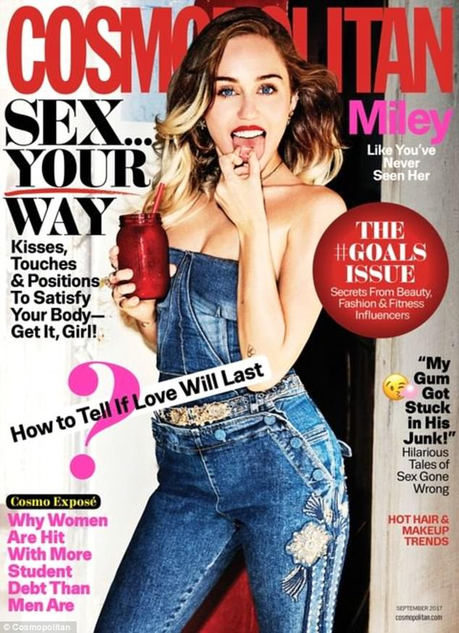
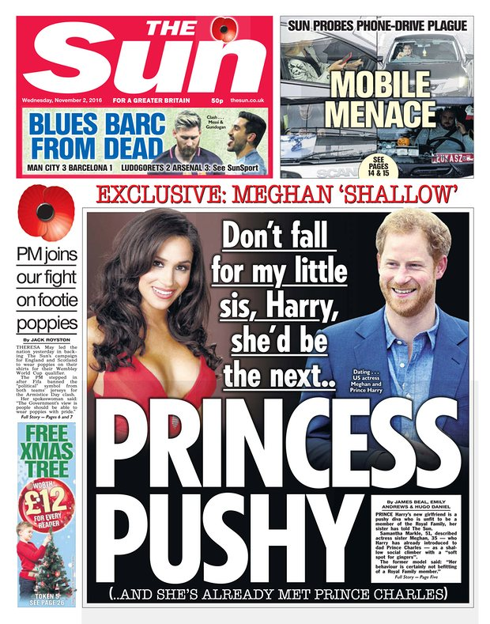
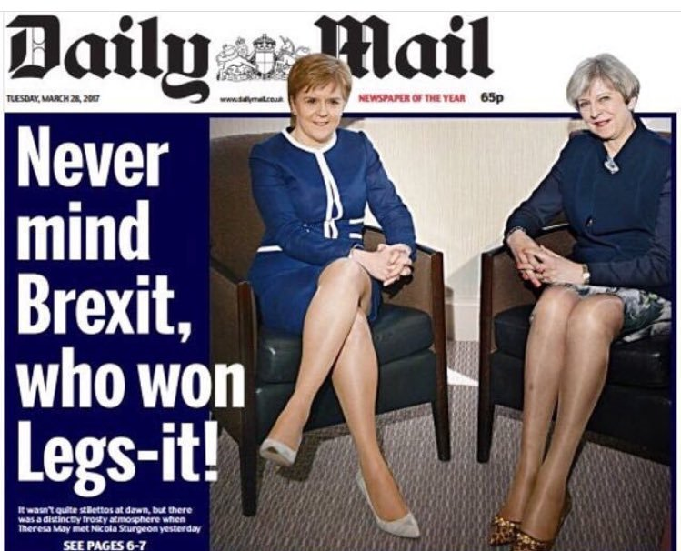
In pairs discuss:
Is our media too sexualised?
What problems can there be with having a heavily sexualised media?
Nicola Sturgeon criticises Daily Mail over 'Legs-it' front page
First minister says newspaper is ‘leading the way’ in taking Britain back to the 1970s after its coverage of her meeting with prime minister Theresa May
Choose which slide to use next
Notes:
https://www.theguardian.com/media/2017/mar/28/daily-mail-legs-it-front-page-sexist

Slide 4
What are your views on this advert?
Think of three words you would use to describe it
Calvin Klein is in trouble again, this time for a series of sexually suggestive underwear adverts, with an "up-skirt" peek at a young woman's crotch attracting the most controversy. The clip is featured as part of the brand's new series, that uses a fill-in-the blanks gimmick, as in: "I — in my Calvins."
"This has a very paedophile vibe to it," remarks one commenter on the Calvin Klein Instagram post of the ad. "The model is 22, but she is made to look younger and child-like."
Notes:
USE THIS SLIDE OR THE NEXT ONE
http://www.ibtimes.co.uk/calvin-klein-blasted-flasher-ad-showing-skirt-view-young-model-1559817

Slide 5
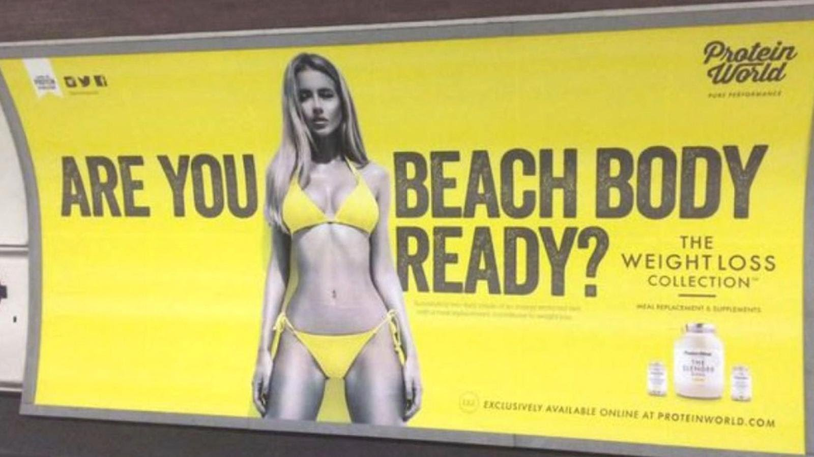
What are your views on this advert?
Think of three words you would use to describe it
The Advertising Standards Authority received 378 complaints on a range of issues including that the “very slim, toned” model under the controversial headline implied other body shapes were inferior, and that the image promoting a slimming product was socially irresponsible.
Do you think this advert should have been banned?
Notes:
https://www.theguardian.com/media/2015/jul/01/protein-world-beach-body-ready-ads-asa

Slide 6
This was a headline from August 2017.
The concern is that in this educational book young people are being told that breasts are there to make women attractive.
Notes:
https://www.theguardian.com/books/2017/aug/29/usborne-apologises-puberty-book-childrens-publisher

Slide 7
Does our society have a an unhealthy view of beauty?
Notes:
http://www.bbc.co.uk/newsbeat/article/41522160/model-arvida-bystrm-gets-rape-threats-after-an-advert-featured-her-hairy-legs

Slide 8
Is this advert racist?
Should it have been allowed to be put online?

Slide 9
Does this video change your mind?

Slide 10
‘More than three-quarters of the children surveyed - 87% of the boys and 77% of the girls - felt pornography failed to help them understand consent, but most of the boys (53%) and 39% of girls saw it as a realistic depiction of sex.
Some of the children's approach to sex was also informed by pornographic scenes, with more than a third (39%) of the 13- to 14-year-olds and a fifth of the 11- to 12-year-olds boys saying they wanted to copy the behaviour they had seen.’
What are the dangers with thinking porn is normal sexual behaviour?
Click article to read it.
Notes:
http://www.bbc.co.uk/news/education-36527681

