Slide 1
Thank you for downloading this resource pack which contains slides to facilitate 17 sessions covering the following themes:
London Identity
E-Safety
Bullying
Discrimination
Exploitation
Hate crime
Cults and extremism
Sex and the media
Abuse and relationships
Teachers are encouraged to review the slides, notes and videos in advance of each session to ensure they are comfortable with the themes and potential questions that might arise.

Slide 2
Week 5 Session 1: Manipulation and peer pressure

Slide 3
We looked at this article last session
This is what the researcher, Dr Elena Martellozzo had to say about the research:
"If boys believe that online pornography provides a realistic view of sexual relationships, then this may lead to inappropriate expectations of girls and women.
"Girls too may feel pressured to live up to these unrealistic, and perhaps non-consensual, interpretations of sex.

Slide 4
To read the full article click on the picture
Out of the girls surveyed, 37 per cent had three or more symptoms of psychological distress…compared to 15 per cent of boys.
“Teenage girls today face a huge range of pressures. Stress at school, body image worries, early sexualisation, bullying on and offline and uncertainty about the future after school are all piling on the stress," he tells me. "Social media also puts pressure on girls to live their lives in the public domain, to present a personal ‘brand’ from a young age, and to seek reassurance in the form of likes and shares.”
Notes:
http://www.telegraph.co.uk/health-fitness/body/why-are-so-many-of-britains-teen-girls-struggling-with-mental-he/

Slide 5
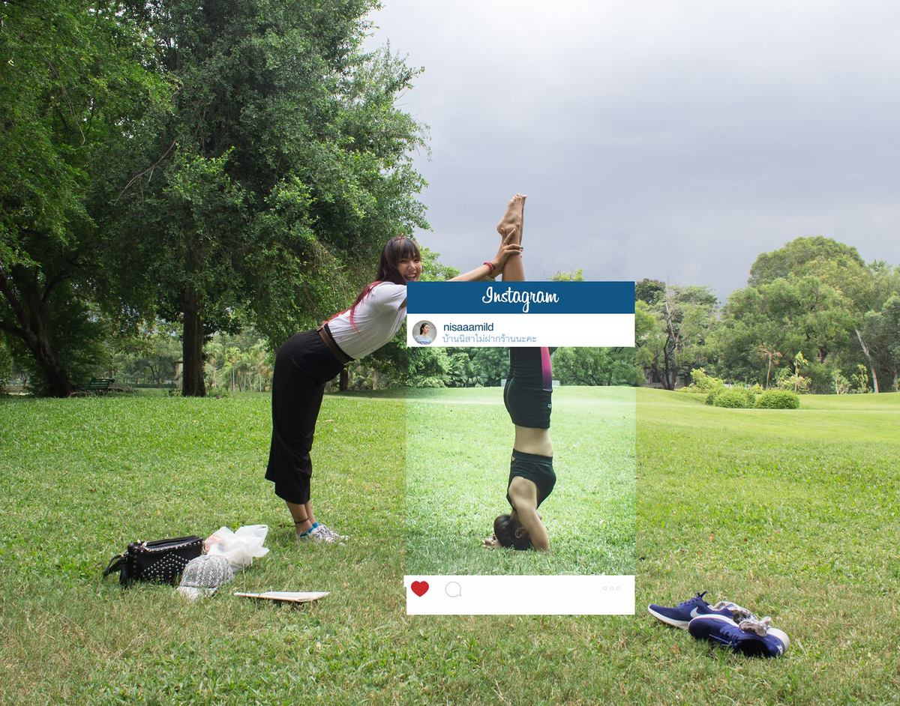
Discuss in pairs:
Does mainstream media put too much pressure on young people?
Does social media give us unrealistic expectations of what life should be like?
From the Guardian in 2017:
People take on average six photos before choosing a selfie to post online, but youngsters can take as many as 20.
Notes:
https://www.theguardian.com/uk-news/2017/aug/03/the-sharenting-divide-half-uk-parents-do-not-post-childrens-pictures

Slide 6
Write down 2-3 pieces of advice to someone in year 7 who feels under pressure to look ‘good’

