Slide 1
Thank you for downloading this resource pack which contains slides to facilitate 17 sessions covering the following themes:
London Identity
E-Safety
Bullying
Discrimination
Exploitation
Hate crime
Cults and extremism
Sex and the media
Abuse and relationships
Teachers are encouraged to review the slides, notes and videos in advance of each session to ensure they are comfortable with the themes and potential questions that might arise.

Slide 2
Week 5 Session 3: Consent

Slide 3
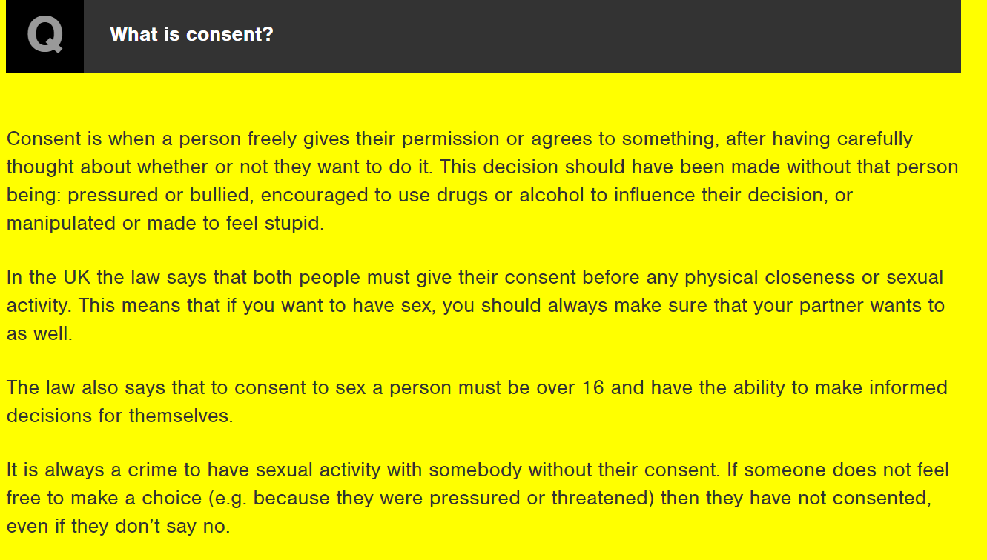
What is the age of consent?
What does consent mean?

Slide 4
Consent is as simple as tea
https://www.youtube.com/watch?v=pZwvrxVavnQ

Slide 5
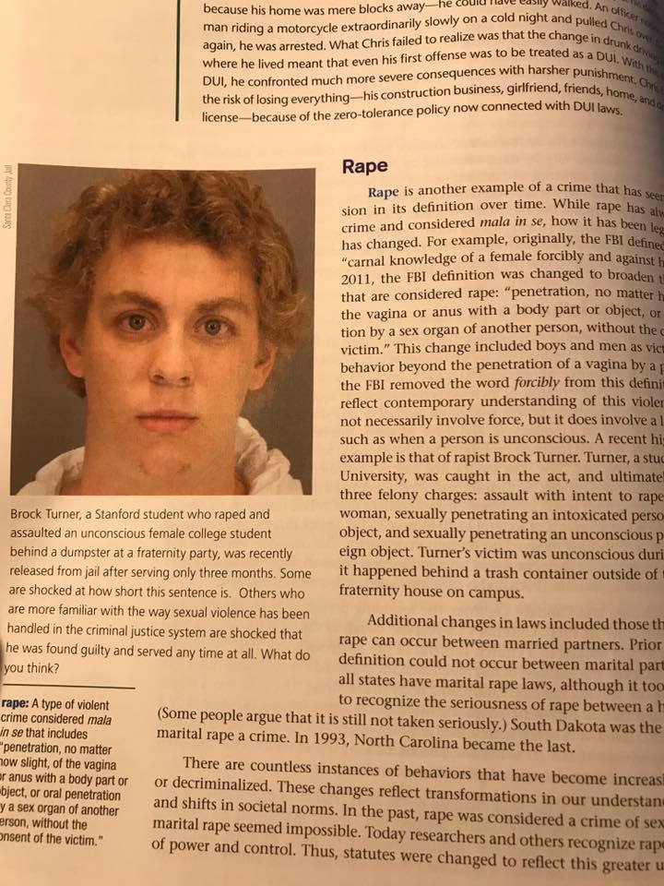
This is now the image in a criminal justice textbook
Brock Turner was jailed for sexual assault.
He only spent 3 months in jail but he is now infamous for committing sexual assault.
Was his sentence too lenient?
Notes:
http://www.independent.co.uk/news/world/americas/brock-turner-rape-photo-textbook-definition-criminal-justice-college-a7945726.html
You can read the powerful victim statement that was read in court here by following the link below. You might want to choose some of it to share with your class as it is long. There is a video on the next slide with some extracts on it.
https://www.buzzfeed.com/katiejmbaker/heres-the-powerful-letter-the-stanford-victim-read-to-her-ra?utm_term=.tlGrE0l37#.nkbdLjYy6

