Slide 1
Thank you for downloading this resource pack which contains slides to facilitate 17 sessions covering the following themes:
London Identity
E-Safety
Bullying
Discrimination
Exploitation
Hate crime
Cults and extremism
Sex and the media
Abuse and relationships
Teachers are encouraged to review the slides, notes and videos in advance of each session to ensure they are comfortable with the themes and potential questions that might arise.

Slide 2
Week 6 Session 2: Unhealthy or abusive relationships

Slide 3
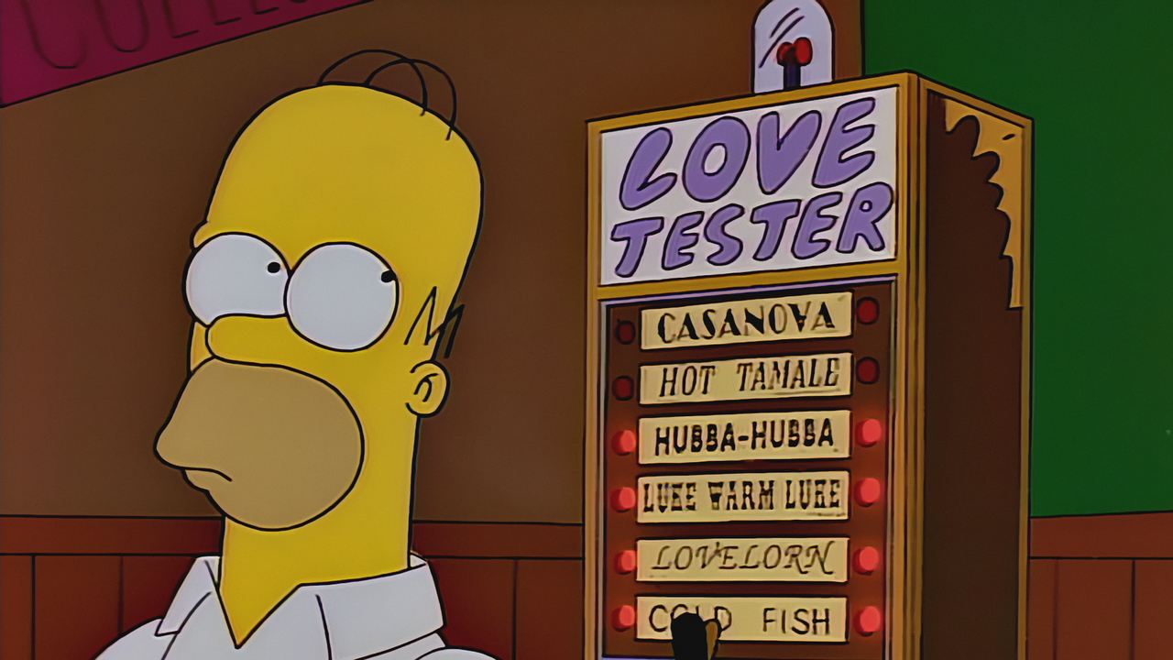
The love test.
Notes:
http://metro.co.uk/2016/06/03/here-are-the-early-signs-youre-in-an-abusive-relationship-5922364/

Slide 4
All of these things could be warning signs of an abusive relationship.
Click here if you want to read the article.
The love test.
For each of the following decide whether this is a sign your partner truly loves you.
IS IT LOVE? | YES | NO
They are incredibly romantic and lavish you with gifts
They move really fast in the relationship
They get jealous easily and want you for themselves
They dislike your friends – and make sure you know it
They’ll worry about you
They check up on your internet history
You’ll feel like you’re with two different people
Notes:
http://metro.co.uk/2016/06/03/here-are-the-early-signs-youre-in-an-abusive-relationship-5922364/

Slide 5
#ListenToYourSelfie
https://www.youtube.com/watch?v=_G8b7yZapkI

Slide 6
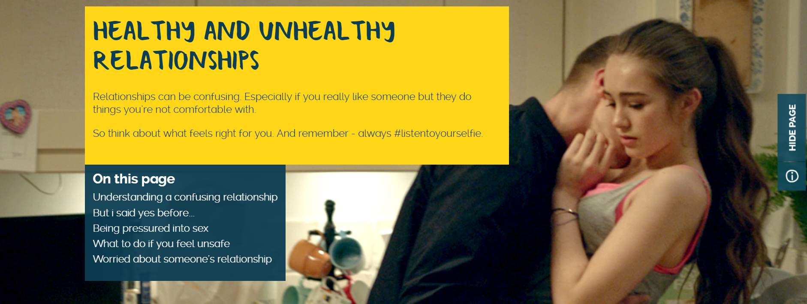
Click here to view the webpage

