Slide 1
Shared Values

Slide 2
Are there ways you get to have a say in how the school runs?
Would you prefer to live in a democracy or a dictatorship?

Slide 3
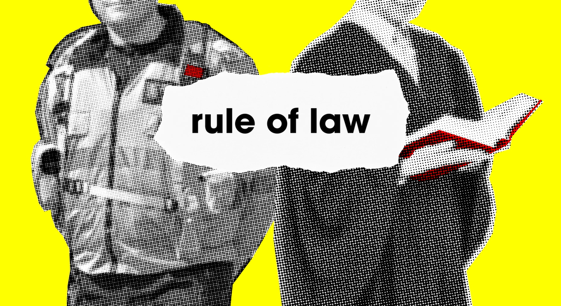
What would happen if there were no rules in the school?
What do you think would happen if the law didn’t exist?

Slide 4
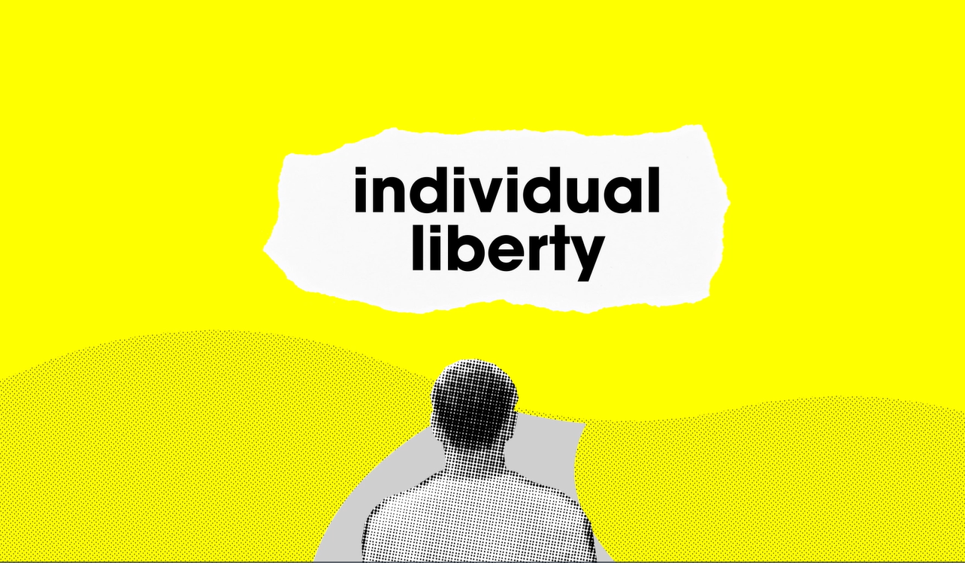
Can you think of an example from history where certain people were not allowed to live life they way they wanted to?

Slide 5
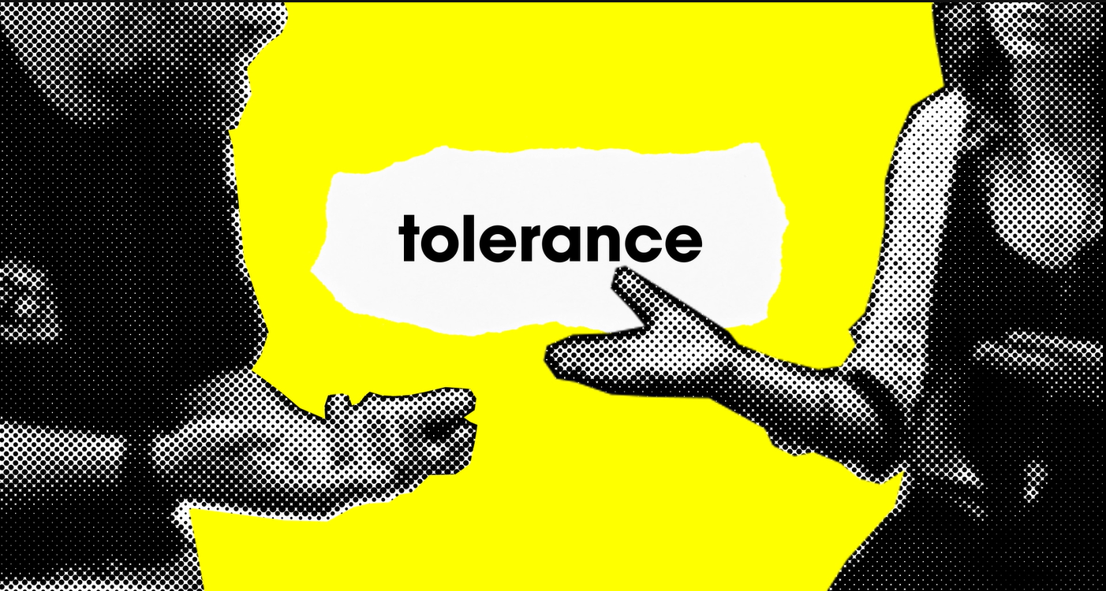
What does it feel like when other people are intolerant towards us?
What can we do to show other people that we respect their views?

