Slide 1


Islamist Extremism

Slide 2

What is
Islamist extremism?
What did you learn from the video?
What do people mean when they say Islamist extremist?

Slide 3

Recruitment
and
radicalisation
What is radicalisation?
What would you do if you were worried about a friend?

Slide 4
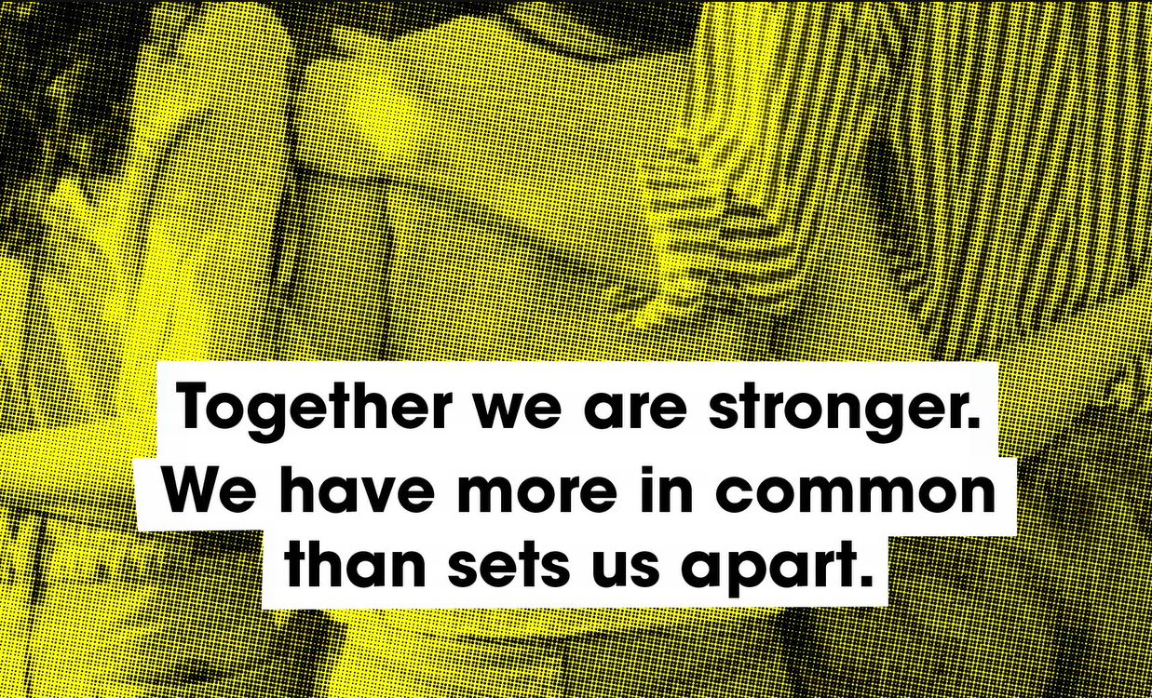
Challenging extremism
How did the video make you feel?

