Slide 2
Starter: Seeing is believing
True or false? (5 mins)
Take a look at these different statements. If you think it is true, go to the left. If you think it is false, go to the right.
Challenge:
Can you work out what this week’s topic is based on this activity?
Notes:
Images
iStock

Slide 3
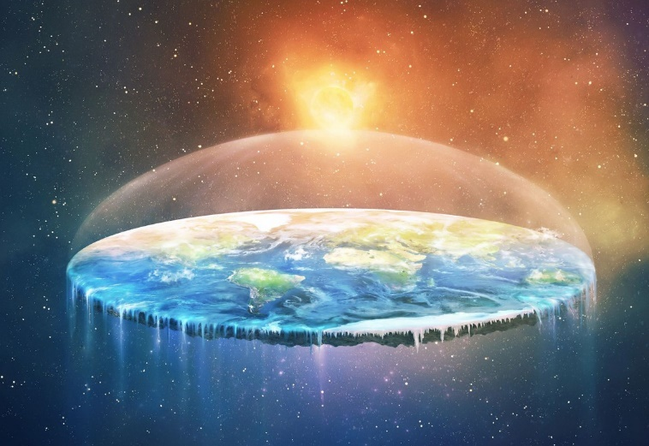
Starter: Seeing is believing
The Earth is flat.
Notes:
Images
iStock

Slide 4
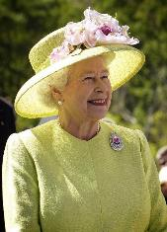
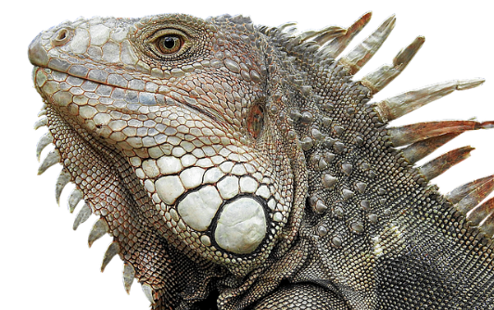
Starter: Seeing is believing
The Queen is a lizard.
Notes:
Images
iStock
https://pixabay.com/photos/lizard-reptile-dragon-vertebrate-3064164/
https://pixabay.com/photos/queen-england-elizabeth-ii-portrait-63006/
https://pixabay.com/photos/royal-crown-imperial-history-golden-2844982/

Slide 5
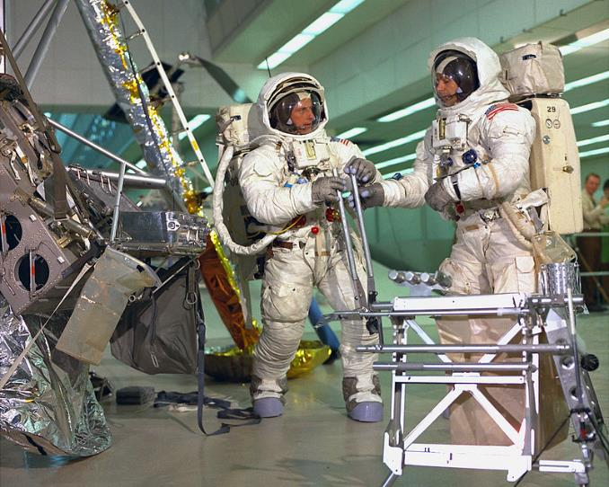
Starter: Seeing is believing
The Moon landing was faked.
Notes:
Images
https://www.flickr.com/photos/nasacommons/9457412841/in/album-72157650077280189/

Slide 6
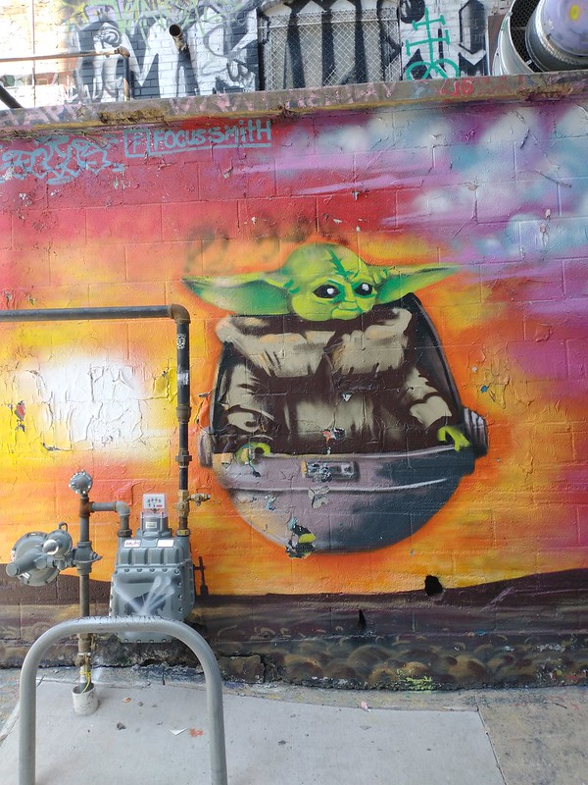
Starter: Seeing is believing
Baby Yoda caused COVID-19.
Notes:
Images
iStock
https://search.creativecommons.org/photos/c03c0ea7-cbfc-4131-8c0b-55d2e2f375df "Baby Yoda Art Alley Rapid City South Dakota." by amanderson2 is licensed under CC BY 2.0

Slide 7
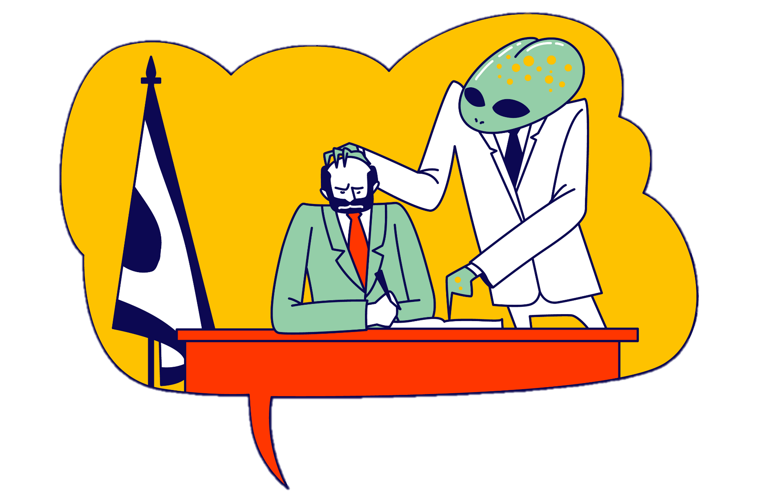
Are conspiracy theories more dangerous than we realise?
Notes:
Images
iStock

Slide 8
Starter: Seeing is believing
What is a conspiracy theory?
Why are we talking about this?
Theories in action
What would you do?
Vote!
Ext: Create a conspiracy theory!
Notes:
Images:
1) Icons8

Slide 9
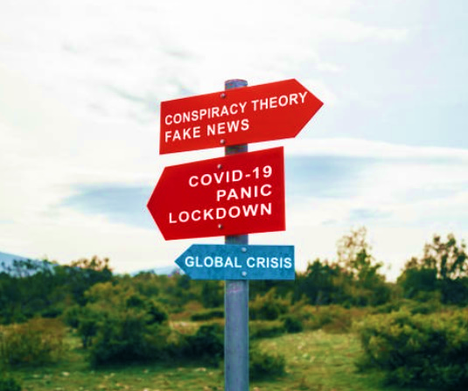
What is a conspiracy theory?
Conspiracy theories are often talked about along with fake news and misinformation, but what do they all mean?
Match the word (3-4 mins)
Take a look at the three terms below. Can you match them to the correct definition? Click to see if you’re right!
Fake news
Misinformation
Conspiracy theory
A story that looks like news, but has actually been created as a joke or to make you feel a certain way.
Believing that an event or situation is the result of a secret plan made by powerful people.
A story that looks like news, but has actually been created as a joke or to make you feel a certain way.
Wrong, or partly wrong information that is trying to trick you.
Believing that an event or situation is the result of a secret plan made by powerful people.
Wrong, or partly wrong information that is trying to trick you.
Notes:
Images:
iStock
References:
https://www.bbc.co.uk/bitesize/articles/zjykkmn

Slide 10
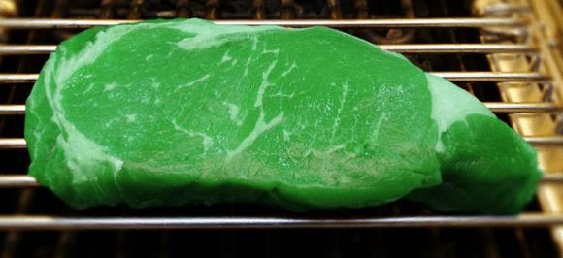
What is a conspiracy theory?
Another big difference between conspiracy theories and fake news is that lots of people believe conspiracy theories. Some studies have found that up to 20% of people believe the most popular ones!
Scientists think that this is because humans try to find patterns in everything. For example, if you got sick after eating green meat, you would think that green meat is bad.
However, experts say that sometimes we find the wrong patterns. For example, Baby Yoda appeared on TV in December 2019, at the same time as COVID-19 started spreading. Did Baby Yoda cause the Coronavirus? Of course not!
Notes:
Images:
iStock
https://search.creativecommons.org/photos/c03c0ea7-cbfc-4131-8c0b-55d2e2f375df "Baby Yoda Art Alley Rapid City South Dakota." by amanderson2 is licensed under CC BY 2.0

Slide 11
Starter: Seeing is believing
What is a conspiracy theory?
Why are we talking about this?
Theories in action
What would you do?
Vote!
Ext: Create a conspiracy theory!
Notes:
Images:
1) Icons8

Slide 12
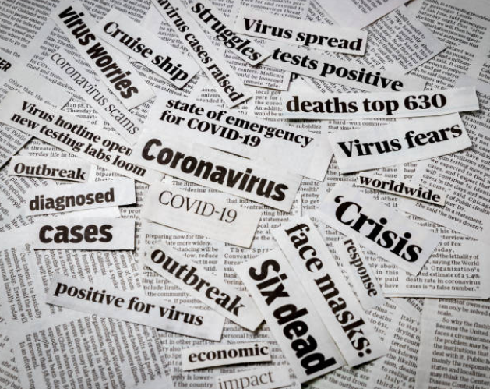
Why are we talking about this?
Experts have found that when we’re stressed and feel like things are out of control, we are more likely to believe in conspiracy theories.
And with everyone spending more time on social media, conspiracy theory posts and videos spread quickly. In fact, one study found that fake news stories can spread quicker online than real ones!
This has been especially true in relation to the Coronavirus, with theories about China, 5G towers and vaccinations all spreading across the UK.
Discuss (2-3 mins)
Have you heard of any conspiracy theories about COVID-19?
Notes:
Images:
iStock
References:
1) https://www.france24.com/en/20200426-conspiracy-theories-and-fake-news-fighting-the-covid-19-infodemic

Slide 13
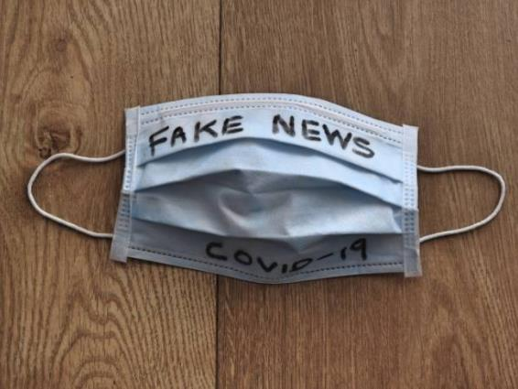
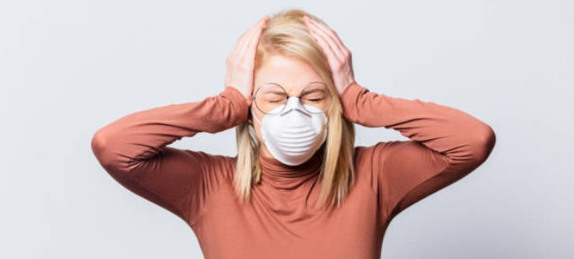
Why are we talking about this?
These Coronavirus theories haven’t just spread here in the UK – similar ones have been seen all over the world.
Some people have said that as well as a pandemic, we are also “fighting an infodemic”, as we try to work out which information is fake and which is real.
But are conspiracy theories really dangerous? Or are they just a bit of fun to help people during a stressful time? That’s what you’ll be deciding today.
Notes:
Images:
iStock
References:
1) https://www.france24.com/en/20200426-conspiracy-theories-and-fake-news-fighting-the-covid-19-infodemic

Slide 14
Starter: Seeing is believing
What is a conspiracy theory?
Why are we talking about this?
Theories in action
What would you do?
Vote!
Ext: Create a conspiracy theory!
Notes:
Images:
1) Icons8

Slide 15
Theories in action
Think! (5-10 mins)
Draw this table on a piece of paper. Then have a look at the five conspiracy theories. Decide which box you think each theory belongs in.
Believable & Harmless
Believable & Harmful
Unbelievable & Harmless
Unbelievable & Harmful
In the classroom?
Do this task on the whiteboard as a class!
Notes:
Images:
1) Icons8

Slide 16
Theories in action: reptilians
The idea of “reptilians” was suggested by former TV presenter David Icke, who claims shapeshifting reptile-human creatures control Earth by taking human form and gaining power.
Mr Icke believes that many world leaders (including our Royal family) are, or are possessed by, reptilians.
Believable & Harmless
Believable & Harmful
Add the reptilian theory to your grid. Where did you put it and why?
Unbelievable & Harmless
Unbelievable & Harmful
Notes:
Images
https://pixabay.com/photos/lizard-reptile-dragon-vertebrate-3064164/
https://pixabay.com/photos/queen-england-elizabeth-ii-portrait-63006/
https://pixabay.com/photos/royal-crown-imperial-history-golden-2844982/
References:
https://en.wikipedia.org/wiki/Reptilian_conspiracy_theory

Slide 17
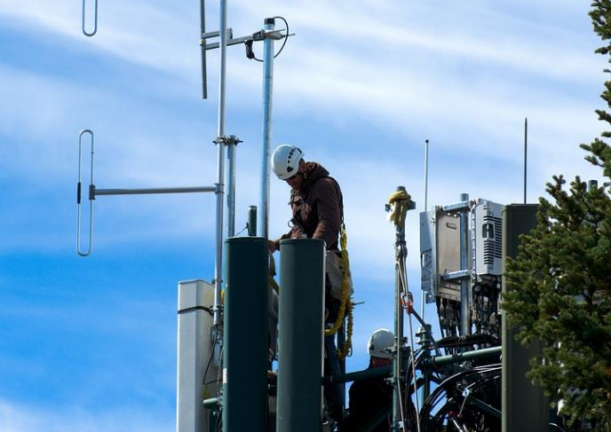
Theories in action: 5G spreads Coronavirus
The latest network upgrade for mobile phones is called 5G.
Some people think that 5G caused the Coronavirus, and that the virus is spread by the towers.
Even though there is no evidence, the theory spread quickly online. In 2020, many towers were set on fire and over 40 engineers were attacked in the UK.
Believable & Harmless
Believable & Harmful
Add the 5G Coronavirus theory to your grid. Where did you put it and why?
Unbelievable & Harmless
Unbelievable & Harmful
Notes:
Images:
Pixabay
References:
https://en.wikipedia.org/wiki/Misinformation_related_to_the_COVID-19_pandemic#5G_mobile_phone_networks

Slide 18
Theories in action: fake Moon landing
In 1969, NASA flew Neil Armstrong and Buzz Aldrin to the Moon. This meant the USA was the first country to put man on the Moon!
The event was shown on television to the whole world, and many photos were taken of it.
However, some people believe the Moon landing was faked to win the “Space Race” against the Soviet Union (now Russia).
Believable & Harmless
Believable & Harmful
Add the fake Moon landing theory to your grid. Where did you put it and why?
Unbelievable & Harmless
Unbelievable & Harmful
Notes:
Images:
https://www.flickr.com/photos/nasacommons/9457412841/in/album-72157650077280189/
References:
https://en.wikipedia.org/wiki/Moon_landing_conspiracy_theories#Space_Race

Slide 19
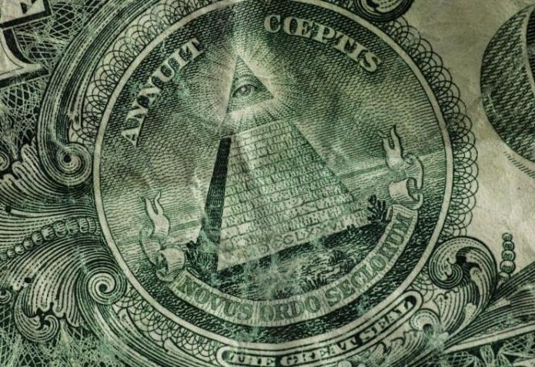
Theories in action: the Illuminati
Some conspiracy theorists believe in the Illuminati – a secret society which controls important world events and even the Government.
While an Illuminati group did exist hundreds of years ago, it wasn’t very powerful and was ended in the 1780s.
Theorists believe that lots of famous people are members, and some believe the group created COVID-19.
Believable & Harmless
Believable & Harmful
Add the Illuminati theory to your grid. Where did you put it and why?
Unbelievable & Harmless
Unbelievable & Harmful
Notes:
Images:
iStock
References:
https://en.wikipedia.org/wiki/Illuminati#In_conspiracy_theories

Slide 20
Theories in action: the Earth is flat
As the name suggests, The Flat Earth Society believe that the Earth is flat, not a sphere.
The Society claims there is no proof that the Earth is not flat, and that NASA are photoshopping their satellite images to trick the public!
Over the years, the group has tried to find evidence that the Earth is flat but all their tests showed that it was actually round…
Believable & Harmless
Believable & Harmful
Add the Earth is flat theory to your grid. Where did you put it and why?
Unbelievable & Harmless
Unbelievable & Harmful
Notes:
Images:
iStock
References:
https://en.wikipedia.org/wiki/Flat_Earth#Flat_Earth_Society

Slide 21
Theories in action
Reflect (3-5 mins)
Have a look at your table again and discuss the following questions:
Challenge:
Add any other conspiracy theories you’ve heard of to your table.
Did you think these conspiracy theories were mostly harmless or harmful?
Did you think these conspiracy theories were mostly unbelievable or believable?
Why do you think
people believe these conspiracy theories?
Notes:
Images:
Referenced previously
Pixabay

Slide 22
Starter: Seeing is believing
What is a conspiracy theory?
Why are we talking about this?
Theories in action
What would you do?
Vote!
Ext: Create a conspiracy theory!
Notes:
Images:
1) Icons8

Slide 23
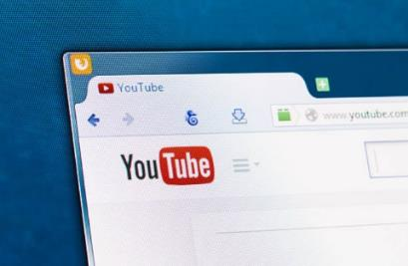
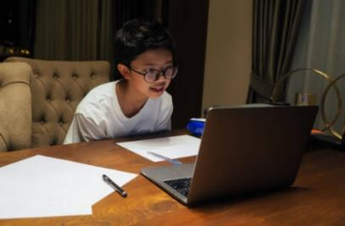
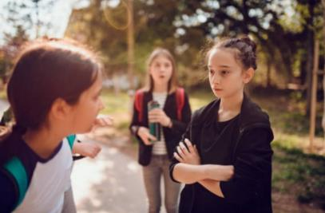
What would you do?
What would you do? (5-10 mins)
Take a look at three different scenarios on the next few slides. For each one, decide what you think the best thing to do would be and why. Then, click to see if you’re right!
Challenge:
Have a chat with your friends or a family member. Have they ever been in a tricky situation surrounding a conspiracy theory? What happened and what did they do?
Notes:
Images:
1) iStock

Slide 24
What would you do?
While on YouTube, you see a video that tells you that a local fire which hurt lots of people was set by the Government.
The video says that there is lots of evidence to show that the Government is lying, and that you should join a protest this weekend to find out more about it.
What would you do and why?
A
Watch the next recommended video on YouTube that’s called “The Government want to silence us!”
B
Speak to an adult about what you have seen and ask questions about it.
Some conspiracy theories can be worrying, or even scary. If you’re not sure about something, speak to an adult about what you have seen or heard.
C
Go to the protest to find out what evidence they’re talking about.
Notes:
Images:
1) iStock

Slide 25
What would you do?
Your teacher asked you to do some research for your Geography homework.
While browsing, you see a website that says that aliens live under the ground, and are planning on attacking humans soon. Now you feel really worried and don’t know what to do!
What would you do and why?
A
Copy the information for your Geography homework and give it to your teacher.
B
Tell all of your friends about the aliens, and see what they think.
C
Conspiracy theories can look very believable, and they may include lots of misinformation. Do some more research, and use Full Fact to help you!
Do some more research to see if any well-known websites agree with the theory.
Notes:
Images:
1) iStock

Slide 26
What would you do?
A girl in your class keeps talking about a conspiracy theory. When you told her that it wasn’t true she shouted at you and now she won’t speak to you.
You don’t want to lose a friend, but you don’t know what to do next.
What would you do and why?
A
Talk to her calmly and explain why you don’t think it is true.
Laughing at someone or ignoring the problem won’t help the situation. Talk calmly to your friend and explain why you don’t agree with them.
B
Laugh at her, and tell everyone else that the theory isn’t true.
C
Agree not to talk about it anymore and pretend that you never had an argument.
Notes:
Images:
1) iStock

Slide 27
Starter: Seeing is believing
What is a conspiracy theory?
Why are we talking about this?
Theories in action
What would you do?
Vote!
Ext: Create a conspiracy theory!
Notes:
Images:
1) Icons8

Slide 28
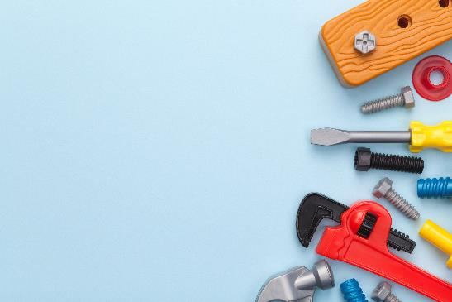
Quick idea
Get the Full Facts…
Full Fact is the UK’s independent fact-checking service. Just type in what you’ve heard and they’ll tell you if it’s true or not!
Big idea
Conspiracy-tackling toolkit!
Based on what you’ve read today, create a “toolkit” to show what people need to look out for when they are faced with something they are unsure about – feature up to five suggestions and design it how you like!
Notes:
Images:
https://fullfact.org/
iStock
References:
1) https://fullfact.org/

Slide 29
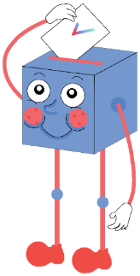
Are conspiracy theories more dangerous than we realise?
The 5G towers are examples that show how dangerous conspiracy theories can be.
They might not always be dangerous, but sometimes they can be, so we need to learn more about them.
Conspiracy theories spread quickly online and you can’t always tell what’s true or false, which can be dangerous.
Too many people are quick to just call the theories “crazy”, when really they need to be taken seriously.
…
Most people only think of conspiracy theories as funny stories – they don’t actually believe them!
The majority of conspiracy theories, like the fake Moon landing or flat Earth, aren’t dangerous to us today.
I know how to spot a conspiracy theory, and how to question what I see and hear, so they’re not dangerous to me.
Because of the theories around the Coronavirus, people seem more aware of the dangers.
…

Slide 30
Get involved!
To find out more about VotesforSchools, please email: primary@votesforschools.com.
We can’t wait to hear from you!

Slide 31
Starter: Seeing is believing
What is a conspiracy theory?
Why are we talking about this?
Theories in action
What would you do?
Vote!
Ext: Create a conspiracy theory!
Notes:
Images:
1) Icons8

Slide 32
Ext: Create a conspiracy theory!
Create your own (5+ mins)
Use the table below to create your own conspiracy theory. To play, roll a dice and use the number to choose from each column. How many different conspiracy theories can you come up with?
Number | Person | Action | Object | Extra detail
1 | The Queen | ate | a werewolf | but it’s illegal to tell anyone…
2 | Lionel Messi | kicked | the Moon | and eats snails.
3 | Your aunt | told off | a tree | but it’s a secret!
4 | Ariana Grande | is/was | a cheese smeller | while singing the alphabet…
5 | Your favourite celebrity | worships | basketballs | and drinks tomato ketchup!
6 | Your teacher | works with | astronauts | and smells like onions!
No dice?
Click the image above to use an online version instead!
Notes:
Alternative Dice Link: https://www.google.com/search?q=dice+roller
Images:
1) https://pixabay.com/vectors/dice-red-cubes-die-shapes-two-575658/

Slide 33
Ext: Create a conspiracy theory!
Number | Person | Action | Object | Extra detail
1 | The Queen | ate | a werewolf | but it’s illegal to tell anyone…
2 | Lionel Messi | kicked | the Moon | and eats snails.
3 | Your aunt | told off | a tree | but it’s a secret!
4 | Ariana Grande | is/was | a cheese smeller | while singing the alphabet…
5 | Your favourite celebrity | worships | basketballs | and drinks tomato ketchup!
6 | Your teacher | works with | astronauts | and smells like onions!
Challenge:
Try creating your own chart before testing it on a friend! Which columns will you include?
Notes:
Alternative Dice Link: https://www.google.com/search?q=dice+roller
Images:
1) iStock

