Slide 1

Teacher Impartiality
Objectives
Understand what impartiality does and does not require
Feel more confident discussing controversial issues safely
Apply practical tools to support balanced classroom dialogue
Training Workshop
Notes:
Welcome participants and briefly introduce the session. This session is designed to support teachers and safeguarding leads to feel more confident facilitating difficult or controversial discussions in the classroom, while meeting their legal duty of political impartiality. Emphasise that this is a practical and reflective session, not a test of beliefs or compliance. This work supports safeguarding, inclusion, and long-term resilience to polarisation and extremism.
This session has been designed to run as a CPD opportunity. You could lead it with your peers, or reflect on the content individually. It is also available as an E-Learning Module via the Educate Against Hate platform.

Slide 2

Session structure
What is teacher impartiality?
A consideration of the law, what it means for us and some practical consideration of how it looks in classrooms
Why does impartiality matter?
Understanding the impact of bias in the classroom
How do we apply impartiality?
Top tips on teaching impartially, some scenario work and practical activities

Slide 3
Teacher impartiality and the law
Education Act 1996
No promotion of partisan political views
Balanced treatment of political issues
DfE Guidance 2022
Teachers can promote shared civic values
of democracy, equality, rule of law
Avoid endorsing parties, campaigns, or movements
Judgement, age, and context matter
Notes:
Explain the department for education has clear guidance on teacher impartiality, as seen on the slide.
However, many teachers still feel unsure and lack confidence in practically enacting this guidance.
Ask the group WHY this might be.

Slide 4
What do we mean by impartiality?
Teachers have a legal duty to maintain political impartiality
This does not mean avoiding controversial topics
It means teaching them fairly and responsibly
Notes:
Introduce impartiality as a legal and professional responsibility under the Education Act and Department for Education guidance. Best practice in citizenship education suggests schools should engage students in education on what can, sometimes, be controversial topics. The duty is about how these issues are taught, not whether they are taught. Impartiality protects both staff and students.

Slide 5
Activity: Does impartiality apply?
Inherently political - impartiality applies | Safeguarding or factual - impartiality does not apply | Analytical - impartiality applies to the approach
If the topic directly concerns political systems, public policy, political movements, or civic power, impartiality guidance applies. | If the topic is about harm, discrimination, safeguarding, or established fact, it is not a political issue for teaching purposes. | If the topic is being analysed, critiqued, or examined rather than promoted, impartiality is about approach, not avoidance.
Notes:
This activity has teachers consider the circumstances that require impartiality in their teaching.
Explain we are going to show different topics on the slide and the teachers must decide which of these categories the topics fits into.
Use the slide to run through the different teaching options.
Explain that the answers do not always feel simple – that is ok! It is why we have this session.

Slide 6
Discussing democracy
Inherently political -impartiality applies | Safeguarding or factual -impartiality does not apply | Analytical - impartiality applies to the approach
Promoting democracy is an important part of teaching about FBVs – we must be careful not to directly promote a specific political position.
Notes:
Allow the group to discuss their thoughts and then reveal the answer.
Explain that we started with perhaps the most complicated one! Democracy is a value the education system is allowed to promote. Political impartiality applies to how democracy is interpreted, practised, and debated, not to whether it matters.
Promotion of democracy is not the same promotion of a political viewpoint
The guidance draws a crucial distinction between:
Promoting democratic principles (allowed and expected)
Promoting specific political views, parties, or policies (not allowed)
Teachers can legitimately:
Teach that democracy is preferable to authoritarianism
Encourage participation in democratic processes
Explore why democratic systems are valued
However, teachers must still:
Avoid presenting one political party or movement as the “correct” democratic choice
Avoid framing dissenting political positions as morally illegitimate unless they breach law or safeguarding

Slide 7
Discussing a political party
Inherently political - impartiality applies | Safeguarding or factual - impartiality does not apply | Analytical - impartiality applies to the approach
Teaching about any political party must be done impartially. If it’s about how society is governed or changed, impartiality applies.
Notes:
Other examples of this nature include:
Parliamentary decisions
Protest
Taxation
Climate policy – different to climate FACTS.
Immigration policy
International relations
War and military action
Activism

Slide 8
Discussing racism
Inherently political - impartiality applies | Safeguarding or factual - impartiality does not apply | Analytical - impartiality applies to the approach
Impartiality is not required when it relates to the prevention of harm or discrimination
Notes:
Other examples of this kind of phenomenon include:
Antisemitism
Islamophobia
Sexism and misogyny
Homophobia or transphobia
Bullying
Online hate
Extremism as harm
Terrorism as violence
Climate science – different to policy or climate activism

Slide 9
Discussing media reports
Inherently political - impartiality applies | Safeguarding or factual - impartiality does not apply | Analytical - impartiality applies to the approach
Teaching students how media reporting works is not political - think language analysis and persuasion techniques. Impartiality only applies if a teacher starts using media analysis to promote a political position.

Slide 10
Discussing international conflict
Inherently political - impartiality applies | Safeguarding or factual - impartiality does not apply | Analytical - impartiality applies to the approach
International conflicts involve states, power, borders, and political decisions, so they are inherently political topics. Teachers can teach the facts and multiple perspectives but must not promote one side or present a single political position as correct.

Slide 11
Discussing climate change
Inherently political - impartiality applies | Safeguarding or factual - impartiality does not apply | Analytical - impartiality applies to the approach
Scientific evidence shows that climate change is happening.
It is a fact, so impartiality does not apply.

Slide 12
Discussing climate change policy or activism
Inherently political - impartiality applies | Safeguarding or factual - impartiality does not apply | Analytical - impartiality applies to the approach
How people, politicians and organisations respond to facts about climate change is political and requires impartiality.

Slide 13
Discuss
How do you feel about teaching political or controversial issues? What emotions come up?
What practical issues do you encounter when discussing political or controversial topics? e.g. curriculum space? levels of personal confidence?
What support would help you to manage such discussions? e.g. SLT support? communication with parents and carers?
Notes:
The questions on the slide should be presented to your group.
Give them 5-10 mins to discuss their answers and feedback to plenary.

Slide 14
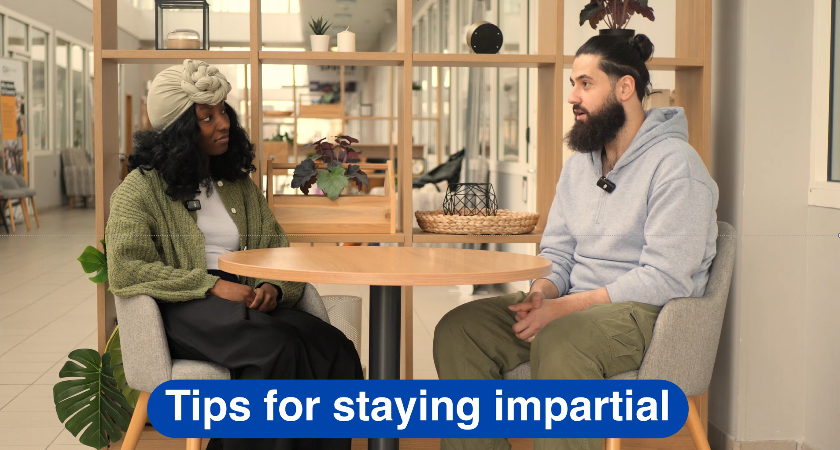
Notes:
OPTIONAL: This video presents a conversation between two expert youth facilitators on how they ensure they practice impartiality in their facilitation. It can be viewed as video, or listened, almost as a podcast.

Slide 15
Impartiality matters because it…
protects teachers
models respectful disagreement
builds critical thinking
Notes:
Link impartiality to safeguarding and trust. When students feel that a classroom is fair, they are more likely to engage openly and less likely to retreat into polarised or extreme positions. Impartial facilitation helps young people learn how to disagree without harm.

Slide 16
Activity: Impartial vs. biased teaching
Group 1:
You are running a discussion in form time as part of your school’s work to promote FBVs. The topic is the issue of ‘compulsory school uniform’.
Your objective is to ensure that all opinions are heard and a consensus is achieved.
Consider: what approach you should take to meet your objectives.
Group 2:
You are running a discussion in form time as part of your school’s work to promote FBVs. The topic is the issue of ‘compulsory school uniform’.
Your objective is to ensure that all pupils understand why school uniform should be compulsory.
Consider: what skills you need to use to meet your objective?
Compare and contrast the different approaches and their potential outcomes – what do you notice?
Notes:
Explain: This activity is designed to allow teachers to experience the presence/absence of impartiality. Make this clear that this is an example to embed skills but not a political issue.
Split your group into 2 and give them 15 mins to come up with a 5 min lesson plan.
Have each group run their lesson plan.
Conduct a reflective discussion (questions on next slide)

Slide 17
Reflection
What are the potential consequences of a biased lesson?
How might a teacher’s views on a topic directly impact the experience of their learners?
What makes a good facilitator?
How is facilitating different from standard teaching?
How do discussions like these help to build an appreciation of democratic values in learners?
Do you have any examples of facilitating interesting discussions on complex issues?
Notes:
Explain: This activity is designed to allow teachers to experience the presence/absence of impartiality.
Explain: Impartiality guidance exists to allow students to reach their own conclusions on important topics. The absence of impartiality risks undermining this opportunity for students.
Explain: It might be easiest for teachers to consider the impartiality guidance as an attempt to allow students to reach their own opinions. This involves thinking about the best way to teach a topic to ensure this, as well as a reflection on our own positions, and the impact our opinions have over our learners.

Slide 18
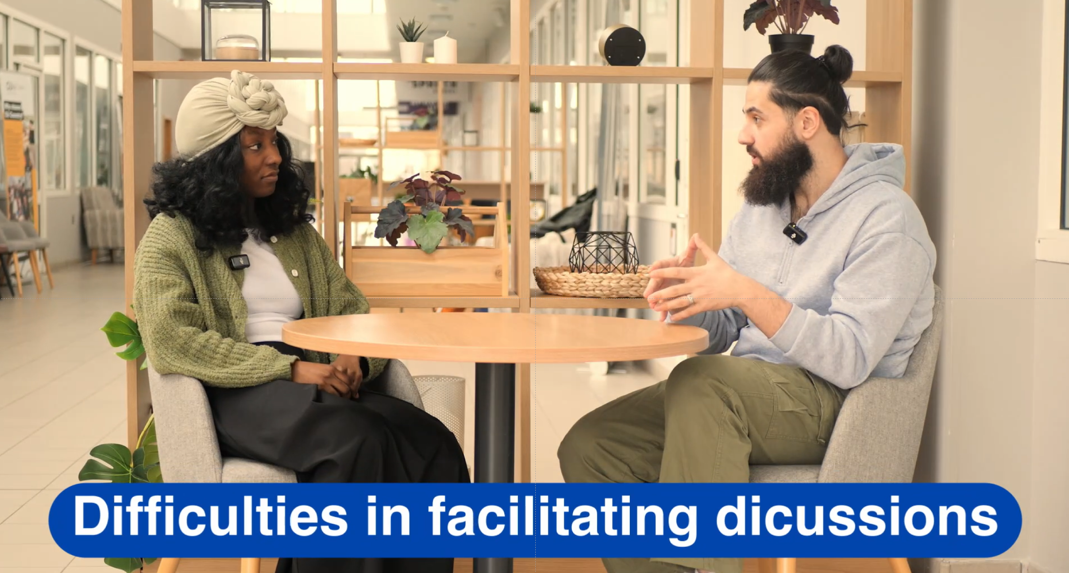
Notes:
OPTIONAL: Facilitators discussing their own struggles and questions around impartial facilitation.

Slide 19

Teaching impartially – 6 steps
1. Separate facts, perspectives, and judgements.
2. Use balanced, not leading, questions
3. Demonstrate balance through lesson structure
4. Use structure discussion formats as guide rails
5. Analyse opinions rather than persuading
6. Understand the role of SEND

Slide 20
Teaching impartially – step 1
When discussing a controversial issue - separate facts, perspectives, and judgements, start the lesson by explicitly saying:
“First, we’ll look at what is broadly agreed”
“Then we’ll look at different perspectives”
“Finally, we’ll reflect on ethical questions”
Why does this support impartiality?
Impartiality is shown by making a distinction between when you are presenting evidence or facts, and when you are exploring viewpoints, and inviting reflection.
Notes:
Run through these top tips for enacting impartiality guidance

Slide 21
Teaching impartially – step 2
When discussing a controversial issue - use balanced framing questions (not leading questions)
Instead of:
“Why is this idea harmful?”
“Why do people oppose this?”
Use:
“What problems can you see here?”
“Why do different groups see this issue differently?”
“What concerns are raised on each side?”
Why does this support impartiality?
The question encourages critical thinking and does not push students toward a conclusion.
Notes:
Run through these top tips for enacting impartiality guidance

Slide 22
Teaching impartially – step 3
When discussing a controversial issue - demonstrate balance through lesson structure
Deliberately make time in the discussion to seek multiple perspectives
Use third-person, neutral language
Acknowledge uncertainty and disagreement
To note - balance is a helpful way of being impartial, but you do not have to present balanced views on topics that do not require impartiality, e.g. racism, homophobia, antisemitism.
Why does this support impartiality?
Careful language, and openness about uncertainty show fairness without avoiding complexity.
Notes:
Run through these top tips for enacting impartiality guidance

Slide 23
Teaching impartially – step 4
When discussing a controversial topic - use structured discussion formats to manage the discussion safely.
Set clear behavioural ground rules
Focus on behaviour, not beliefs
Challenge the thinking not the thinker
Demonstrate active listening
Model disagreeing agreeably
Why does this support impartiality?
Ground rules that focus on respect and evidence, not on which views are acceptable, promote shared values. Structured discussion reduces conflict and perceived bias.
Notes:
Run through these top tips for enacting impartiality guidance.

Slide 24
Teaching impartially – step 5
Analyse, do not seek to persuade
Teach about political action, don’t mobilise students to a cause
End lessons with reflection, not resolution
Be explicit about your role as facilitator, e.g. “I am here to conduct the discussion with the aim of helping you decide what you think about a topic.”
Why does this support impartiality?
Emphasising your facilitator role, establishes an environment of open appraisal, and encourages critical thinking.
Notes:
Run through these top tips for enacting impartiality guidance

Slide 25
Teaching impartially – step 6
When discussing a controversial topic – support learners with SEND by scaffolding the debate.
Avoid overload by - focusing first on “What do people believe?” before “Is it right or wrong?” to support learners who struggle with abstract moral reasoning.
Pre-teach key concepts and language by - introducing emotionally charged terms in advance so they don’t derail engagement during discussion.
Make disagreement predictable by - using structured formats (sentence stems, turn-taking, discussion rules) to reduce anxiety around conflict or ambiguity.
Name neutrality explicitly - explaining that the goal is understanding different views, not agreeing or persuading. This helps learners who seek certainty.

Slide 26
Scenario 1
Discuss how you would respond if…
You are teaching a Year 9 class a lesson on a controversial social issue. Several students have SEND needs, including autism and ADHD.
During a discussion activity, one student becomes distressed and says:
Other students react strongly, and the room starts to feel tense.
“I don’t get why we’re even talking about this. One side is obviously wrong.”
Notes:
The following slides present some scenarios to consider. When delivering this session, you could use them all or focus on specifics. Each should take 5-7 mins to run through and discuss.
Consider…
How could you acknowledge the student’s distress without endorsing their view?
What structural support might help this student stay engaged without shutting down the discussion?
How could you reframe the task to focus on understanding perspectives rather than judging them?
What options could you offer if a student needs distance from open debate but still meets the learning aim?
How would you explain impartiality here in a way that feels reassuring rather than threatening?

Slide 27
Scenario 2
Discuss how you would respond if…
You are teaching a lesson on safe and respectful relationships. A students says that women and girls should not be able to teach Maths because their brains are not wired to understand logic.
You challenge the student, explaining this is sexist ( remember we do not need to be impartial about this). The student replies, arguing that in some countries the rights of women are different than here.
Notes:
Read the scenario, give them 5 mins to discuss, then feedback and summarise:
Set a clear boundary: State calmly that the original comment is sexist and not acceptable in the classroom.
Acknowledge without endorsing: Recognise that women’s rights differ in some countries, without treating this as justification.
Reframe to facts and values: Make clear that different laws or cultures do not mean women are less capable.
Anchor to school standards: Refer to equality, respect, and expectations in this school and under UK law.
Close the debate: Do not argue further; redirect back to the lesson focus.
Key principle for teachers
Impartiality does not apply to discriminatory or harmful claims.

Slide 28
Scenario 3
Discuss how you would respond if:
You are teaching about an international conflict during tutor time.
You follow the impartiality rules by providing multiple interpretations of the conflict, multiple ways it has been reported, etc.
Your personal views on the conflict are strong and you have attended protests in your own time on this issue. One of your students, during the lesson says,
“I saw you at the protest last week. Why don’t you just say what you really think?”
Notes:
Read the scenario, give them 5 mins to discuss, present back and then summarise:
Acknowledge the question calmly: Do not deny or appear defensive.
Reassert your professional role: Explain that your role in school is to facilitate understanding, not share personal political views.
Separate personal life from teaching: If comfortable, you could accept and acknowledge the fact they’d seen you at a protest BUT, you should quickly make clear that what teachers do in their own time does not determine how topics are taught in class.
Refocus on lesson purpose: Emphasise that the aim is to understand multiple perspectives so students can form their own opinion, not to persuade the students of your view, or anyone else's.
Close the issue and move on: Redirect back to the discussion without revealing personal views.
Model response (optional for notes)
“Teachers have personal views, but my role here is to help you understand different perspectives, not to tell you what to think.”
Key principle for teachers
Impartiality is shown through professional boundaries and facilitation, not personal disclosure.

Slide 29
Activity
In small groups, select a topic you know requires impartiality.
Plan a short discussion activity to run in form time on this topic. Use your learning from today’s session to outline your approach.
Present and explain your planning to the wider group.
Notes:
OPTIONAL: Practical activity that allows staff to practice tips they have been given on impartial teaching.

Slide 30
Summary
Teacher impartially is a statutory requirement
Impartiality guidance applies to topics that are inherently political
It is the duty of teachers to allow students space to develop their own opinions on these issues

