Slide 1

Debate and discussion in the classroom
Objectives
Be clear on why discussion in schools' matter
Practice the difference between debate and discussion
Be more confident in facilitating discussion and debate in classrooms
Have the tools to differentiate discussion and debate for all learners
Notes:
This set of slides can be run as CPD. The slides include presentation guidance should you wish to deliver to your peers. They can also act as tools for individual reflection. This module is also available as E-Learning on the Educate Against Hate platform.
Depending on how much time you have available, some slides are marked OPTIONAL.

Slide 2

Session structure
Understanding the difference between debate and discussion
Debate and discussion practice
Differentiation options

Slide 3
Why discussion matters
Classroom discussion matters because:
1
2
Many young people rarely speak opinions aloud
Online interaction rewards speed, not reflection
3
Online ‘likes’ replace weighing up ideas – the internet encourages black and white thinking
4
Classrooms may be the only space for real dialogue for many students
Notes:
Normalise the idea that speaking and listening are now learned skills, not givens.

Slide 4
Discussion vs. Debate
Discussion and debate are not the same. Both need structure - especially with controversial issues.
Discussion
Debate
Exploring ideas and experiences
Presenting and testing arguments
Notes:
Ask them which of these would be better/more useful when teaching controversial topics, e.g. Extremism.

Slide 5
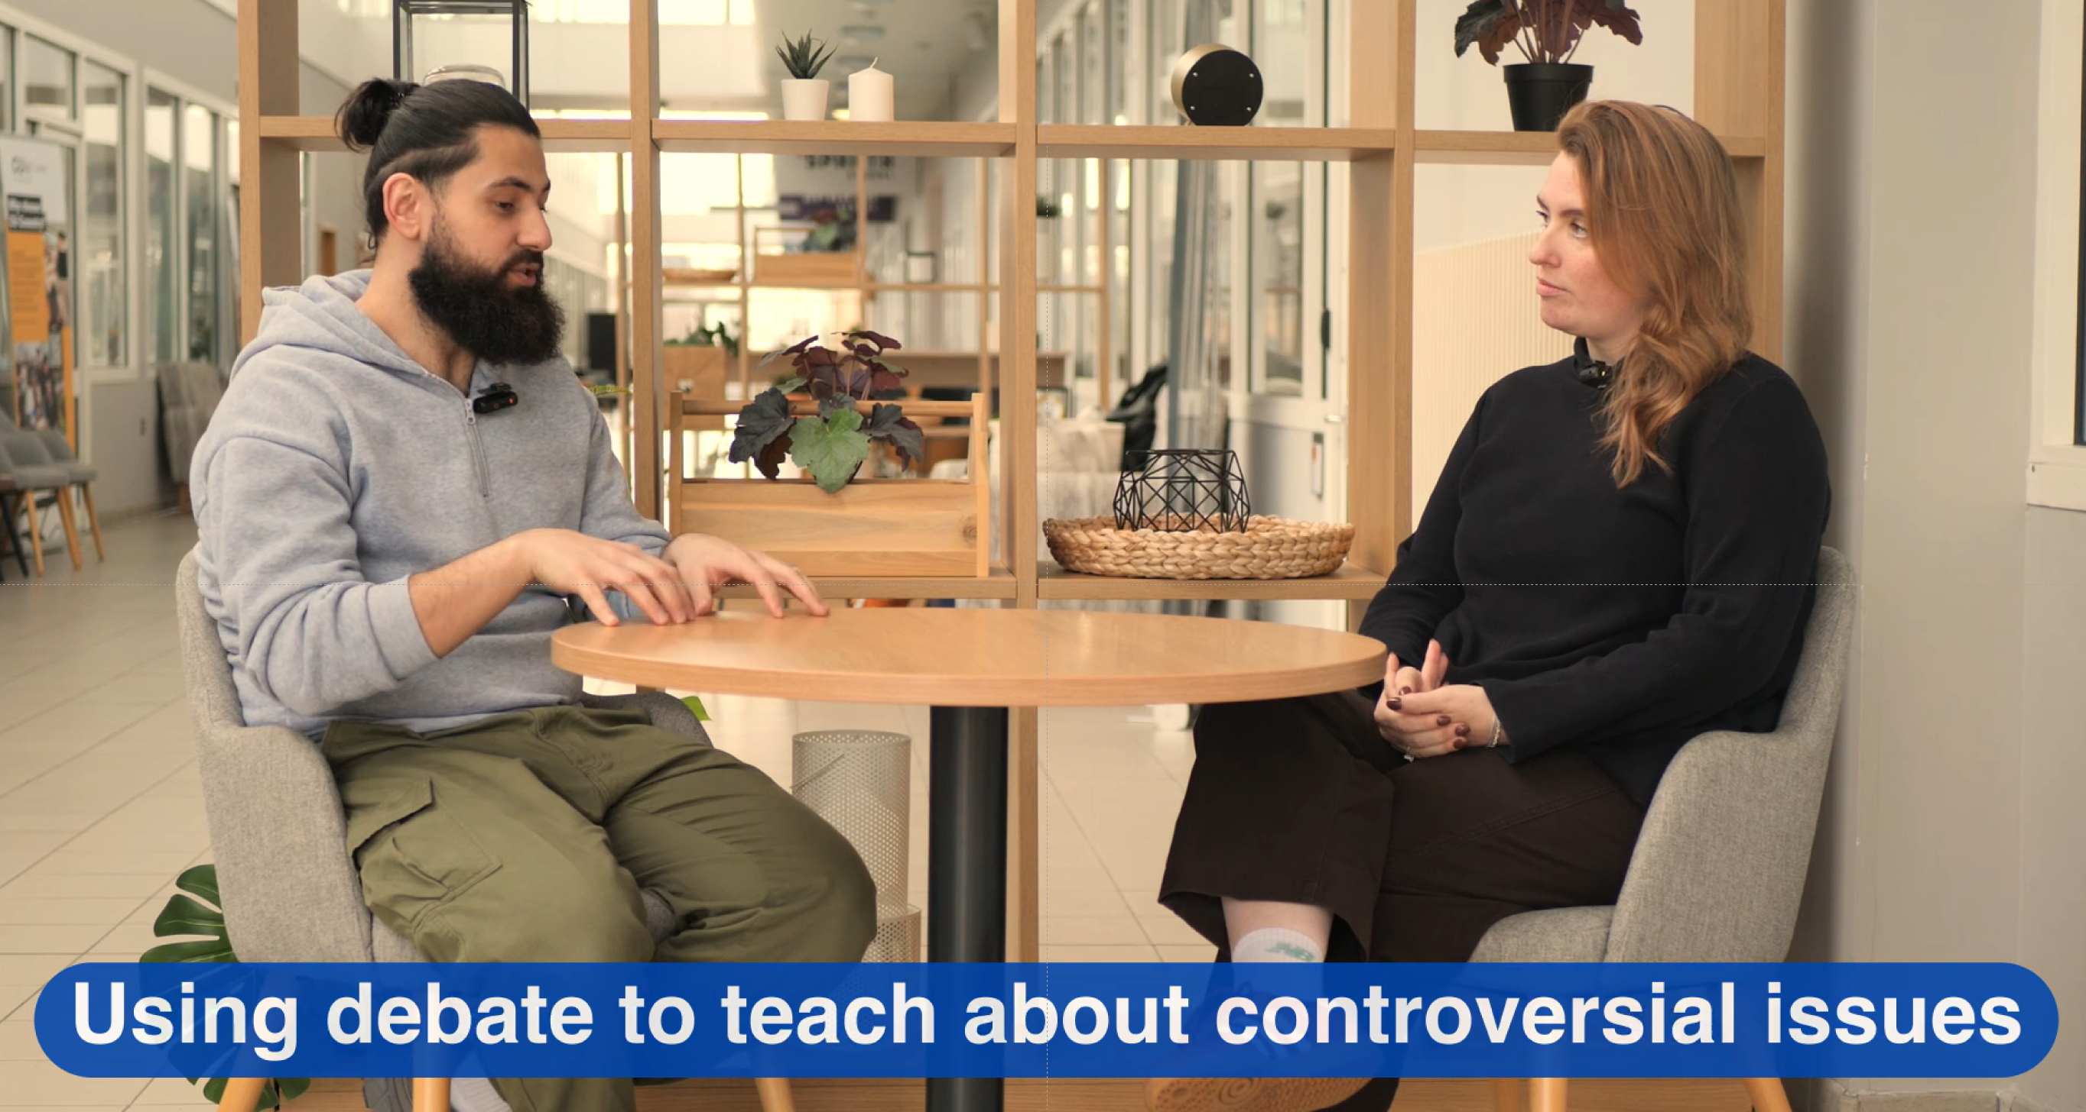

Slide 6
Discuss
For 10 minutes, we will discuss the statement on the screen:
Extremism is the issue that most divides communities
Notes:
The following slides are designed to demonstrate and experience the difference between debate and discussion. If you are reflecting on this individually, consider how these two experiences might feel different.
Facilitator ask questions like:
What are your initial thoughts on this statement?
How might extremism divide communities?
What is the impact of extremism?
What other issues divide communities?
What are your experiences? Do you feel comfortable sharing?
What might other people think about this statement?

Slide 7
Debate
Split into three groups. After, each group will present their arguments, allowing the opposite group to counter/respond each argument after it is made:
Extremism is the issue that most divides communities
Group 1
Create three arguments that support this statement
Group 2 & 3
Create three arguments that counter this statement
Notes:
After both the discussion and debate (should take 30 mins in total), have the group reflect on how they felt different.
Which did they enjoy more?
Which would be easier to conduct in classroom/form time?
What resources would they need to conduct either of them?

Slide 8

Which would you choose?
You want to speak to your students about Extreme Right-Wing Terrorism.
Would you choose:
Open discussion
Structured debate
Paired exploration
Silent written reflection
Why?
Notes:
This surfaces instinctive pedagogy and reinforces that format choice is part of risk management.
Spend no more than 5 mins on this discussion.

Slide 9
Tool 1: The Discussion Contract
A discussion contract is:
Co-created with students
Based on lived experience
Focused on behaviour, not beliefs
Individually, answer one question:
1) What helps you take part in discussion? or 2) What stops you taking part?
In groups, agree 3 rules you think matter most.
Notes:
Good discussion relies on:
Shared expectations
Psychological safety
Clear boundaries
Teacher facilitation
FACILITATION NOTES Stress that rules are enabling, not restrictive.
The model on the slide mirrors exactly what teachers would do with students.

Slide 10

An example contract
Common contract commitments include:
Listening without interrupting
Disagreeing respectfully
Taking part even when unsure
Asking for clarification
Valuing contributions

Slide 11
Listening as part of thinking
Discussion is not just speaking; it requires active listening. Listening skills often need teaching and practice.
Activity
In pairs: One person speaks for 1 minute on a neutral topic. The other person must paraphrase before responding. After, swap roles.
Notes:
OPTIONAL ACTIVITY: This activity allows teachers time to consider the role listening plays in facilitating debate and discussion. Run this if you want to land this point.
Debrief briefly: most people struggle to paraphrase accurately, often it helps to check back with your partner to see if you have properly understood. This also gives the partner or participant a chance to re-frame/re-phrase their point, especially after seeing how it has been understood by another person.

Slide 12
The right not to speak
In sensitive discussions:
Not all students will want to speak
Anonymity can be helpful
Written contributions may be safer
Safeguarding may be triggered
Students have the right:
To pass
To observe
To contribute later
Notes:
Run through the points on the screen.

Slide 13
Differentiation
Practical solutions might look like:
In what ways can students participate in lessons?
Exit cards or post-it notes
Anonymous question boxes
Voting or ranking activities
“Agree / unsure / disagree” cards
Written reflections before discussion
Written or anonymous contributions
Small-group or paired talk
Sentence starters and prompts
Time to prepare before speaking
Notes:
Ask the Q on the screen and then reflect on the answers: Speaking
Listening actively
Writing or drawing
Asking questions
Observing and reflecting
Challenge the assumption that “good discussion” means lots of confident speakers. Emphasise that thinking often happens internally before it becomes verbal, especially with complex or controversial issues.
Highlight that these approaches are especially useful early in a sequence, before moving to whole-group discussion.

Slide 14
Reflection
Think of a recent discussion you led or consider a discussion in this session. In pairs, discuss for 5 minutes:
Who spoke most?
Who spoke least?
How else might students have engaged?
Identify one change you could make next time
Notes:
This works well as a reflective activity. Avoid judgement; focus on noticing patterns and imagining alternatives.

Slide 15
Differentiation: SEND
Helpful strategies include:
Consider adapting debate by:
Removing time pressure
Reducing group size
Allowing written contributions
Using role-based participation
Avoiding confrontational formats
Clear structure and expectations
Visual prompts or agendas
Extra processing time
Predictable routines
Explicit modelling of responses
Notes:
Stress clarity and predictability. Many SEND learners benefit from knowing exactly what will happen and what is expected of them.
Explain that traditional adversarial debate can be overwhelming. Structured, cooperative formats often work better.

Slide 16

Designing inclusive discussion
Choose a topic you teach. In small groups, plan:
One way students could contribute without speaking
One way you would support a SEND learner
One thing you would avoid
Be ready to share one idea
Notes:
OPTIONAL ACTIVITY: To support staff with inclusive discussion design.

Slide 17
Summary
Schools are good places to attempt discussions of controversial topics
Discussion and debate are separate tools for facilitating conversation on controversial topics
There are ways to differentiate discussion and debate to include multiple kinds of learners

