Slide 1

Controversy and Conspiracy
Objectives
Understand why controversy feels harder to teach now
Be clearer about the aims of addressing controversial issues
Have practical tools for responding safely and confidently
Feel more confident closing difficult discussions
Notes:
This session focuses on building teacher confidence in responding to controversial and disputed issues, including conspiracy narratives, hate, and polarised topics, without escalating harm or breaching professional boundaries.
This set of slides can be run as CPD. The slides include presentation guidance should you wish to deliver to your peers. They can also act as tools for individual reflection. This module is also available as E-Learning on the Educate Against Hate platform.
Depending on how much time you have available, some slides are marked OPTIONAL.

Slide 2

Session structure
Why teach controversial topics?
What makes a controversial topic?
Tools to teach controversial topics
Critical Thinking
Curious questioning
Notes:
Emphasise confidence and judgement rather than expertise or perfect answers.

Slide 3
Why does this sort of teaching feel so hard today?
Teaching controversial issues feels harder because:
1
2
Social media accelerates misinformation
Hate and conspiracy are more visible
3
4
AI increases the credibility of fake content
Trust in institutions is lower
Notes:
Ask the group this question.
Then reveal some of the answers provided.
Normalise discomfort. This pressure is structural, not a failure of teachers.

Slide 4

Why schools still matter
Schools can still:
Model respectful disagreement
Build critical thinking
Reduce harm through dialogue
Safe environments
Strengthen resilience to extremism
Notes:
This reframes the work as protective and essential, not optional.

Slide 5
Discuss
How would you respond?
A student says:
“I’ve seen loads of videos saying women secretly want controlling relationships.”
Discuss:
Would you open this up for discussion?
What feels risky?
What feels necessary?
Notes:
This is about instinctive judgement. No right answers. Avoid debate at this stage - just surface reactions.
Give participants 5 mins to discuss in pairs and then ask for feedback.
Useful follow up questions you can suggest to staff include:
Where did you hear that?
What interests you about it?
Why do you think people share it?
Explain: These questions slow thinking without endorsing the view.

Slide 6
What makes a controversial issue?
Controversial issues?
Gender identity
Race and racism
Israel and Palestine
Legalising drugs
Terrorism
Gay marriage
Artificial Intelligence
Vaccinations
Votes for women
Climate emergency
Notes:
MAIN POINT: The circumstances that surround an issue – geography, time, mis/disinfo, individuals connected to an issue, can make it controversial or non-controversial. These contexts can change how we understand consequences, like protest or the police or hate speech.
Ask the participants to look at the screen and decide if the issues they can see are all examples of controversial issues.
Ask them why/why not
Pick out the issues people spend the most time on
Why might these issues be more or less controversial in today’s environment?
E.G Votes for women, in UK classrooms, remains to be a non-controversial issue. But there was a time when that wasn’t the case. Equally, the rights of women are often called into question by problematic influencers like Andrew Tate – how might these experiences contribute to the controversy of an issue? The same with Gay Marriage. In many spaces, this issue is entirely non-controversial, but same-sex marriage was not legalised in the Republic of Ireland until 2015 – so very recently (and still today in some spaces) was considered controversial.
Summarise:
A controversial issue usually:
Involves opposing viewpoints
Touches identity or values
Triggers strong emotions
Raises competing claims to truth

Slide 7
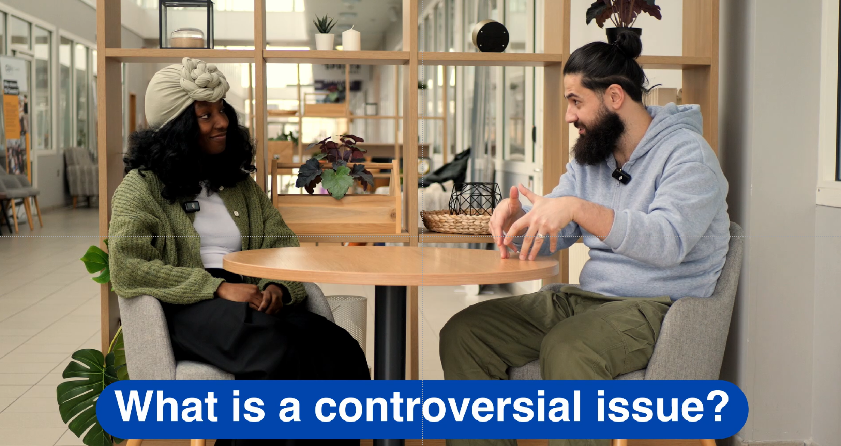

Slide 8
What are we trying to achieve?
When addressing controversy, we aim to:
Help students understand different viewpoints
Encourage evidence-seeking
Recognise harm and its impact
Support respectful challenge
Notes:
These aims stay constant even when topics change.

Slide 9
Controversial topics and SEND
Controversial topics can feel more complex in SEND spaces
Ambiguity can be cognitively demanding
Controversial issues often lack clear answers, which can be challenging for learners who prefer certainty or clear rules.
Emotional intensity is harder to regulate
Strong moral language, perceived injustice, or identity-linked topics can trigger overwhelm or shutdown.
Perspective-taking may require extra scaffolding
Understanding that reasonable people disagree can be harder for learners who think more literally or concretely.
Notes:
Run through the points and then have teachers reflect on any experiences of discussing controversial or political issues with SEND learners.

Slide 10
Controversial topics and SEND
Why controversial topics can feel more complex in SEND spaces
Social dynamics are less predictable
Open discussion can involve interruption, disagreement, or changing norms, increasing anxiety.
Language carries hidden complexity
Abstract, value-laden, or euphemistic terms can obscure meaning and create misunderstanding.
Past experiences may heighten sensitivity
Some learners may bring experiences of exclusion, bullying, or rigidity in previous learning contexts.
Notes:
Run through the points and then have teachers reflect on any experiences of discussing controversial or political issues with SEND learners.

Slide 11
Tools to teach controversial topics
Critical thinking
SEND considerations
Curious questioning

Slide 12
Discuss
In pairs, discuss the following questions:
What is critical thinking?
Are you a good critical thinker?
Where on the curriculum does critical thinking happen?
Do you feel confident teaching children critical thinking skills?
Notes:
Facilitate this discussion for 10 mins

Slide 13


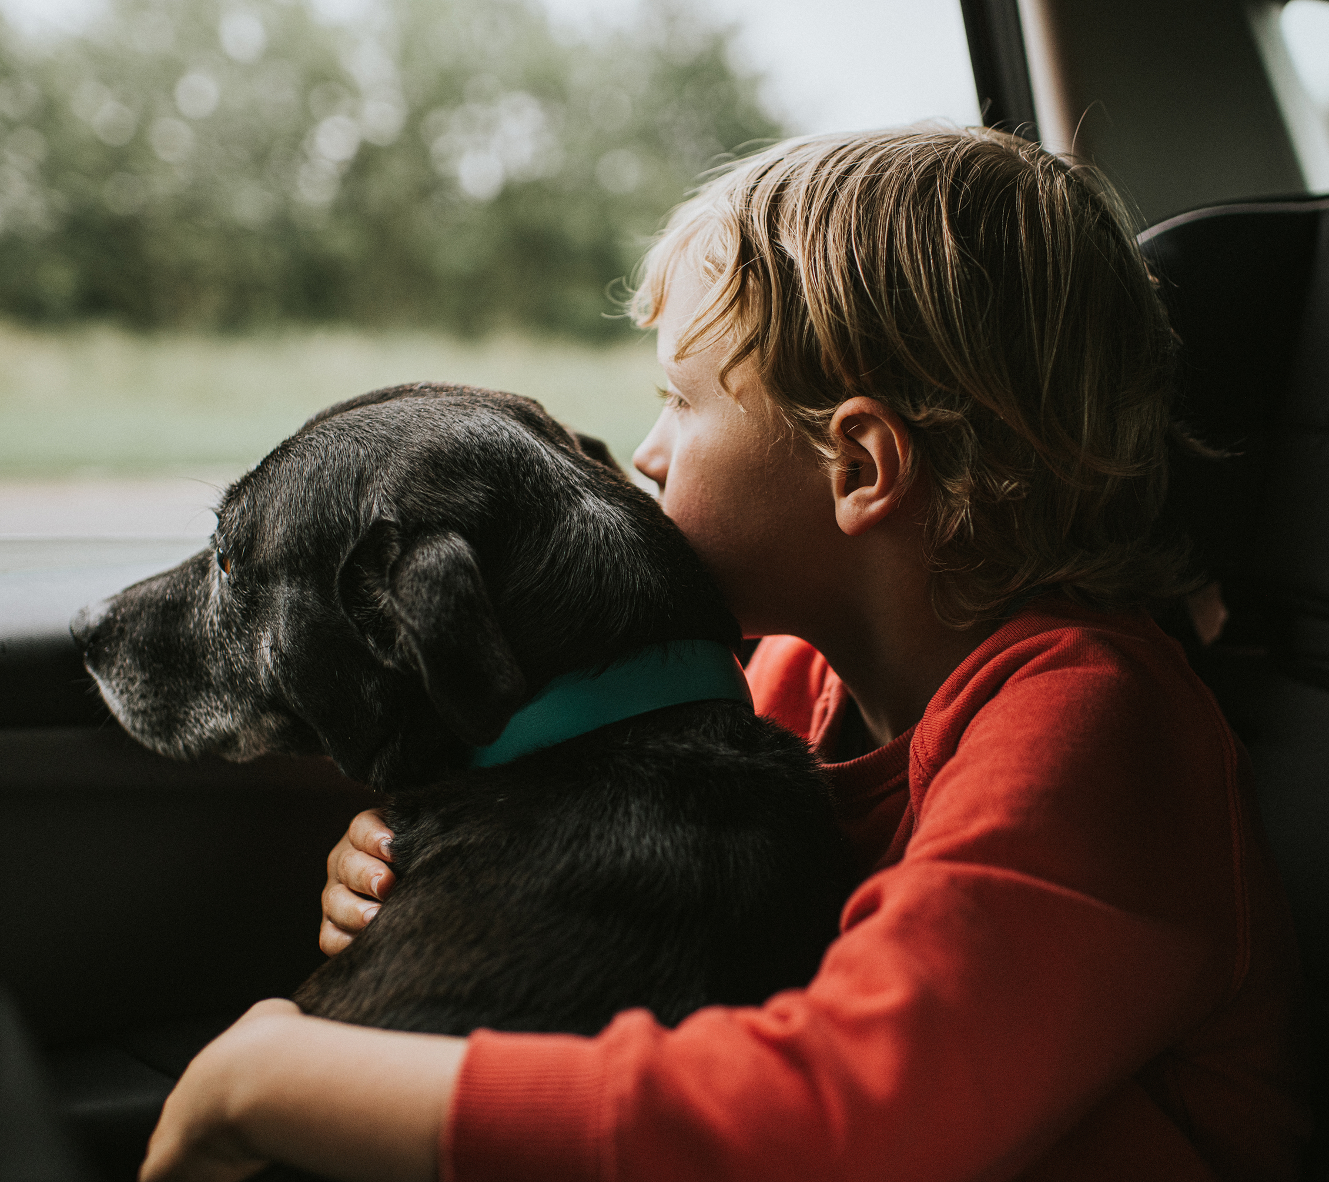

From philosophy for children
What is a chair?
Notes:
This activity is designed to have participants answer a seemingly simple question. Run discussion on it for 10 mins maximum. If you are accessing these slides as individual learning, consider your answers to the discussion questions and what this means for our reliance as educators on ‘critical thinking’ as a solution to teaching complex topics. Critical thinking is often more difficult than we would normally consider.
Ask the question. Most will say “It is something you sit on”
If we begin critically thinking (philosophers might call it conceptual analysis) we realise quickly it is a bit more complicated than that.
The images on the slide appear one at a time. You should ask the group each time:
Is this a chair?
Why/why not?
If, for example, someone agrees that a sofa is a chair, you might ask: well, why do we call it something else?
You can sit in a car seat, so is it a chair?
You can sit on a horse, so is it a chair?
The overall point of this activity is to expose the way we all make assumptions about the truth – it is a simple example, but helps to make the wider point about the need to ACTIVELY critically think. Most of the time we assume the things we see are true. We have to be PROACTIVE in our critical thinking and analysis.
Explain this is an activity adapted from a Philosophy for Children and Stan’s Cafe game, to help better understand critical thinking.

Slide 14
Activity
You will be given a statement that may challenge your own views. Your task is not to argue against the statement. Instead, you must try to understand:
Why someone might find it convincing
What experiences or concerns it speaks to
Why it might feel reasonable to others
Notes:
OPTIONAL ACTIVITY: Over the next 4 slides. This activity should take 15 mins. This is another opportunity to understand the difficulty of critical thinking.
There are a lot of arguments about the worth/value of critical thinking in education, but not much written or relayed about how difficult it is to teach. This is primarily because most people think that critical thinking is simply asking questions about the world around us. That is certainly part of it, but it is a much more complex task, that can require deep reflection and discomfort. To be a true critical thinker you must be willing to actively engage in ideas that are counter to you own, consider where they come from, why they appeal to others, how they might be relevant to your life, or even more broadly true.
To try and emulate this feeling, we will run the following activity.
Critical thinking is not just asking questions.
It often involves discomfort.
In this activity, you will be asked to engage seriously with an idea you may disagree with.
This activity is designed to feel slightly uncomfortable, but not unsafe. You are not being asked to change your beliefs or agree with anything — only to practise a particular kind of thinking.
Reassure participants that:
No one will be asked to defend a belief they hold
This is about process, not persuasion

Slide 15
Statements
“Freedom of speech should include the right to offend”
“Young men are being unfairly blamed for society’s problems”
“Strict immigration controls are necessary to protect social cohesion”
“Feminism has gone too far and now disadvantages boys”
Notes:
Participants should not choose the statement they agree with most - encourage them to pick one they find challenging.

Slide 16

Reflection questions
Work silently. Do not discuss yet.
Consider:
Why might this idea appeal to some people?
What fears, experiences, or values might sit behind it?
In what situations might it feel persuasive or reasonable?
Notes:
Silence matters here — it increases discomfort in a productive way.
Give 2–3 minutes.
Remind participants they are not being judged on their answers.

Slide 17
Reflection continued
In pairs, discuss:
What was hardest about this task?
When did you feel the urge to argue back?
Did understanding feel different from agreeing?
Notes:
This is where most of the learning surfaces.
Listen for:
Frustration
Resistance
“But that’s just wrong”
Relief at not having to defend the view
All of this is normal and useful.
Explain: This activity shows that -
Critical thinking is effortful
It can feel uncomfortable or unnatural
Understanding is not the same as agreeing
Emotional reactions are part of thinking
You can say:
“This is the kind of thinking we often ask young people to do, while we, as adults, rarely practise it ourselves.”

Slide 18
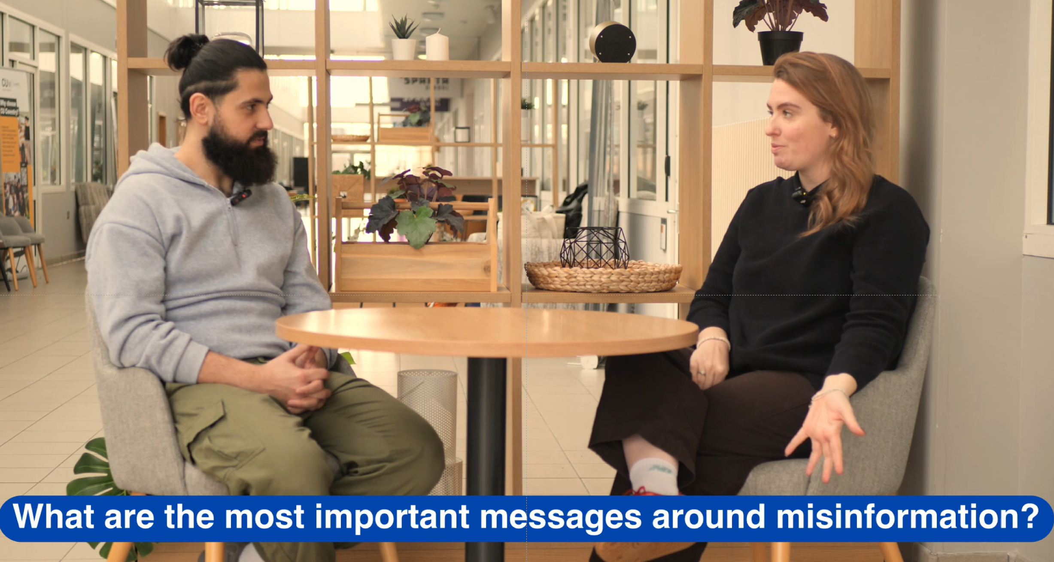
Notes:
OPTIONAL: This video is two expert facilitators discussing the role of emotion in teaching controversial topics, and explaining how they use a tool (featured on the Educate Against Hate platform) called Head, Heart, Conscience (From Facing History and Ourselves) to help students confront their emotions in the face of controversial or contested topics.

Slide 19
A critical thinker is someone who must…
1
4
Be prepared to search for evidence
Understand when and where there might be multiple views
2
Be able to tell the difference between misinformation and disinformation
5
Possess positive traits such as curiosity, compassion and communication
3
Question, acknowledge and test previously held assumptions and recognise ambiguity
6
Understand their own identity and emotions and the role these have in their understanding of information
Notes:
A summary slide to finish the activities on critical thinking

Slide 20
Critical thinking: Scaffolding
Critical thinking guidance is helpful but can be very unstructured and require ‘theory of mind’ processes that can be complicated for many young people.
Providing structured conversation to analyse if content and narrative is safe can help.
WHO?
WHERE?
WHY?
HOW?
A friend?
Someone at home?
Someone we don’t know?
Someone pretending?
Online?
Through social media?
In school?
In the news?
To make money?
To get followers?
To spread love?
To spread hate?
Happy?
Sad?
Confused?
Worried?
Excited?
Notes:
Explain: Much guidance in the prevention of violent extremism and exploitation tells us to hone our critical thinking skills. This is all well and good, but many young people struggle with the theory of mind processes this requires – essentially, the putting themselves in the shoes of another person to analyse motivations for behaviour.
Explain: This is not something that is only difficult for autistic young people, many children and young people (CYPs) struggle to empathise to high degrees when they cannot draw linkages between their lives and the lives of someone a little like them.
Explain: So, when conducting Critical Thinking activities, it can help to be more prompting. Provide scaffolding for the conversations – which essentially means guidance that breaks up the learning into smaller chunks, and providing closed choices and thinking by the CYP. For example, if we are asking CYP to consider the location of a source, provide some examples for them to choose from in most image and text.
Explain: For CYPs that need additional guidance, we could even show them content and guide them through the answers. For example, if you’re in a setting where there is particular interest in a conflict, explicitly tell them what kind of content could be illegal or could cause harm. Explain where they might see it and why it might be being shared. This can be especially helpful in relation to signs and symbols that have been coopted by terrorist organisations – explaining this to young people is important.

Slide 21
Differentiating when teaching controversial topics
In SEND-inclusive classrooms:
Clarify the purpose of the discussion
Make explicit that the aim is understanding viewpoints, not persuading or reaching agreement.
Structure uncertainty
Use clear formats (sentence stems, roles, step-by-step tasks) to make discussion predictable.
Separate thinking from communication
Allow different ways to engage, e.g. silent reflection, written responses, visuals, or supported talk.
Stage complexity
Start with “What do people believe?” before moving to “Why do they believe it?” or “What do I think?”
Pre-teach key language and concepts
Introduce emotionally or morally loaded terms in advance to reduce overload during discussion.
Offer regulated opt-in participation
Provide ways to step back from live debate without disengaging from the learning objective.

Slide 22
Curious questioning
F | A | C | E
Feeling | Accuracy | Credibility | Evidence
What is your emotional response to the story? Happy? Angry? Often disinformation is designed to evoke an emotional response | It might fit your world view, but can you acknowledge the possibility that it might not be true? | What organisation is it coming from? Is this a trusted source? | Are other news outlets running this? Is there evidence that can be checked elsewhere?
Notes:
Explain: This is a tool to help ask curious questions about information we see online.
We are going to practice it now!

Slide 23
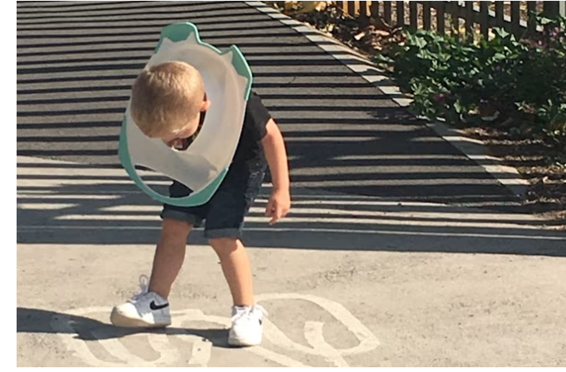
Curious questioning
“Toddler cut free from toilet seat after sticking his head down the loo”
F | A | C | E
Feeling | Accuracy | Credibility | Evidence
What is your emotional response to the story? Happy? Angry? Often disinformation is designed to evoke an emotional response | It might fit your world view, but can you acknowledge the possibility that it might not be true? | What organisation is it coming from? Is this a trusted source? | Are other news outlets running this? Is there evidence that can be checked elsewhere?
Notes:
This is a fun/non-political example! But give the group 5 mins to look into this story and ask these questions.
Then ask them to consider:
How might these questions help in relation to news/information about controversial topics?
Source: ITV News, Jan 2026
https://www.itv.com/news/westcountry/2020-08-04/toddler-cut-free-from-toilet-seat-after-sticking-his-head-down-the-loo

Slide 24
Establishing boundaries
For discriminatory or harmful views:
Set a clear boundary
Do not debate harm
Reassert respect and dignity
Redirect or close if needed
Notes:
These aims stay constant even when topics change.

Slide 25

Institutional values and policies
Community
Ambition
Resilience
Challenge
Care
Readiness
Creativity
Kindness
Respect
In small groups, discuss what your settings’ values are and how they may or may not provide an existing framework for responding to conflict in classrooms. Think about:
Is it possible to ‘enforce’ values?
How are values embedded in your setting?
What are your policies on bullying?
What behaviour management tools do you already rely on?
SCHOOL VALUES
Notes:
OPTIONAL ACTIVITY: Has staff considering how their institutions policies/values might support the teaching of controversial topics.
Run through slides/points on the screen
Ask participants to share what their institution’s values are

Slide 26
Rights Respecting Schools (RRS)
In an RRS everyone learns about their rights - and learns that everyone has rights regardless of who they are, and what they have done.
What are rights?
Rights are an agreed value system which cuts across all religions and none.
Rights provides a framework on what to respect and what to disrespect, to make judgements on competing values.
They help understand (not justify) conflict in terms of violations of rights.
Knowledge of rights enables confidence to challenge injustice but constrains violence and harm.
Notes:
Explain: Run through the points on the slide.

Slide 27
Rights Respecting Schools (RRS)
Knowledge of different sorts of rights is key to claims and counter claims, for example:
Freedom of expression is a qualified/restricted right not an absolute right
The right to freedom from harm supersedes a claim to a cultural right such as FGM
There is no right in international law not to be offended
Religions don’t have rights, people do
Right to self-defence does not override obligations under International Humanitarian Law
Notes:
Explain: Run through the points on the slide

Slide 28
Summary
Schools are good places to attempt discussions of controversial topics
Understanding and practising critical thinking is very important – so is understanding it is not easy and adding scaffolding where appropriate
You have tools available in your setting – consider school values or Rights Respecting programmes

