Slide 1

Researching Controversial Topics
Objectives
Confidence check - how do teachers feel about responding to discussion on controversial topics in the classroom?
Introducing the research road map: Terminology, evidence seeking, disinformation and multiple perspectives.
Activities – applying what you have learned
Training Workshop
Notes:
This session focuses on how teachers can build confidence researching complex or controversial issues, without feeling they need to be experts. The emphasis is on habits, judgement, and modelling good practice for students.
It emphasises that in many cases, preparation for this kind of teaching is key. It is ok to take the time to prepare.
This set of slides can be run as CPD. The slides include presentation guidance should you wish to deliver to your peers. They can also act as tools for individual reflection. This module is also available as E-Learning on the Educate Against Hate platform.
Depending on how much time you have available, some slides are marked OPTIONAL.

Slide 2

A common tension for teachers…
Teachers often feel a tension between:
Wanting to be well informed
Not knowing enough about fast-moving issues
Feeling pressure to have the ‘right’ answer
Notes:
Normalise this tension. Emphasise that uncertainty is common and professional, especially with complex or emerging topics.

Slide 3
Confidence check
Look at the statements below. Without researching, how confident you feel discussing each one with students?
Andrew Tate is followed by the majority of teenage boys
Extremism is clearly defined and universally agreed
Puberty blockers are widely prescribed to children in the UK
Most refugees arrive in the UK illegally
Notes:
This activity encourages teachers to reflect on their levels of confidence in discussing difficult topics with their students, specifically related to their levels of knowledge/understanding.
Ask teachers not to answer out loud or justify their views.
Invite them to silently note:
Confident
Unsure
Not confident at all
Reassure participants that this is not a test — it’s about noticing instinctive confidence levels.

Slide 4

Confidence check
Discuss in pairs:
Are these statements true?
Which statements felt hardest to judge?
What made them difficult?
Would you feel confident responding if a student asked about this?
What are our response options?
Notes:
Give the group 10 mins to conduct their discussion on these statements.
Use the final question to move onto one potential response option.

Slide 5
Response option - Diversion
Common responses include:
These techniques can be a useful default but can sometimes feel artificial or evasive if overused with young people.
What might be the impact of using this response option in relation to our previous statements?
“That’s interesting, but a better question is…”
“I don’t know, but what I do think…”
Notes:
Run through the content on this slide.
Ask for their answers to the question at the bottom.
The point of this activity is to get teachers comfortable with the possibility of not knowing and considering the ways they might respond in those circumstances, including to students in the moment and then after the fact, e.g. what to do afterwards.

Slide 6
Response Option - Fact check
Andrew Tate is followed by the majority of teenage boys
Extremism is clearly defined and universally agreed
it is not true that “most teenage boys follow him”
There is no single universally agreed definition
Puberty blockers are widely prescribed to children in the UK
Most refugees arrive in the UK illegally
They are not routinely prescribed to under 18s in England
It is not true that “most arrive illegally”
Notes:
Facilitators can run through these facts, but the main point is that understanding these realities takes work and research. They are also just some available sources from which we could draw. The main point of this slide is to explain research on these topics makes us better prepared to respond, but also that research can be time consuming and difficult in what is something called the ‘online information disorder’ (the endless information and content related to any given topic available online – much of which is not true).
Puberty blockers (England)
NHS England stopped the routine prescribing of puberty blockers for under 18s in March 2024 following evidence reviews (Cass Review context). GOV.UK+2Health Media+2
The UK government also introduced restrictions on puberty blockers for under 18s (based on expert advice) and has maintained them. GOV.UK
“Most refugees arrive in the UK illegally” (UK)
This statement is too broad and misleading. “Refugees” includes people arriving through authorised humanitarian routes and people granted protection after claiming asylum.
Home Office stats show that in the year ending September 2025, around half of asylum seekers arrived via illegal routes (e.g. small boats or clandestine). A further 38% had previously arrived on a visa or with other leave. GOV.UK
Also, small boat arrivals were less than two fifths of all people claiming asylum in the year ending June 2025. GOV.UK
Safer wording for teachers: “Some asylum seekers arrive irregularly, but many people seeking protection arrive through other routes, including visas and humanitarian pathways.”
“Andrew Tate is followed by the majority of teenage boys” (UK)
Evidence does not support “majority”.
YouGov found 84% of boys aged 13–15 had heard of Tate, and 23% of boys aged 13–15 had a positive opinion. YouGov
A Savanta poll found 32% of young men (16–25) had a positive view (not a majority). Savanta – Savanta
Work with over 300,000 young peope in the UK conducted by ConnectFutures tells us that young boys are no longer interested in Andrew Tate in the way they might have been in 2020-2023. Many young people we work with inform us their teachers’ interest in him is quite funny because he no longer relevant to them.
Safer wording: “He is widely known among boys, but positive support is not the majority.”
“Extremism is clearly defined and universally agreed” (UK)
The UK government published a new definition of extremism in March 2024, which shows there is an official definition, but that doesn’t mean there is universal agreement. GOV.UK+1
The definition attracted public and expert criticism and debate, illustrating that “extremism” remains contested. The Guardian
Safer wording: “There are official definitions used by government, but the concept is debated and contested.”

Slide 7
Response option: A sustainable approach
Instead of deflecting, we can:
Develop habits of research
Know where to look for reliable information
Model good research behaviour to students – look for the facts and evidence together
If unprepared, it is always appropriate to say to students:
“That is an excellent question. I am not sure of the answer, but I will go away and find some information to share with you.”
Notes:
This shifts confidence from ‘knowing everything’ to ‘knowing how to find out’.

Slide 8
Research road map
Finding multiple perspectives
Searching for disinformation
Searching for evidence
Understanding terminology
Notes:
Over the following slides, we will consider the important aspects of research and preparation.
We will also suggest some of the best places to look.
We will consider:
Understanding terminology
Searching for evidence
Searching for disinformation
Getting multiple perspectives

Slide 9
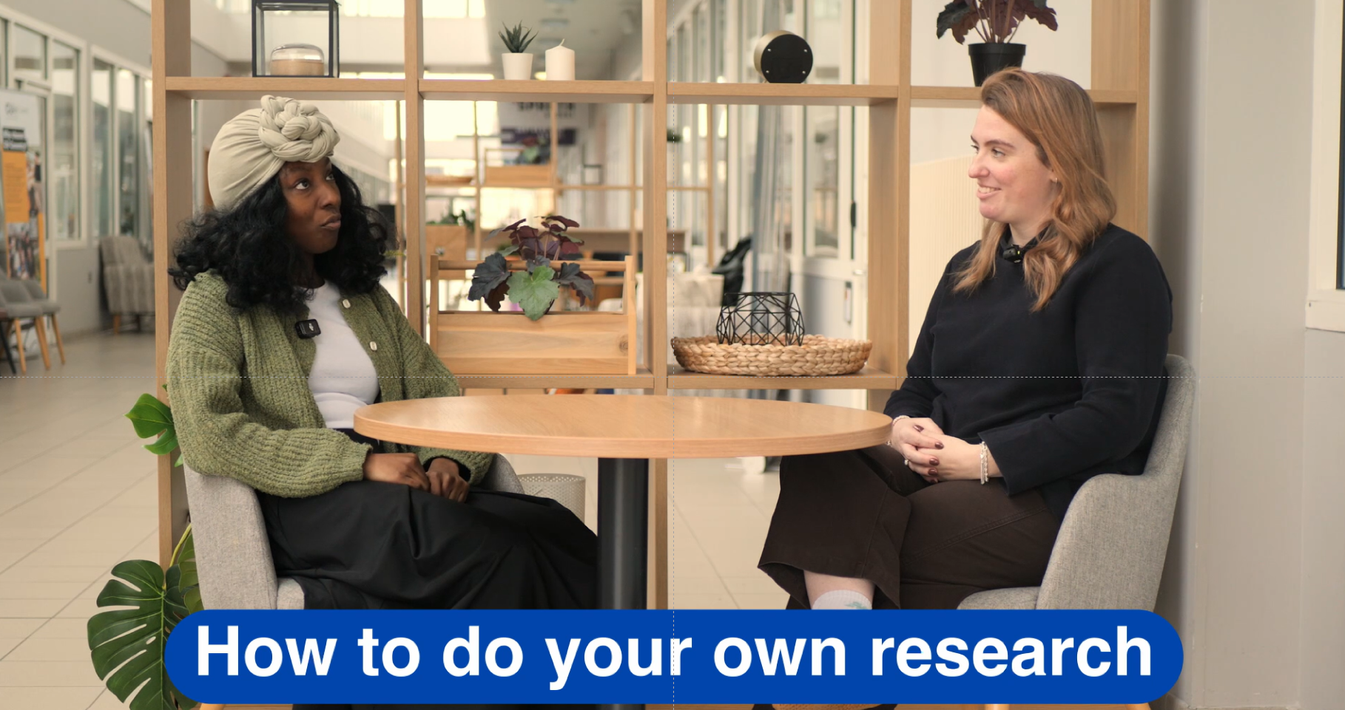
Notes:
OPTIONAL: Facilitators discussing the research road map tool and how teachers can research on topics they are unsure about.

Slide 10

Get clear on terminology - Extremism
Free dictionary ‘A person who advocates or resorts to measures beyond the norm, especially in politics’.
Archbishop Desmond Tutu ‘When you do not allow for a different point of view; when you hold your own views as being quite exclusive; when you don’t allow for the possibility of difference’.
HM Government (2015) ‘Extremism is vocal or active opposition to fundamental British values, including democracy, the rule of law, individual liberty and mutual respect and tolerance of different faiths and beliefs. We also include in our definition of extremism calls for the death of members of our armed forces, whether in this country or overseas’.
Notes:
This discussion aims to show how complex topics often need to start with discussion related to meaning. It is to demonstrate the first step in the research road-map and how a teacher might go about it with students. If running as a CPD, spend no longer than 10 mins on this discussion.
Link to the following slide to reinforce and practice.
One tactic when discussing topics that are debated, is to provide multipe definitions and discuss the ways in which they are useful and relevant.
This slide demonstrates this activity, related to the concept of extremism.
Run this discussion with your participants to model how they might run it with their students.
Read out the definitions and ask:
Is this a helpful definition? If yes, why? If no, why?
What is helpful about this definition?
What is it missing?
Where is it from? Why is this important?
Does this match how you understand extremism?
Do you like this definition?

Slide 11
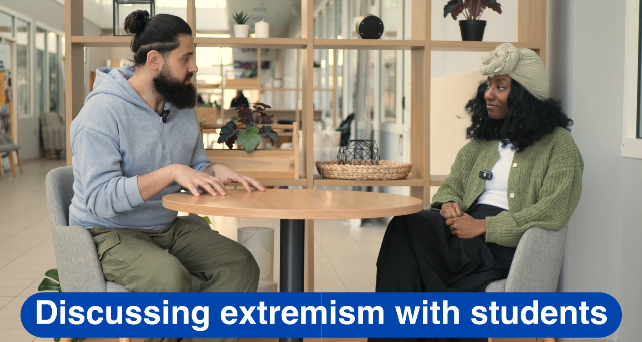
Notes:
OPTIONAL VIDEO: Shows expert youth facilitators discussing HOW they facilitate discussions on contested language and controversial topics, in this case, extremism.

Slide 12
Searching for evidence
Most students use social media to receive their news.
Full Fact
Ground News
BBC Verify
Reuters Fact Checking
Your task, in groups:
Use your own social media to find information about the topic we are researching.
Then, using the websites on the right, verify the claims you found on social media.
Notes:
OPTIONAL ACTIVITY: This activity introduces teachers to some of the resources that do a lot of the Fact Checking work for them.
Trainer should pick a topic that is dominant in the news at the time.
Run through the task on the screen. Give the group 15 mins, including time to report back.
Explain: Reputable fact-checking websites, such as Full Fact or Snopes, provide independent verification of claims circulating in the media. Encourage students to consult these sites when in doubt, and to check whether a claim has already been investigated.
Using such resources helps build habits of verification and reduces the spread of false information in the classroom.

Slide 13
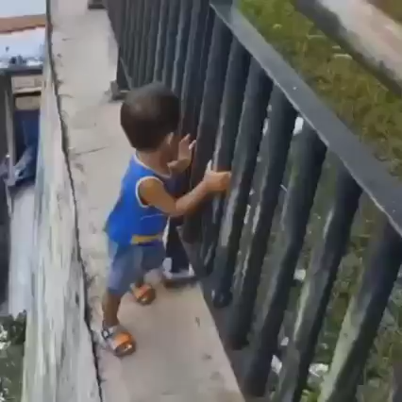
Searching for disinformation
What is happening in this video?
How does it make us feel?
Why would its creator want us to feel that way?
What does it tell us about the online information disorder?
Notes:
Explain that the following few slides are an introduction to mis/dis/mal-information. It is important that we are aware of the Fake News surrounding the topics we hope to teach so we can anticipate and discuss it with our students.
This slide acts as an introduction to this topic. Play the video and have the group answer these questions.
Emphasise that much disinformation online exists to provoke reactions in viewers. The stronger the reaction, the more likely the content is shared/engaged with – which ultimately makes the content monetizable. Explaining this to students is important. We sometimes call it ‘seeing through the hype’.

Slide 14
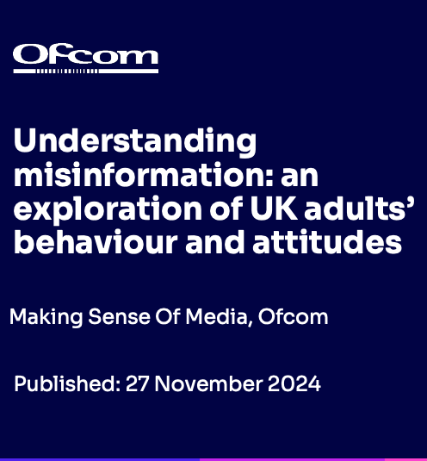
Searching for disinformation
Over three-quarters of UK adults agree that it’s important to check different sources for news.
A quarter of UK adults say they have used a fact checker website or tool at least once
When asked to decide which statements about current affairs were true or false, three in ten UK adults believe that there is a single group of people who secretly control the world together, and a similar figure believe that there is significant evidence of large-scale election fraud.
Four in ten are sceptical of conventional news production processes and only one-third agree that journalists follow codes of practice
Notes:
Introduce this as a “this is how the land lies” kind of slide. Explain, these stats come from ‘Understanding misinformation’ report, from Ofcom 2024.
The first two statements on the slides show there is an understanding amongst adult populations that misinformation exists and information needs checking more generally.
The second 2 show that misinformation still impacts, despite the fact we believe we know it exists.

Slide 15
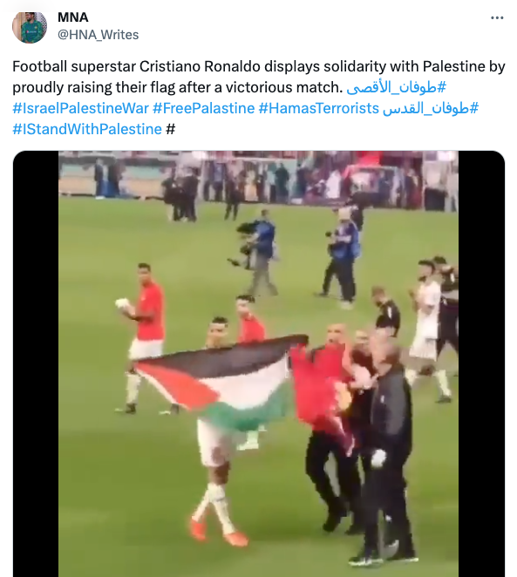
Searching for disinformation
Misinformation
False or misleading information shared without intent to harm (e.g. sharing a fake story believing it’s true).
Notes:
Run through the definition on slide and explain each image/video included.
Image 2: This viral video, with more than 50,000 views, is misleading. It shows Moroccan national football player Jawad El Yamiq waving a Palestinian flag after his team defeated Canada at the 2022 World Cup in Qatar. Several international media outlets covered the event at the time and took photographs of the jubilation.
The video in question can, for example, be found on YouTube, where the World Cup is mentioned. If you look closely, you can see another man in the clip waving a Moroccan flag next to El Yamiq. The Moroccan team waved Palestinian flags several times after their victories.
We do not know if the sharer knew the information being shared was false- but this image went viral on twitter at the time.

Slide 16
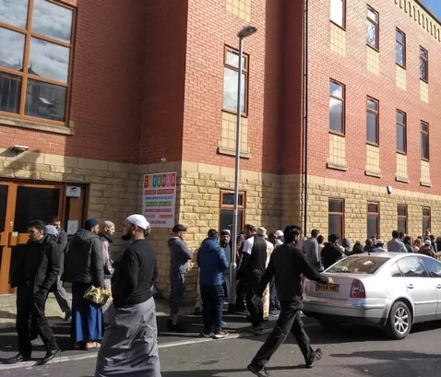
Searching for disinformation
Malinformation
True information shared to cause harm, often taken out of context (can include doxxing, leaking private data).
Notes:
Run through the definition on slide and explain each image/video included.
Image: From FullFact.org – shows a picture taken outside a Mosque in Leeds. The image was shared widely during the coronavirus lockdown, alongside the narrative that Muslims going to mosque were not complying with lockdown rules. The image was in fact taken BEFORE the pandemic began.

Slide 17
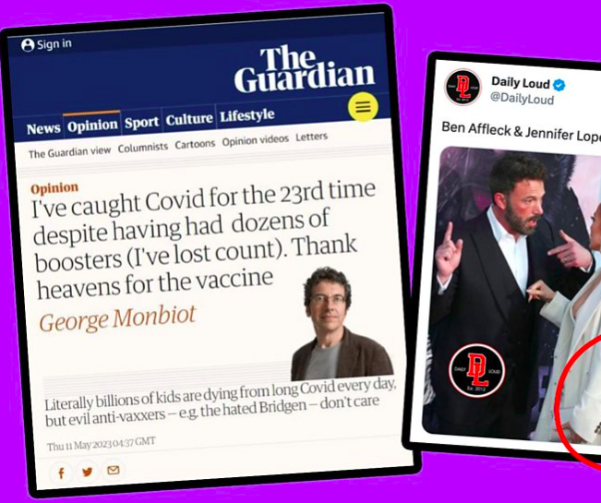
Searching for disinformation
Disinformation
False information shared with intent to deceive or cause harm (e.g. propaganda, conspiracy content).
Notes:
Run through the definition on slide and explain each image/video included.
Image: From BBC details two cases of disinformation BBC verify sourced.
We do not know if the sharer knew the information being shared was false- but this image went viral on twitter at the time.

Slide 18
Activity
1
A Facebook post claims a celebrity has died, but it’s a hoax shared by someone who thought it was true.
2
A fake political ad spreads online saying an election date has changed to stop people voting.
3
A relative shares an unverified health ‘tip' they saw on WhatsApp.
4
A genuine photo of a local protest is reposted years later to stir tension in a new context.
5
A journalist publishes leaked private messages from a politician that expose hypocrisy on a public issue. The messages are genuine and cause public outrage.
Notes:
OPTIONAL: This activity embeds the learning from the previous slides and introduces teachers to potential nuances. Only run if there is time.
Explain: This activity can be run with young people or adults to help them decide what counts as mis/dis/mal-information.
Facilitator Notes: “Truth, Trick, or Twist?” Activity
Purpose:
Help adults understand and apply the differences between misinformation, disinformation, and malinformation through short examples.
Timing:
10–12 minutes
Instructions for Facilitator:
Begin by briefly defining the three terms aloud:
Misinformation: False information shared without intent to cause harm.
Disinformation: False information shared with intent to deceive or cause harm.
Malinformation: True information shared to cause harm, often taken out of context.
Tell participants:
“I’ll read a few short examples. For each one, type in the chat — or say out loud — whether you think it’s misinformation, disinformation, or malinformation. Then we’ll discuss why.”
Read each example slowly and allow a few seconds for responses.
Examples and Correct Answers:
Example 1: “A Facebook post claims a celebrity has died, but it’s a hoax shared by someone who thought it was true.”
→ ✅ Misinformation — false, but no intent to harm.
Example 2: “A fake political ad spreads online saying an election date has changed to stop people voting.”
→ ✅ Disinformation — false and intentionally deceptive.
Example 3: “A genuine photo of a local protest is reposted years later to stir tension in a new context.”
→ ✅ Malinformation — true, but shared to mislead or inflame.
Example 4: “A relative shares an unverified health ‘tip’ they saw on WhatsApp.”
→ Example 5: ✅ Misinformation — false or unverified, but likely well-intentioned.
A journalist publishes leaked private messages from a politician that expose hypocrisy on a public issue. The messages are genuine and cause public outrage.
→ ✅ Tricky case — could be malinformation if the intent is to damage reputation rather than inform the public.
But you can also discuss how public interest complicates this — sometimes sharing true, sensitive information serves accountability rather than harm.
Facilitator note:
Use this one to spark discussion about intent, context, and public interest.
Ask participants:
“When does exposing wrongdoing become necessary transparency, and when does it become malinformation?”
“How do we judge motive and harm online?”
After each example, briefly explain why that’s the right category.
Conclude with a quick reflection question:
“What makes it hard to tell intent online? What simple checks could we use before sharing?”

Slide 19
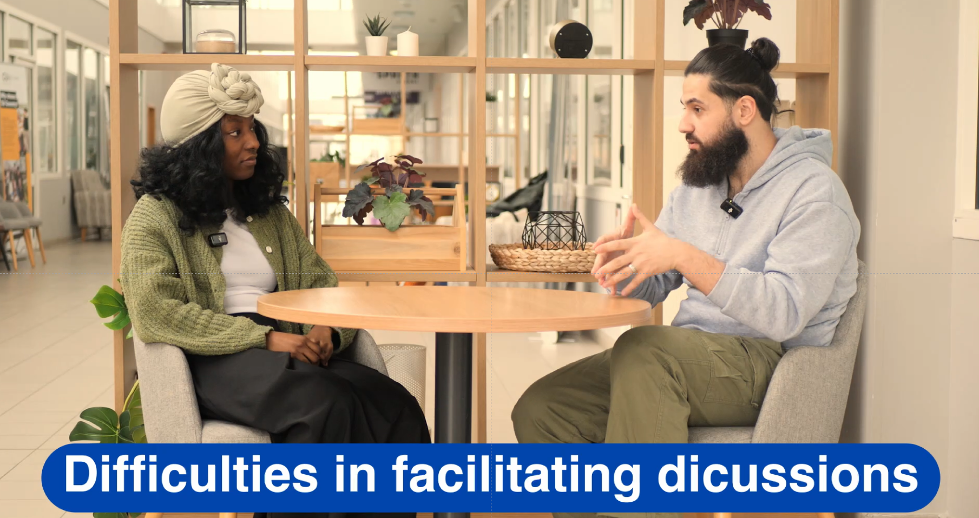
Notes:
OPTIONAL VIDEO: Facilitators discuss how they speak to young people about mis/dis/malinformation in UK classrooms.

Slide 20
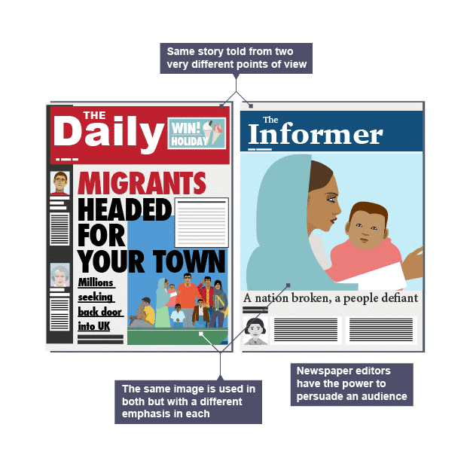
Seeking multiple perspectives
Different news outlets often report the same story in varied ways, highlighting certain facts or viewpoints while downplaying others. Comparing coverage allows you to identify these differences and consider why they exist.
Encourage students to examine headlines, language, and the selection of sources to uncover how narratives are constructed and what might be omitted.
Source: BBC Bitesize
Notes:
Bias in media can appear through word choice, selective use of facts, or emotional framing. Spin involves presenting information in a way that supports a particular agenda or interpretation.
Help students develop a critical eye for spotting loaded language, unbalanced reporting, or the omission of alternative perspectives.
Media organisations tailor their content to appeal to specific audiences, which can influence the tone, focus, and depth of coverage. Editorial policies also play a role in shaping what is reported and how.
Discuss with students how understanding the intended audience and editorial stance can provide insight into why stories are presented in particular ways.
Algorithms and chatbots increasingly determine what news and information people see online. These digital tools can reinforce existing beliefs by prioritising content that matches users’ preferences.
Encourage students to reflect on how their online experiences may be shaped by unseen digital influences, and to seek out a range of sources to broaden their perspective.

Slide 21
Cases for classroom use
Students will
A refugee hostel in your town has been attacked by a far-right group. There were minor injuries but significant property damage. The event has quickly become the subject of media coverage, public protests, and political debate.
Analyse how different media outlets report the same event.
Identify facts vs. opinion and emotional framing.
Examine legal frameworks related to asylum, protest, and expression.
Discuss the role of language, imagery, and statistics in shaping public opinion.
Notes:
Explain these are some cases you could use to practice the skills from today’s session with your students.
If there is time, facilitators can assign groups one of these cases for them to consider themselves. Give the group 20 mins to complete this task (looking into the case and then following the instructions on the screen).

Slide 22
Cases for classroom use
Students will
A politician gives an interview in which they complain that there are “too many immigrants arriving in this country.” The comment circulates widely online and in the media. Some people agree with the statement, others argue it is misleading or inflammatory, and others say it ignores the history of the area.
Examine how political statements can simplify or distort reality
Use data to assess claims about communities and identity
Understand how history shapes present-day demographics
Reflect on how language influences public debate about place and belonging
Notes:
Explain these are some cases you could use to practice the skills from today’s session with your students.
If there is time, facilitators can assign groups one of these cases for them to consider themselves. Give the group 20 mins to complete this task (looking into the case and then following the instructions on the screen).

Slide 23
Summary
Teachers do not need to be experts in all topics and it is ok to tell your students this
Research and fact-checking can support the teaching of controversial issues
Seek out mis, dis, malinformtion on trending topics
Seek multiple perspectives on controversial news stories

Slide 24
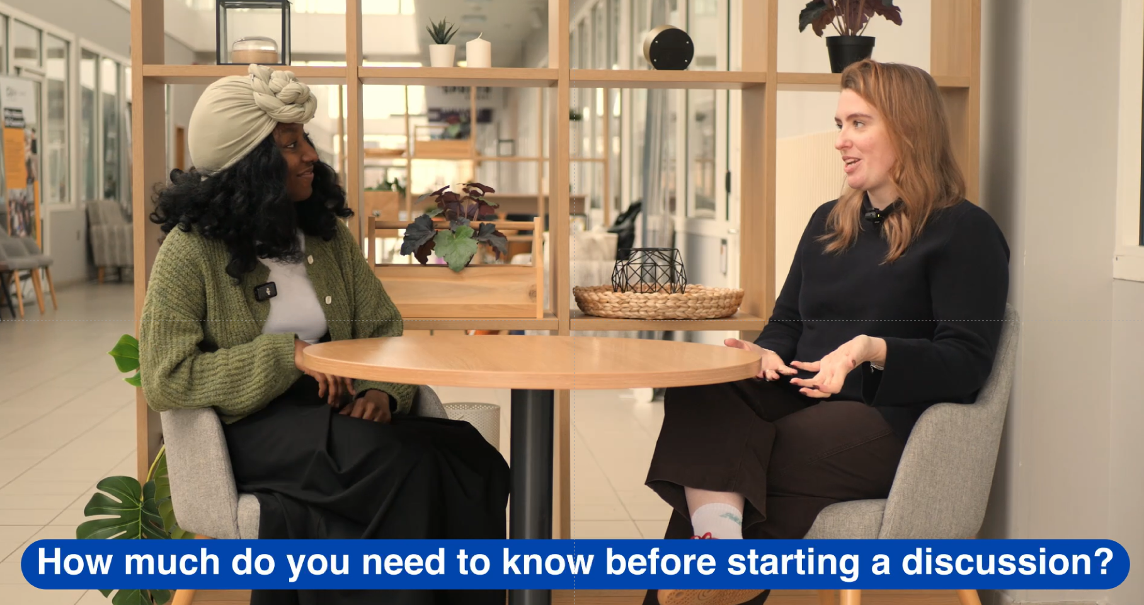
Notes:
OPTIONAL: Expert facilitators summarise their main takeaways on this topic – research is important, but teachers should not feel pressure to be subject matter experts in everything.

