Slide 1

Understanding Risk in Classroom Discussions
Objectives:
Understand different types of classroom risk
Be able to weigh risk against educational benefit
Identify practical mitigations that support safe discussion
Feel more confident making professional judgements
Training Workshop
Notes:
This session focuses on how teachers can make informed, confident judgements when teaching controversial or sensitive topics. The aim is not to avoid risk, but to recognise it, weigh it against educational benefit, and apply appropriate mitigations.
This set of slides can be run as CPD. The slides include presentation guidance should you wish to deliver to your peers. They can also act as tools for individual reflection. This module is also available as E-Learning on the Educate Against Hate platform.
Depending on how much time you have available, some slides are marked OPTIONAL.

Slide 2

Session structure
Why should we think about risk in classroom discussions?
Consider what risk is and why we must proactively prepare for it.
How do we manage risk?
Introducing the risk matrix to help make informed decisions about our practice
Scenario work and planning

Slide 3

Consider
You are teaching tutor time the morning after a major international incident.
Students arrive having seen graphic footage, misinformation, and strong opinions online.
Several students ask:
You are unsure whether discussing it will help or make things worse.
“Are we going to talk about what happened?”
Notes:
This discussion aims to have teachers consider risk related to discussing a controversial topic.
Ask teachers to pause and think about this scenario before discussing risk.
You might prompt them verbally with one or two of the following questions:
What are the risks of opening this discussion?
What are the risks of avoiding it?
Who might be affected either way?
What support or preparation would you want in place before responding?
Do not seek definitive/sure answers yet. Instead explain that this is about surfacing instinctive reactions – that is what we are most interested in.
Reassure participants that feeling uncertain here is normal and professional.

Slide 4
Reflection
What feels most risky in this moment?
Saying the wrong thing
Allowing harmful
views to surface
Escalating tensions
Avoiding the topic
altogether
Notes:
This helps teachers recognise that risk is not just about speaking, but also about silence. Elicit feedback then click through to display common concerns.
Use this to transition directly into the next slide on why we need to think about risk deliberately rather than reactively.

Slide 5
Why think about risk?
Discussing controversial issues always involves some risk
Risk is not the same as wrongdoing
Avoiding certain issues can also cause harm
Notes:
Avoiding discussion can leave misinformation unchallenged and students unsupported. The question is not “Is this risky?” but “Is the benefit worth the risk, and how do we manage it?”

Slide 6
What affects risk?
Risk depends on many factors, most notably:
School and community context
Age and experience of students
Existing relationships and trust
Whole-school culture and support
Notes:
The same activity may be low risk in one setting and high risk in another. Professional judgement is essential.

Slide 7
Discuss
In your context, how might the level of risk differ when discussing:
- Israel-Hamas conflict
- Immigration control
- Puberty blockers
Points to consider:
Your student cohort
Your parents
Your wider community
Your school culture/values
Local demographics and lived experience
Recent local or national events
Existing tensions or vulnerabilities
Level of staff and SLT support
Notes:
OPTIONAL DISCUSSION: This discussion (over this and the following slide) supports teachers to reflect on the risks associated with discussions on various topics, with specific audience/stakeholders.
Explain that there are no universal right or wrong answers here.
The purpose is to practise contextual judgement, not to decide whether these topics should ever be taught.
Ask participants to work in pairs or small groups.
Give them 10 mins to discuss these questions. Use the guidance questions on the next slide to help them.

Slide 8
Discuss
When thinking about each topic, consider:
What are the possible educational benefits?
What are the main risks in your setting?
Who might be particularly affected?
What might increase or reduce risk?
Notes:
Encourage teachers to think beyond “complaints” and consider emotional impact, misinformation, existing tensions, and safeguarding.
Remind them that a topic can be high benefit and high risk at the same time.
Have the group feedback. Use the below questions if you feel further reflection is needed:
Which topic felt most risky in your context?
Did anyone feel avoiding a topic might also carry risk?
What support would help you feel more confident?

Slide 9
Specific risks when discussing controversial issues with SEND learners
Black-and-white moral reasoning
Some learners may gravitate towards absolute claims (“only one truth”, “everyone else is lying”), increasing susceptibility to extremist or conspiratorial narratives
Over-identification with grievance narratives
Experiences of exclusion, injustice, or marginalisation can make simplified blame stories feel personally validating
Literal interpretation of provocative content
Satire, hypotheticals, or extreme examples may
be taken at face value rather than as tools for discussion
Notes:
Run through the points – ask if anyone has experienced these.

Slide 10
Specific risks when discussing controversial issues with SEND learners
Emotional dysregulation escalating discussion
Heightened emotional responses can shift dialogue from exploration to defensiveness or withdrawal
Social imitation or echoing
Learners may repeat extreme or conspiratorial language without understanding its origins, implications, or harms
Difficulty distinguishing exploration from endorsement
Discussing ideas “as examples” may be misread as legitimising or validating them
Notes:
Run through the points – ask if anyone has experienced theses.

Slide 11

How do we manage risk?
Effective mitigation often relies on:
- Clear SLT guidance
- Shared school values and expectations
- Prior student learning and practice
- Strong safeguarding culture
- Differentiated sessions based on age and SEND need
Notes:
Many mitigations need to exist before a difficult discussion happens. Individual teachers should not feel they are carrying risk alone.
Give them the below context:
Examples of whole-school mitigations:
SLT clarity on responding to controversy
Communication plans with parents
Staff training on impartiality
Clear safeguarding protocols
AND
Lower risk when students have:
Experience of respectful discussion
Practice challenging stereotypes
Media and misinformation literacy
Understanding of rights and responsibilities

Slide 12
Managing Risk
In the following activities we will:
Identify potential risks of specific discussion topics
Consider educational benefits
Plan mitigations in advance
The following scenarios have all taken place in schools – we will now consider the possible benefits, risks and required mitigations for each scenario to inform your own practice.
Notes:
Explain that the next slides walk through real classroom scenarios using these three steps

Slide 13
How should you respond?
Group Activity
In a Science lesson, a student in your tutor group makes a racist comment. The subject teacher makes you aware. They did not intervene other than to ask the student to say sorry.
You want to discuss prejudice in your tutor group.
What are the:
Possible benefits?
Possible risks?
Possible mitigations?
Notes:
Now it is up to participants to consider the:
Possible benefits
Possible risks
Possible mitigations
For the scenarios on this slide.
Give the group 5-7 mins to discuss, feedback and then run through the below reflections:
If challenged:
Harm is not normalised
Affected students feel supported
Risks:
Tension may escalate
Silence can legitimise harm
Key message: silence is often riskier than calm challenge.
Possible mitigations:
Remind students of discussion rules
Use boundary statements
Ask reflective questions
Focus on respect and impact

Slide 14
How should you respond?
Group Activity
A protest took place in your town/city, and it turned violent. It has begun receiving local press interest and police inform the school national news outlets are likely to pick it up.
You want to discuss this with your year 11 group.
What are the:
Possible benefits?
Possible risks?
Possible mitigations?
Notes:
Now it is up to participants to consider the:
Possible benefits
Possible risks
Possible mitigations
For the scenarios on this slide.
Give the group 5-7 mins to discuss, feedback and then run through the below reflections:
If challenged:
Harm is not normalised
Affected students feel supported
Risks:
Tension may escalate
Silence can legitimise harm
Key message: silence is often riskier than calm challenge.
Possible mitigations:
Remind students of discussion rules
Use boundary statements
Ask reflective questions
Focus on respect and impact

Slide 15
How should you respond?
Group Activity
Following a terror attack, there has been lots of misinformation online. Parents are spreading it amongst themselves.
You want to run a session on understanding fake news.
What are the:
Possible benefits?
Possible risks?
Possible mitigations?
Notes:
Now it is up to participants to consider the:
Possible benefits
Possible risks
Possible mitigations
For the scenarios on this slide.
Give the group 5-7 mins to discuss, feedback and then run through the below reflections:
Benefits:
Students spot fake news
Reduced spread of harm
Risks:
Students distrust all sources
Cynicism replaces critical thinking
Parental anger
Possible mitigations:
Myth-busting tools
Trusted sources modelled
Visual examples of manipulation (AI, headlines)
Comms with parents about reliable sources

Slide 16
Apply your understanding
Now choose a topic you know would be controversial in your context
Identify benefits and risks
Suggest realistic mitigations
Notes:
Give the group 15 mins to discuss this and feedback to the wider group.

Slide 17
Managing risk for pupils with SEND
Know your cohort before the content - Consider communication needs, emotional regulation, prior exposure, and relevant lived experiences
Assess content for cognitive and emotional load - Identify where abstraction, moral complexity, or emotionally charged language may overwhelm learners
Plan containment as well as content - Decide in advance how discussion will be structured, paused, redirected, or closed if risk emerges
Separate safeguarding from discipline - Treat concerning language as a support need first, not a behavioural issue
Build in exit routes - Ensure learners can step back from discussion without loss of dignity or learning opportunity
Align with safeguarding pathways - Be clear on when to log concerns, seek advice, or escalate, especially where extremist or conspiratorial fixation appears
Notes:
Discuss each point in turn and elicit examples from participants. Do they work with students who would need this extra scaffolding?

Slide 18
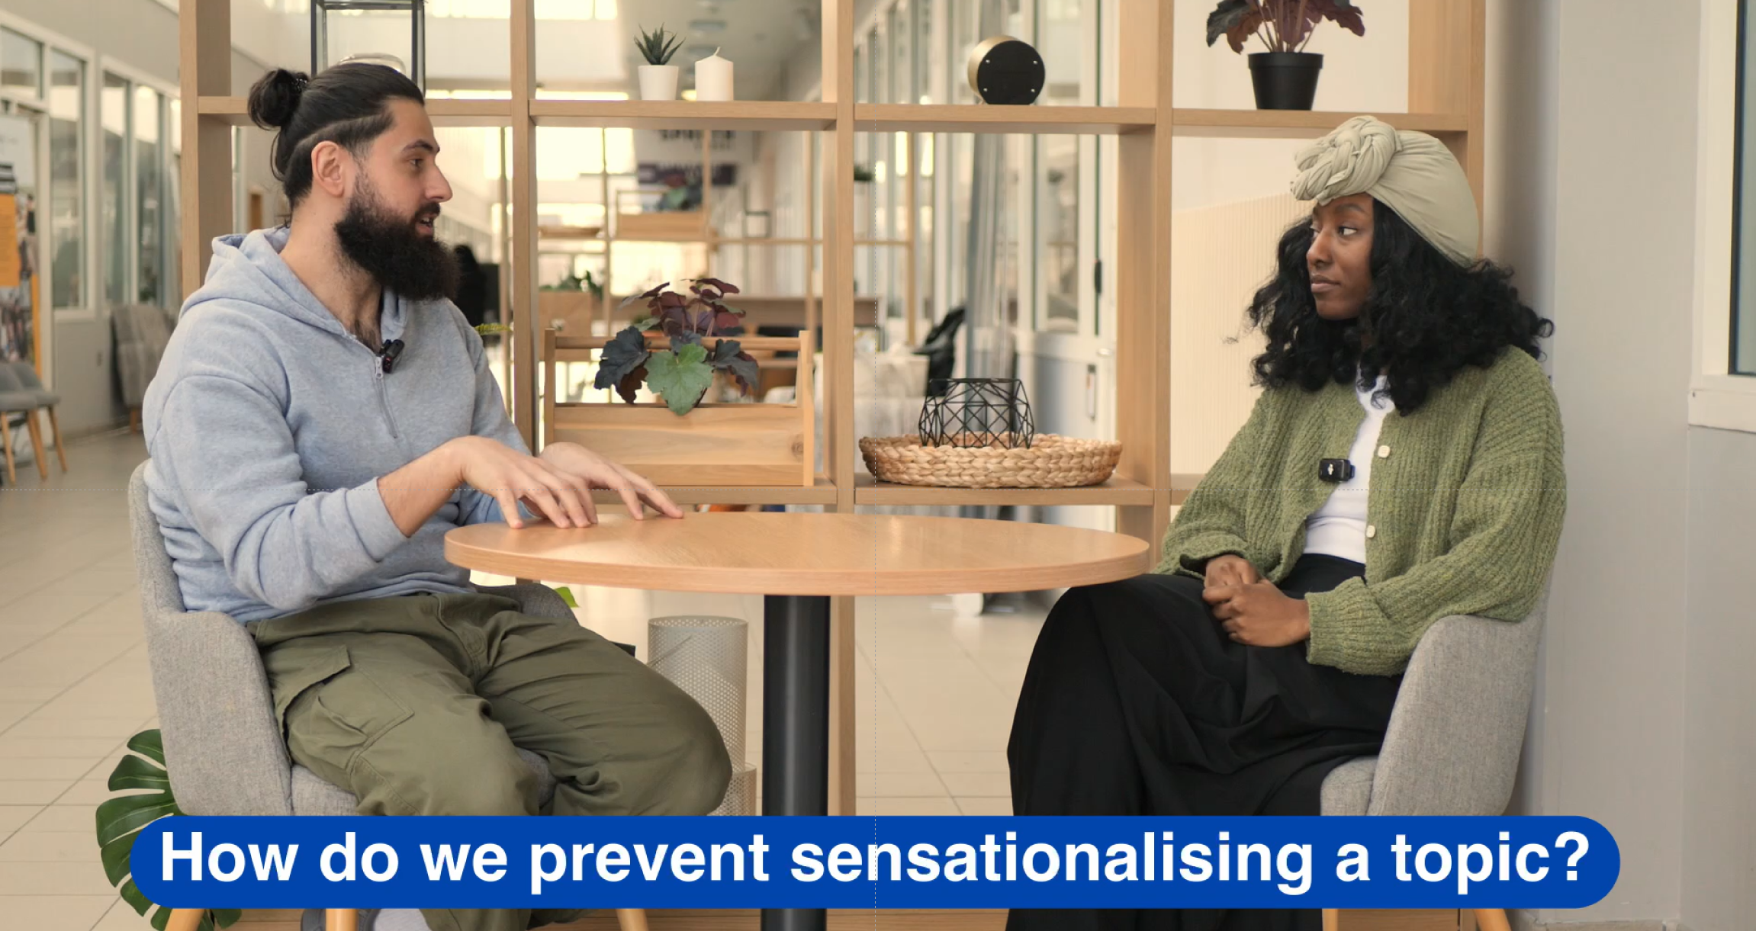
Notes:
OPTIONAL VIDEO: Facilitators discuss how to manage risk via avoiding sensationalizing certain controversial topics.

Slide 19
Summary
Risk is unavoidable in meaningful education
Avoidance can create harm
Mitigation is often collective
Professional judgement matters

