Slide 1
Online Influences
Lesson 1

Slide 2
Where do you get your news from?

Slide 3
First Impressions: real or fake?

Slide 4
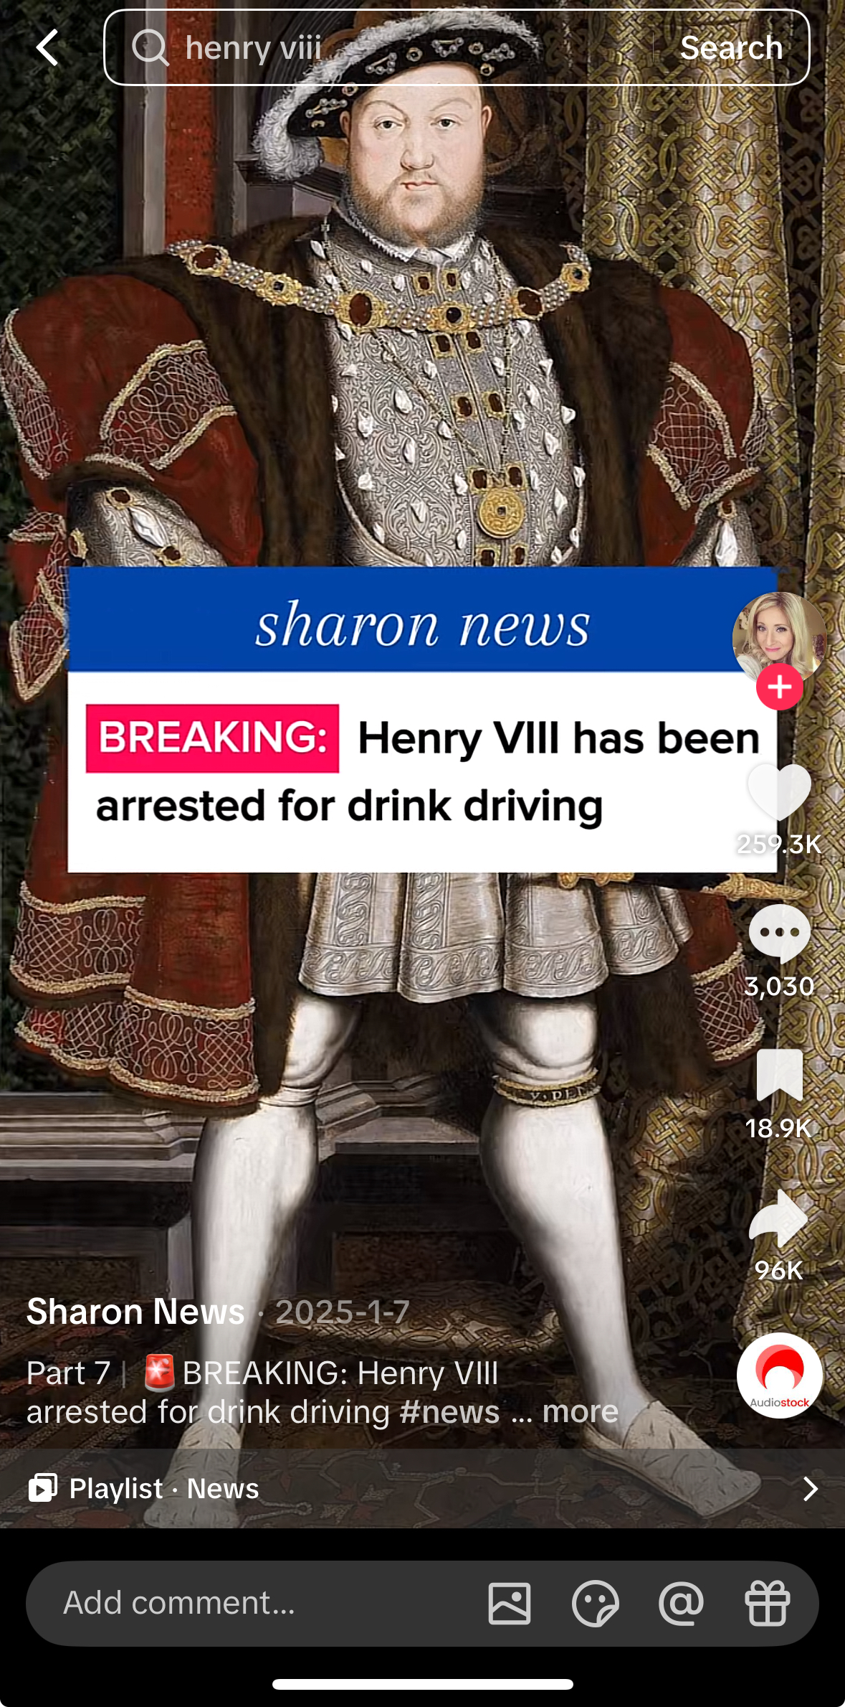
Henry VIII was arrested for drink driving

Slide 5
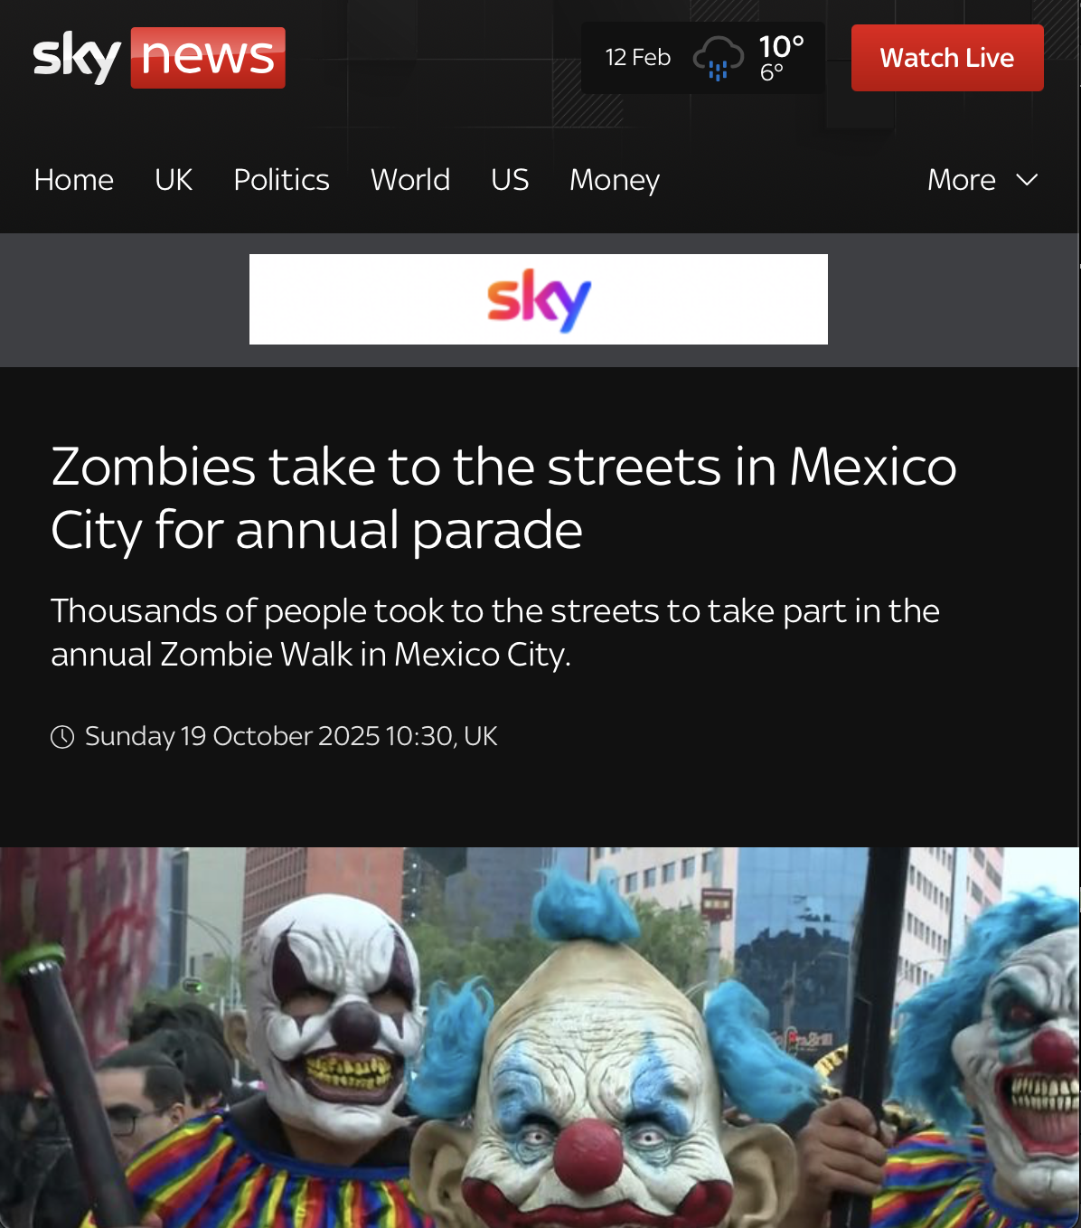
Zombies took over Mexico City last year

Slide 6
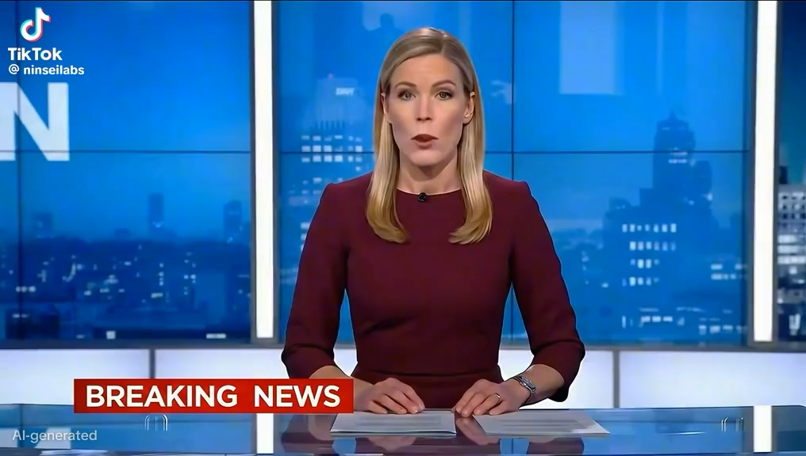
Birds are actually drones

Slide 7
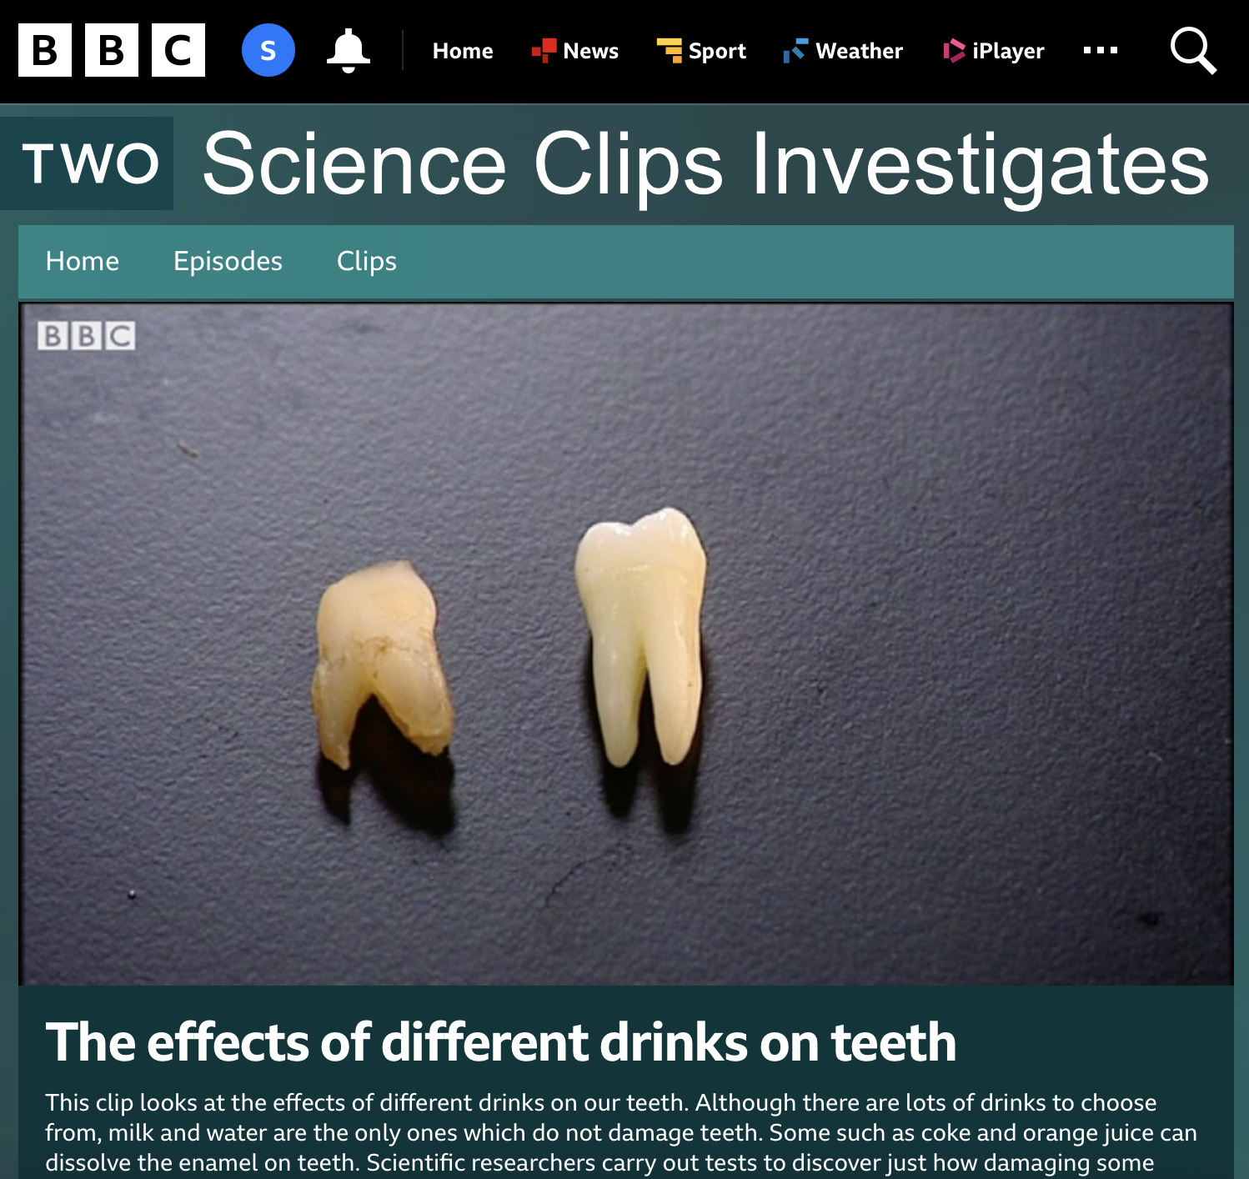
Sugary drinks rot your teeth

Slide 8
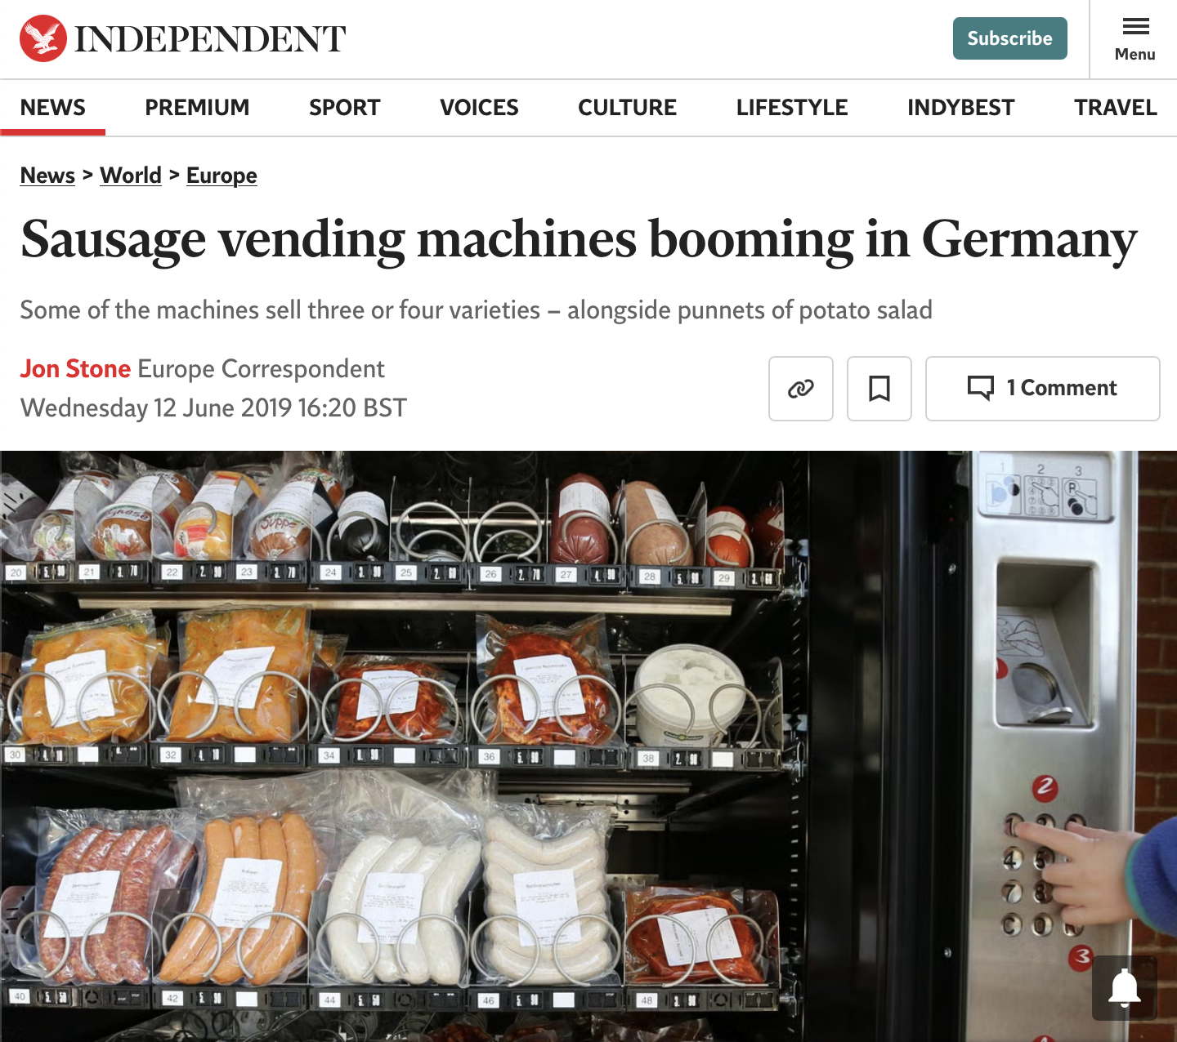
Germany loves vending machines filled with sausages

Slide 9

The banks are keeping moneymaking secrets from us

Slide 10
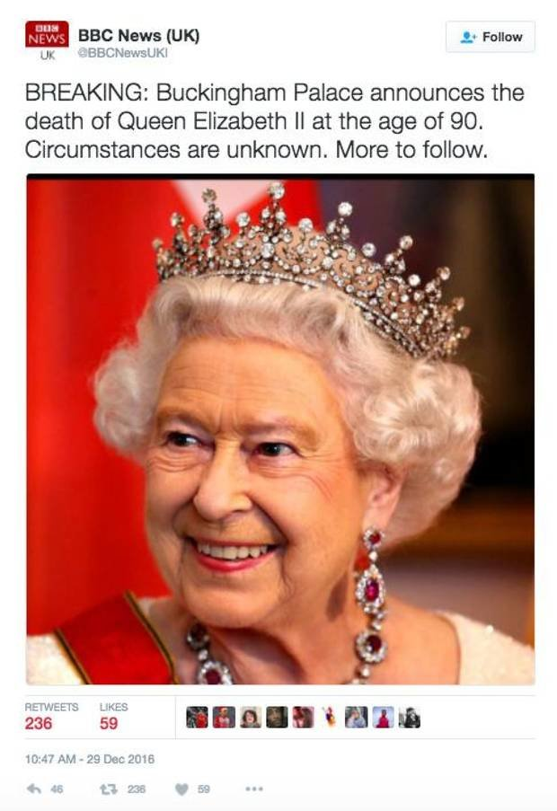
Queen Elizabeth II passed away in 2016

Slide 11
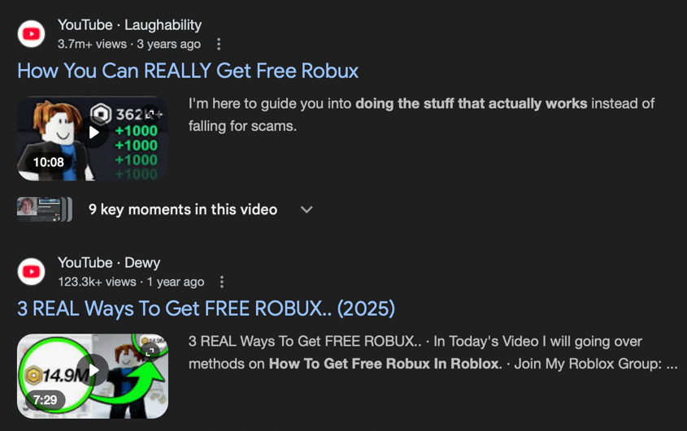
You can get free unlimited Robux

Slide 12
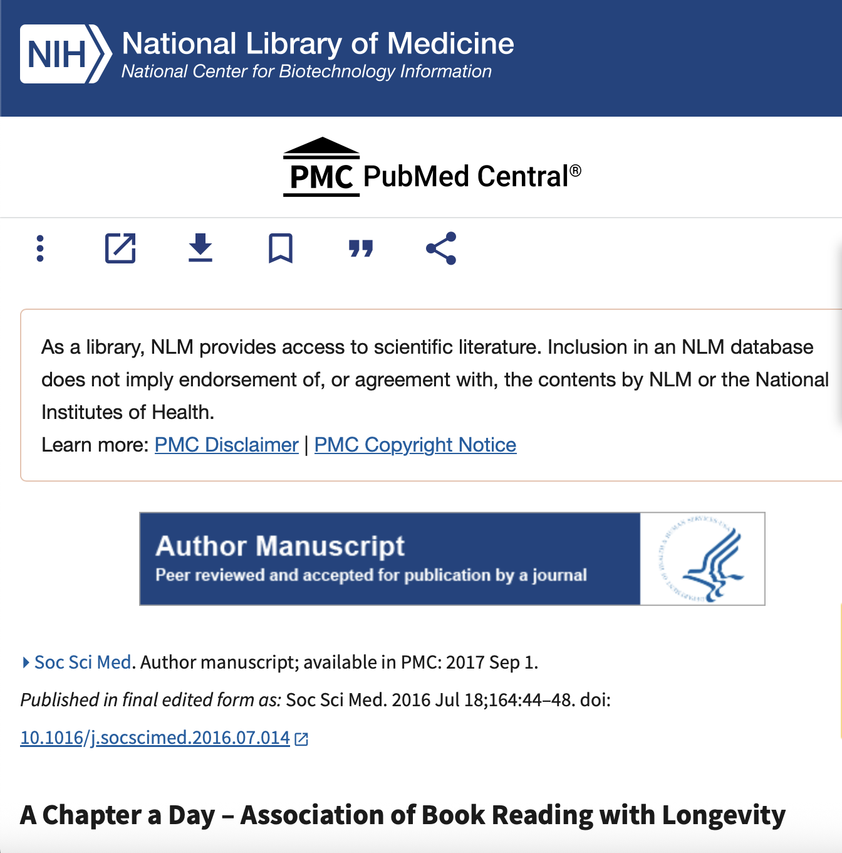
Reading makes you live longer

Slide 13
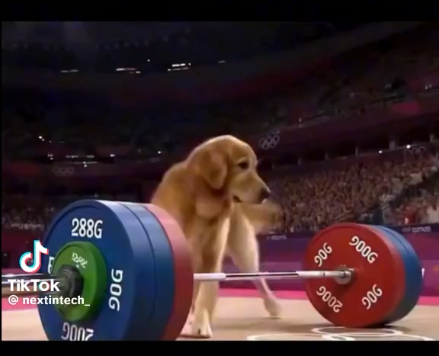
Dogs now compete in Olympic Powerlifting

Slide 14
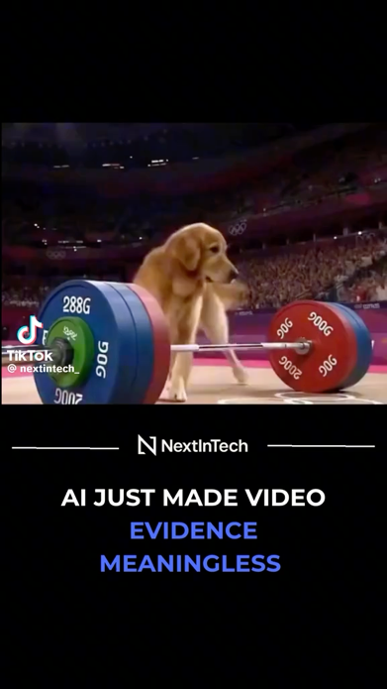
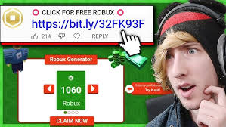
Fake – what do they share?

Slide 15
True – what do they share?

Slide 16
Manipulation Tactics

Slide 17
Physical
Fake experts
Giveaways
Edited images
Out of context clips from videos
Old news being reused as new
Deepfakes

Slide 18
Emotional
Peer pressure and left out
Feeling rushed
Pressure to avoid a consequence
Triggering sadness
Anger-driven
Fear-driven
Guilt inducing
“Everyone is watching this!”
“Last chance to watch!”
“Share this video or have bad luck”
“This is heartbreaking, share before it gets deleted”
“They’re lying to you. Wake up”
“This app is secretly spying on you, delete it NOW”
“If you don’t share this, you’re part of the problem”

Slide 19
The Amygdala
The Brain
Responsibilities:
Processing emotions
Memory formation
Emotional learning

Slide 20
AMYGDALA HIJACK!
Fear
Impulsivity
Elation
Action without thinking
Anger
Panic

Slide 21
Why?
Money
Political influence
Views, likes, shares
Status
‘Fun’

Slide 22
Wrap Up
Write on the post it note 2 manipulation tactics and 1 reason for them

Slide 23
User-Generated vs Journalism
Lesson 2

Slide 24
Activity
What is user generated content and what is journalism?
Write down what you think each are
Any examples?

Slide 25
Journalism Code of Conduct
Source Verification
Fact Checking
Expert Consultation
Ethical Standards

Slide 26
Source Verification
Select official first-hand documents over second-hand reports
Evaluate credibility, expertise and bias of information providers
Find multiple confirming sources

Slide 27
Fact Checking
Ensure quotes and data are not taken out of context
Two-layer principle: reporters gather news and fact-checkers verify details
Use official data: government statistics, financial records, scientific papers

Slide 28
Expert Consultation
Seek opposing viewpoints to ensure a balanced story
Consult subject experts and specialists to verify technical details
Check for conflicts of interest from experts

Slide 29
Ethical Standards
Promptly acknowledge and correct any errors made
Aim for transparency throughout the process
Cite sources for readers to verify information themselves

Slide 30
Remember: CRAPPY
Check In
Recent
Accreditations
Purpose
Pair
Your thoughts

Slide 31
Check In
Recent
Accreditations
Purpose
Pair
Your thoughts
How are you feeling after seeing it?
Is the information recent?
Are the authors trusted and reliable?
What is the purpose of the information?
Can you pair it with another source?
What are your thoughts?

Slide 32
Activity
10 minutes
Get into pairs - you are now journalists
Find a piece of user-generated content
Use the CRAPPY system to go through it and correct any shortcomings

Slide 33
Wrap Up
Write on the post 2 things you could do to check content is reliable.
Bonus points for writing 2 things journalists must do before releasing a story

Slide 34
Algorithms
Lesson 3

Slide 35
“How did I end up here?”
Have you ever opened TikTok or YouTube to watch one video... and an hour later realised you're still scrolling?
Explore: Where did you start and where did you end up half an hour in?
Did you choose these video's or were they chosen for you?

Slide 36
Activity
Read the tweets
Place the cards on the arrow as to where you think they fit
Green – basic, harmless posts
Orange – confusing, emotional or ‘dark humor’ posts
Red – false, dangerous and/or extreme posts

Slide 37
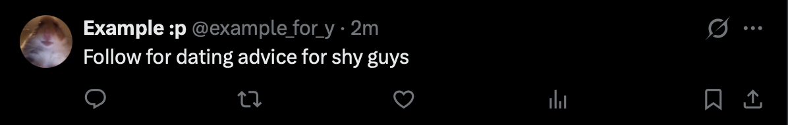
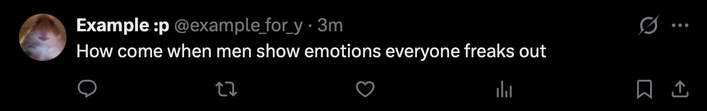
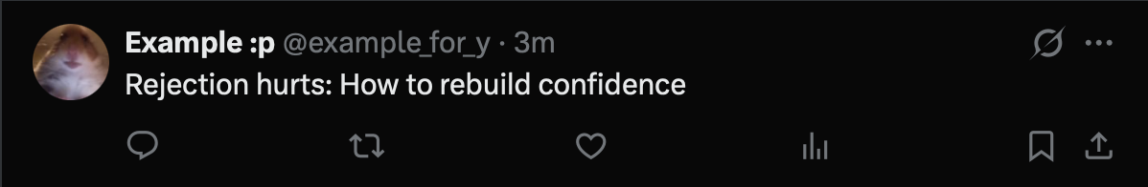
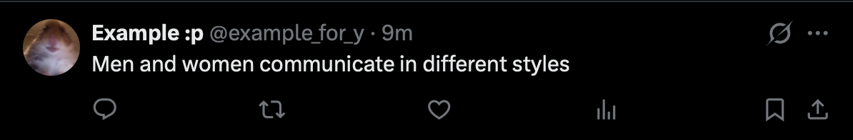
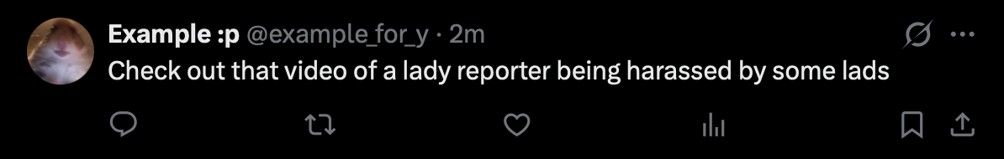
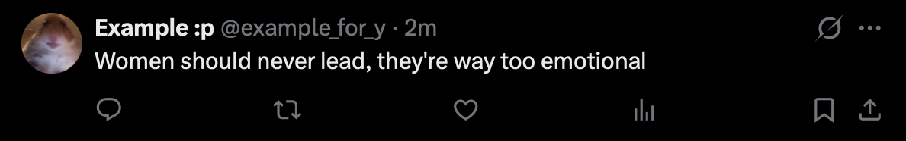
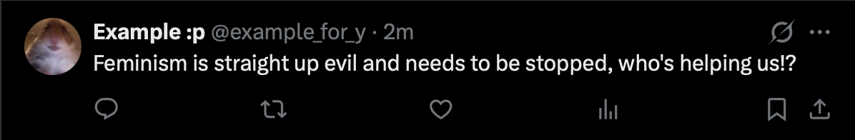
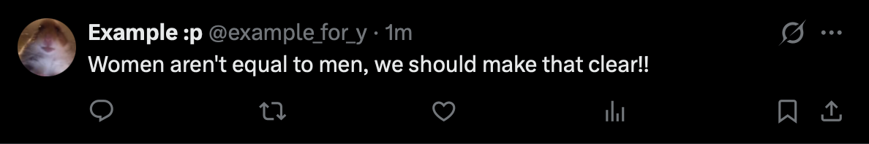
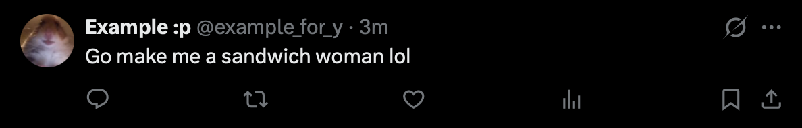

Slide 38

Harmless
Problematic
Dangerous

Slide 39
How many did you correctly identify?
Were any of the tweets difficult to place?
Any disagreements between groups?
Is there a pattern?

Slide 40
How do these make you feel?
Does it spark emotion?
Does it keep people watching?
Does it fit a pattern of increasingly extreme content?
Rewrite one harmful message into a healthy respectful one

Slide 41
Questions to ask yourself
Who made this?
What emotion is it trying to make me feel?
Does it have a trusted source?
Am I being rushed or pressured?

Slide 42
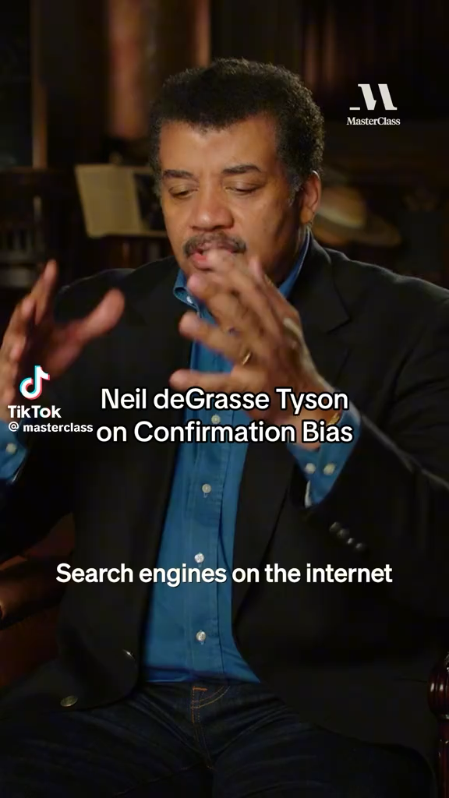

Confirmation Bias
Confirmation Bias
We believe what fits with what we already think
- We trust familiar ideas more than challenging ones
- 80% more likely to share news that matches our political views
-
Algorithms
- Platforms track what we click, like, and watch
- More engagement = more of the same content
- Your feed is personalized to keep you hooked — not informed
The Comfort Zone Effect
- It feels good to be “right.”
- We avoid ideas that challenge us
- Algorithms + confirmation bias = intellectual bubble
Media Shift Indicator
Traditional news audiences are shrinking
Social media is now a primary news source for many
Social feeds prioritize engagement over balance
Content increasingly aligns with existing beliefs

Slide 43
Activity
‘A student, Alex, has been accused of cheating on his Biology GCSE exam’
Here’s what we know:
Alex improved dramatically from the last exam
A phone was found in his backpack
A student claims Alex looked at something in the exam
Guilty or Not Guilty?

Slide 44
‘A student, Alex, has been accused of cheating on his Biology GCSE exam’
More evidence is being revealed:
Alex was seen whispering during the exam
The phone in his bag was turned off
Alex has been working with a tutor prior
Alex was whispering for a tissue in the exam
No exam answers were found on the phone
Alex searched exam-related topics the night before
Guilty or Not Guilty?

Slide 45
‘A student, Alex, has been accused of cheating on his Biology GCSE exam’
Did you interpret the new evidence differently depending on your first choice?
If you thought Guilty first, did innocent evidence seem weak?
If you thought Not Guilty first, did suspicious evidence seem exaggerated?
Who changed sides? Why?
Confirmation bias affects our opinions
and how we interpret new information

Slide 46
Activity
Alex’s case is now trending online
Divide into two groups:
  ‘Pro-Guilty Feed’
  ‘Pro-Innocent Feed’
Design 3 social media posts that would get the most engagement from your feed
  Eg. ”TOP STUDENT CAUGHT CHEATING!?”

Slide 47
Alex’s case is now trending online
If someone clicks one post, what will the algorithm show them next?
After a week, what would each group believe?
Would both groups think they have all the facts?
Confirmation bias shapes how we interpret evidence.
Algorithms decide how much of that evidence we see.

Slide 48
Wrap Up
Imagine you watched five videos about aliens being real:
What might YouTube recommend next?
How might that affect what you believe over time?

